Slide 1
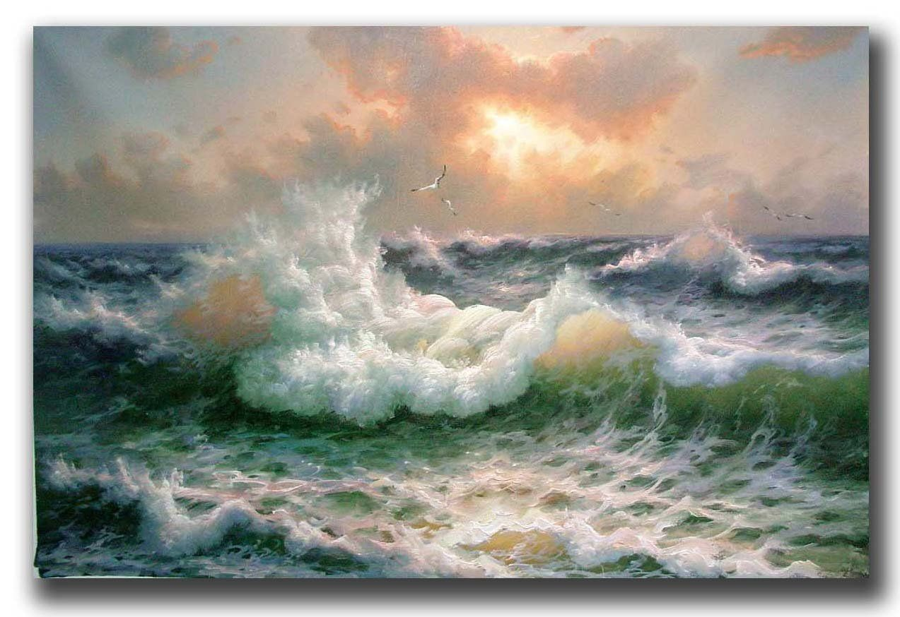
Coastal Dynamics 2021
June 28th - July 2nd
HyTCWaves:
A Hybrid Methodology for Downscaling Tropical Cyclone induced Wave Climate
Sara Ortega van Vloten
PhD student, University of Cantabria

Slide 2
HyTCWaves: Motivation
HyTCWaves
NUMERICAL SIMULATION
TC Paka
Category 3
Jan-Feb 1990
OBJECTIVE: Extreme Value Distribution for TC-induced wave height

Slide 3
HyTCWaves: Proposed methodology
HyTCWaves
DYNAMIC DOWNSCALING
Storm selection
Numerical modelling
Wind field,
SWAN
TARGET LOCATION
EXTREME VALUE DISTRIBUTION OF TC-INDUCED WAVE HEIGHT
HYBRID DOWNSCALING
“HyTCWaves”
Storm track parameterization
Storm selection
Numerical modelling
Reconstruction
Parameters {$Pmin,Vmean,δ,γ$}
Maximum Dissimilarity Algorithm
Wind vortex,
SWAN
Radial Basis Functions

Slide 4
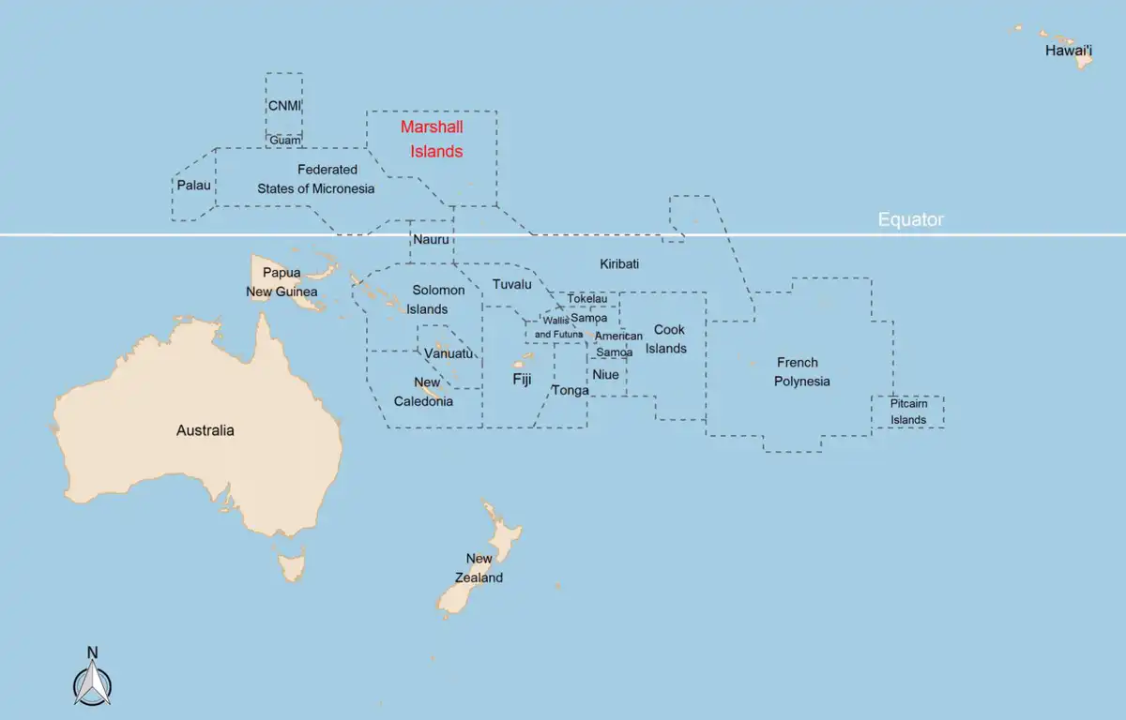
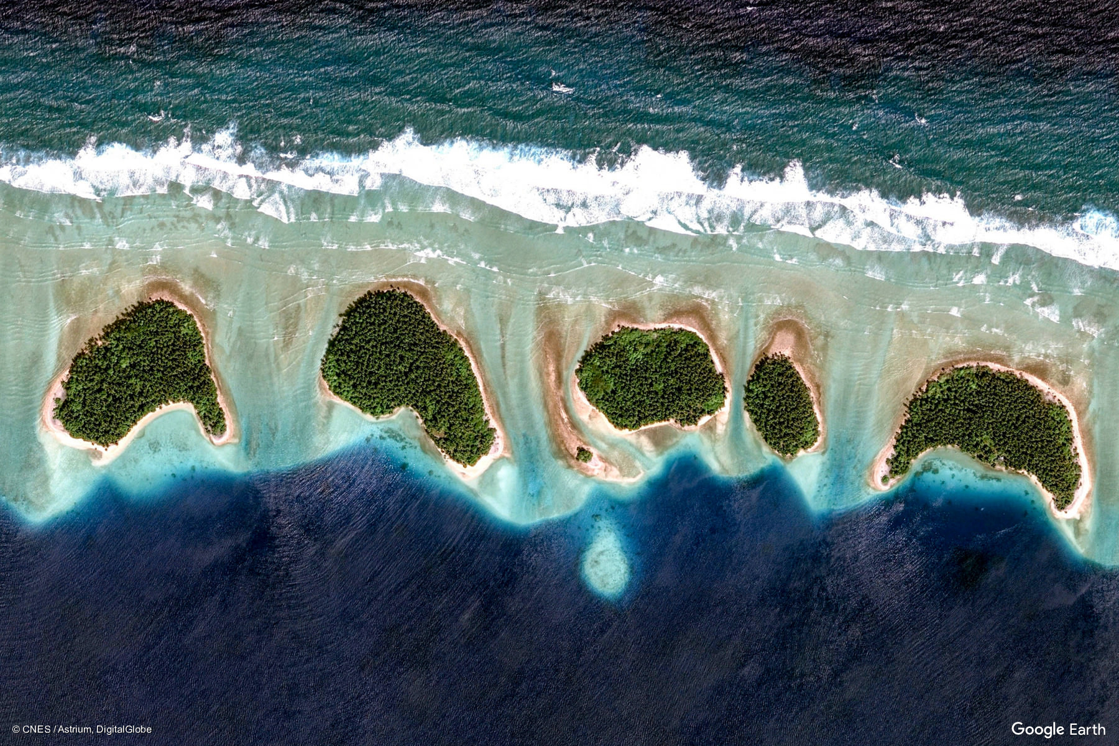
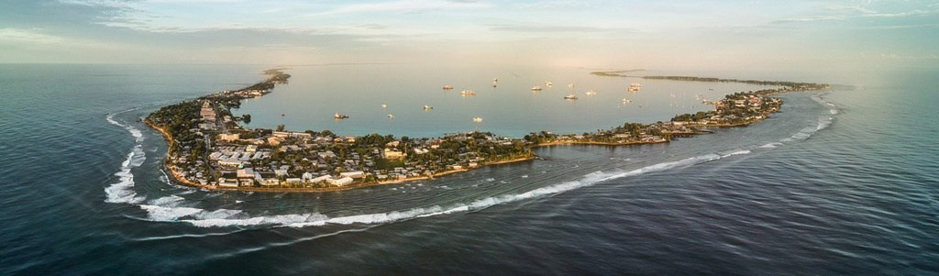
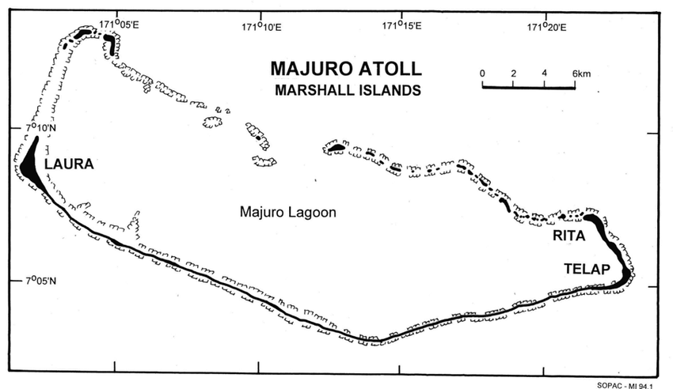
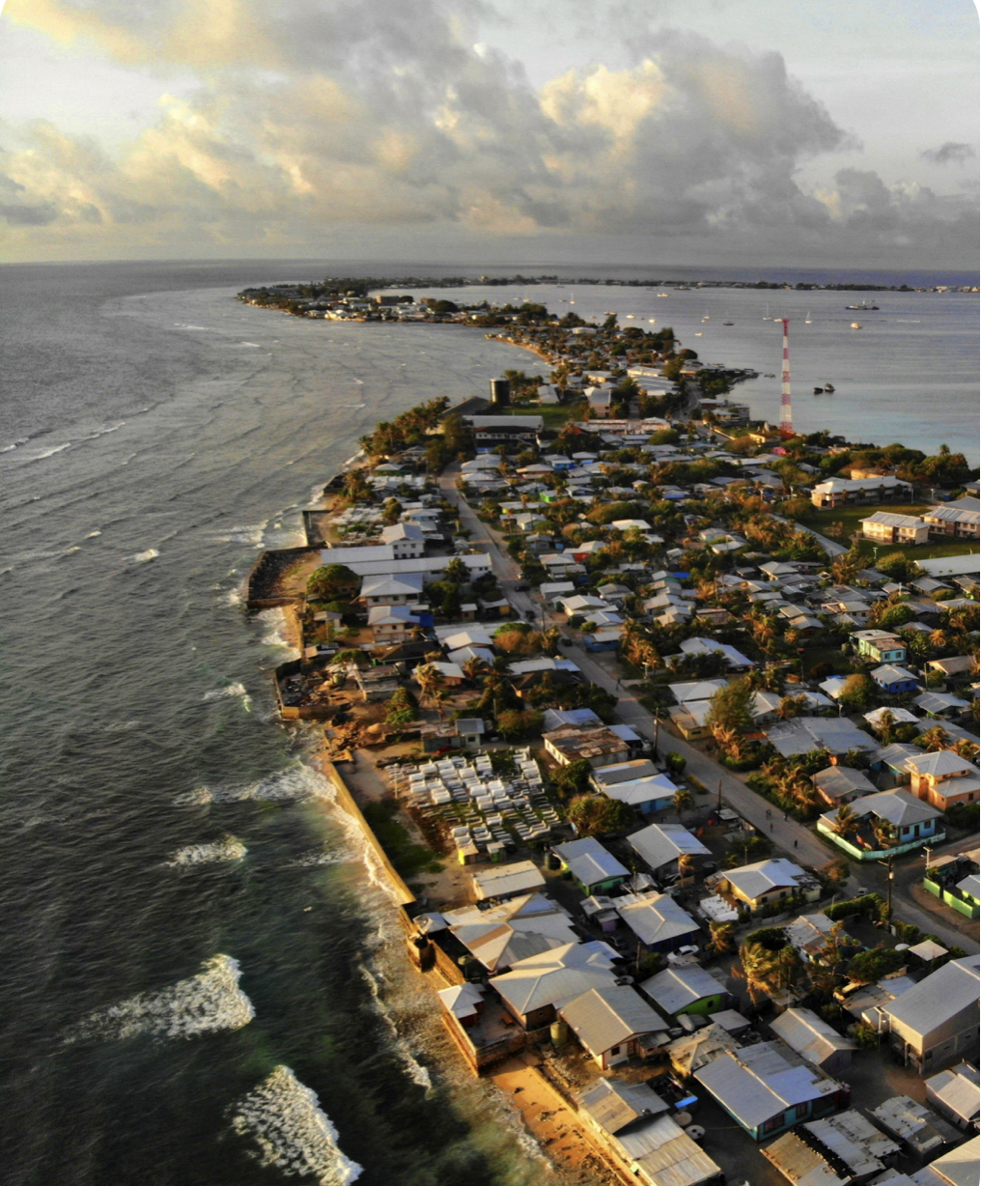
HyTCWaves: Target location
Marshall Islands
A
B
A
B
C
AIRPORT
D
D
C

Slide 5
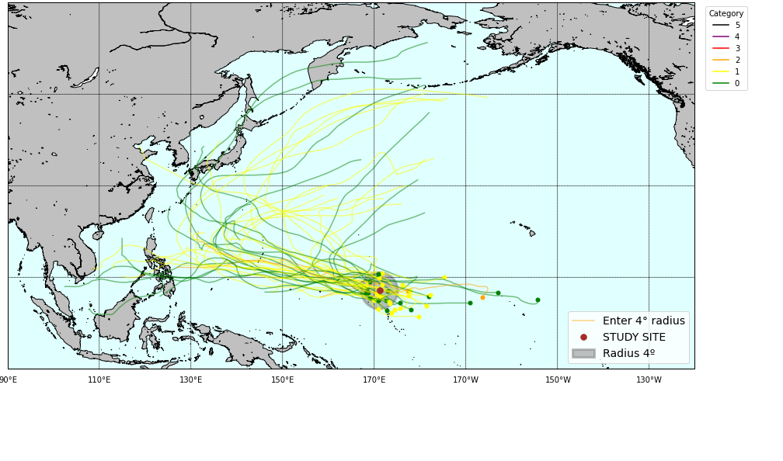
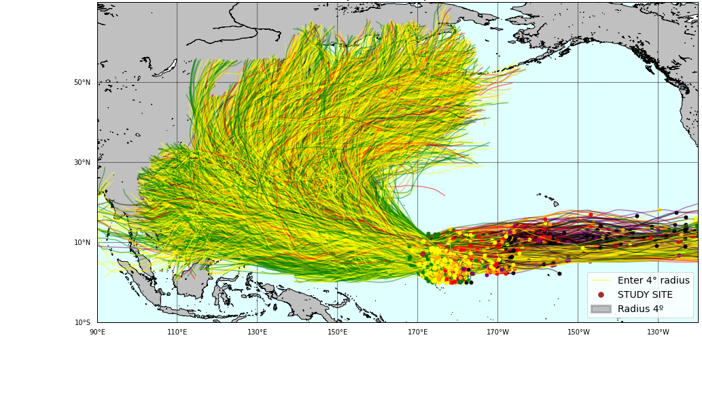
HyTCWaves: Storm databases
HyTCWaves
Historical database
Synthetic database
Storm tracks
IBTrACS
Nakajo et al. 2014
Target: Majuro
37 tracks 1951-2021
10.064 tracks 10.000 years

Slide 6
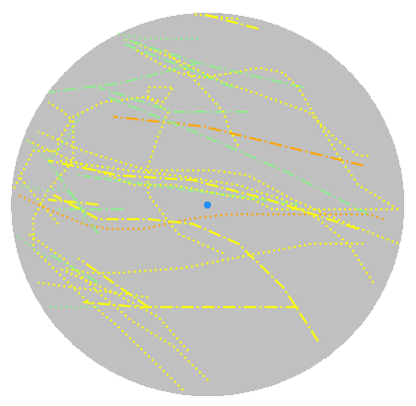
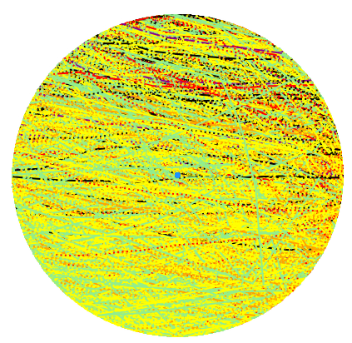
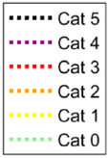
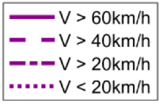
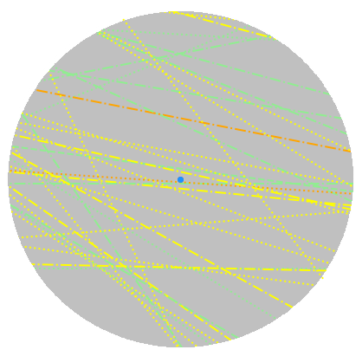
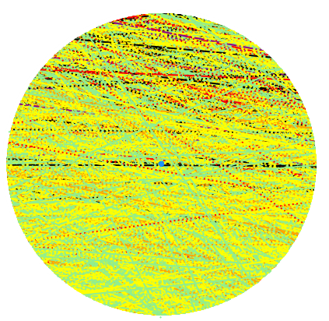
HyTCWaves: Track parameterization
HyTCWaves
Historical
Synthetic
Storm track parameterization
- Minimum central pressure
- Mean translational velocity
- Angle of entrance
- Angle of forward direction
$$δ$$
Pmin
Vmean
$$γ$$

Slide 7
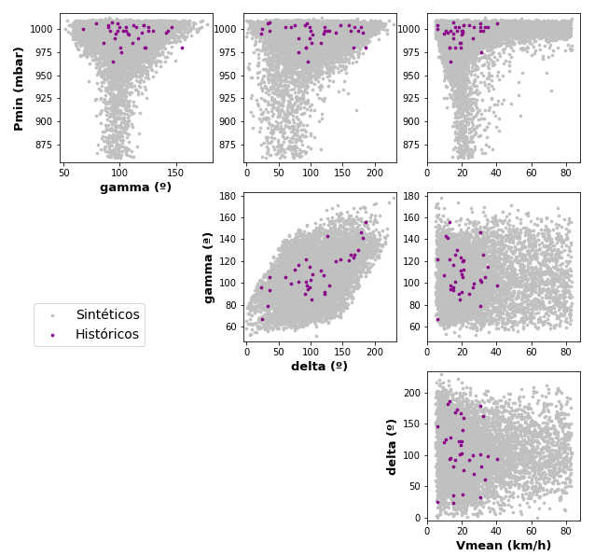
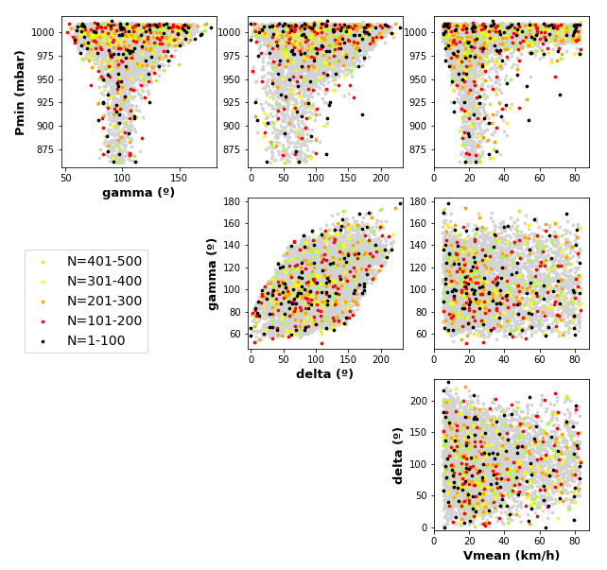
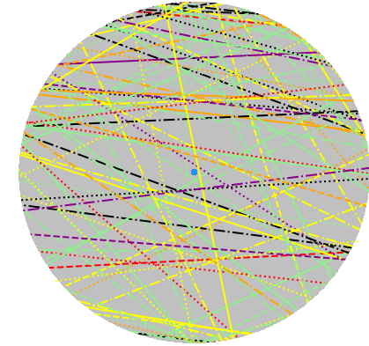
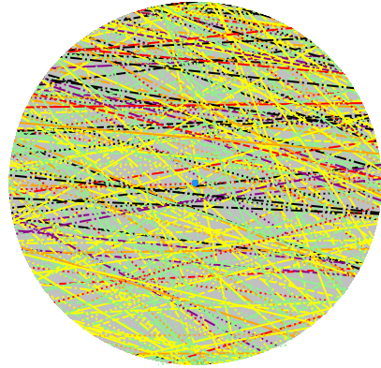
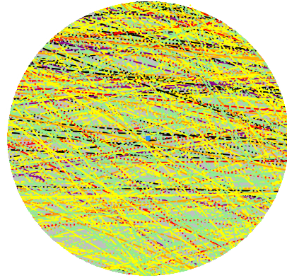
HyTCWaves: Storm selection
Maximum
Dissimilarity
Algorithm
$X_{i}={\left\{p_{min},v_{mean},δ, γ\right\}}_{i}$
N = 8.773 (dataset)
M = 500 (subset)
FILTERING SYNTHETICS
$p_{min}$ > 860mbar
$v_{mean}$ < 83km/h
$δ$ < 270º
$γ$ > 40º
Historical
Synthetic
M=100
M=300
M=500

Slide 8
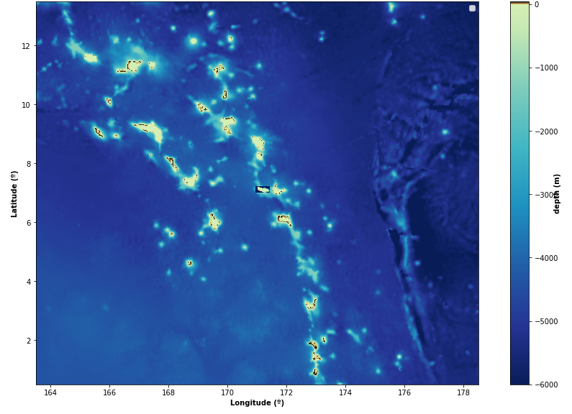
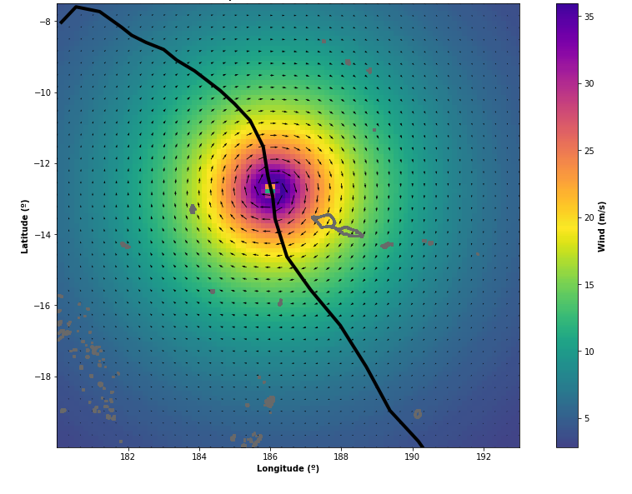
HyTCWaves: Numerical Modelling
HyTCWaves
Bathymetry
GEBCO (450m)
Numerical modelling
SWAN
Parameterized wind
Non-stationary mode
Dynamic wind fields
Wind drag coefficient
Propagation processes
DYNAMIC HOLLAND MODEL
(Holland 1980, Fleming et al. 2008)
Latitude (lat)
Translation speed ($v_{mean}$)
Minimum central pressure ($p_{min}$)
Maximum wind speed ($v_{max}$)
Radius of maximum wind ($R_{mw}$)
Vortex model wind field
Storm duration

Slide 9
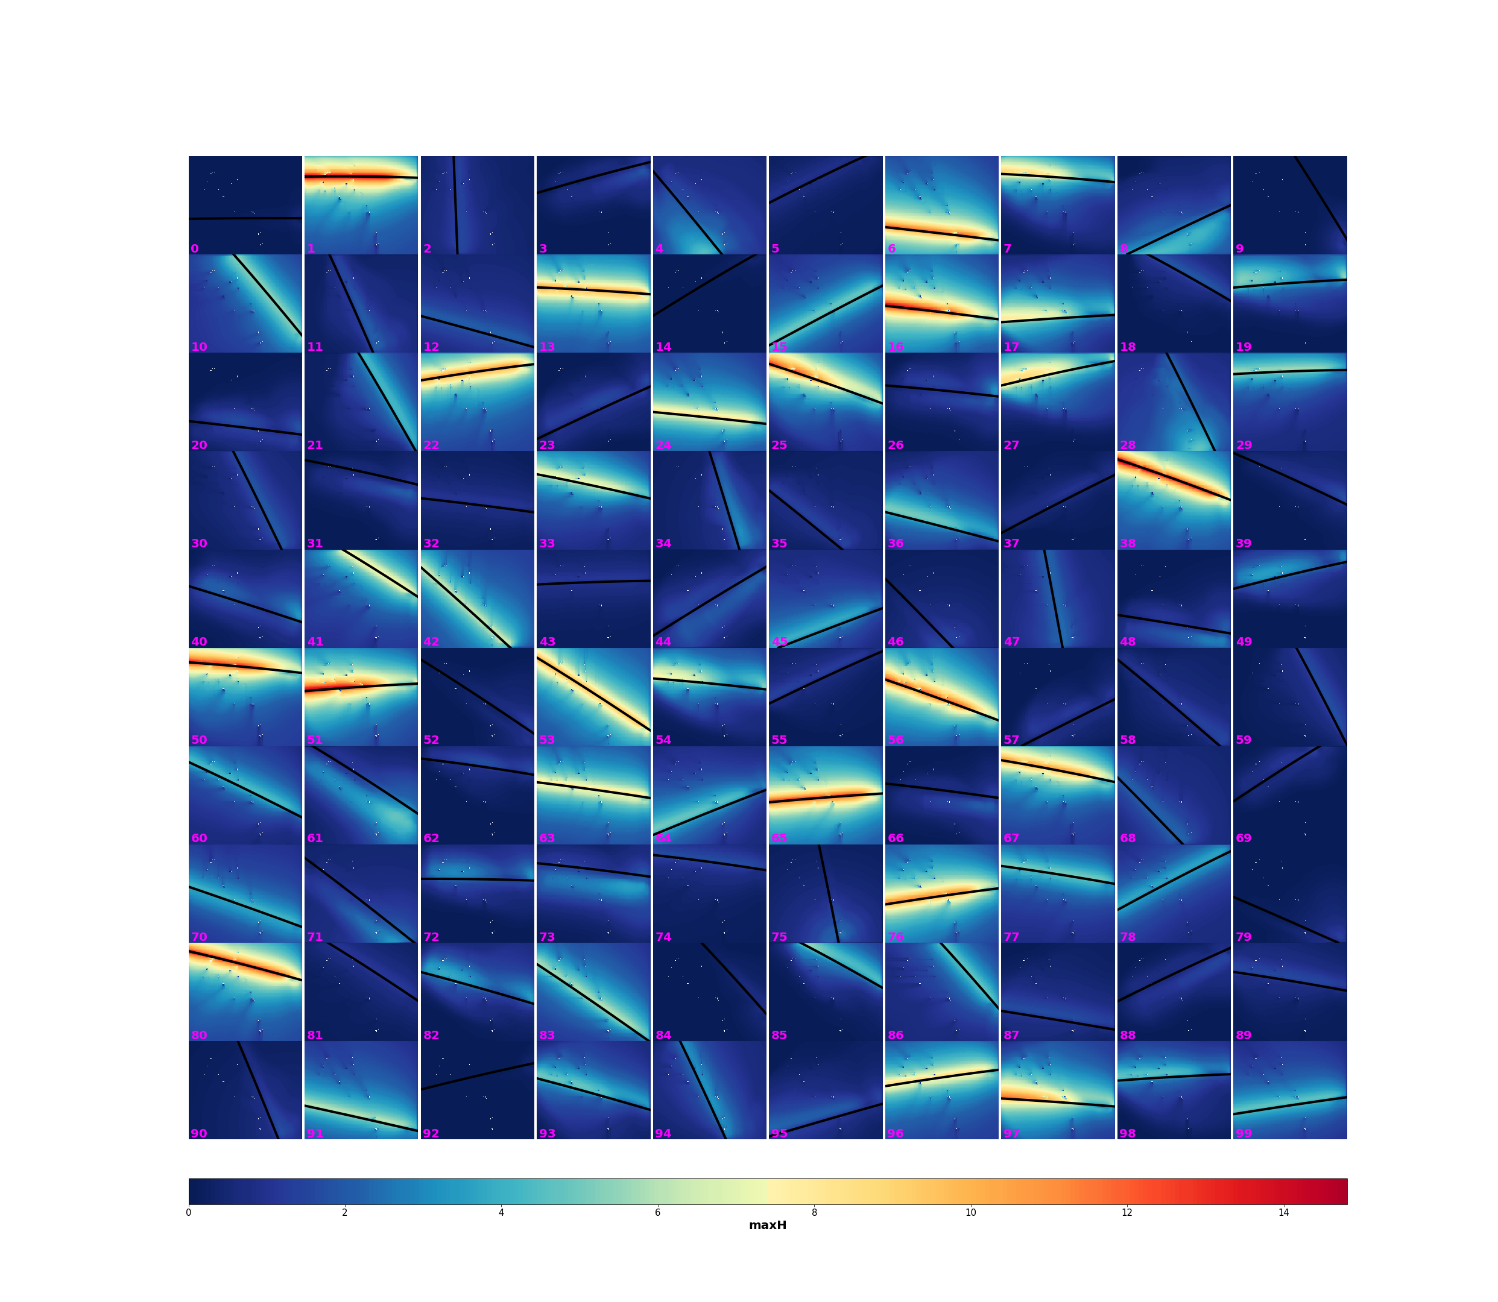
HyTCWaves: Numerical Modelling
HyTCWaves
First 100 cases…
Output results: maximum significant wave height (swath maps)
Total simulation time: 5-days with an 8-processor computer

Slide 10
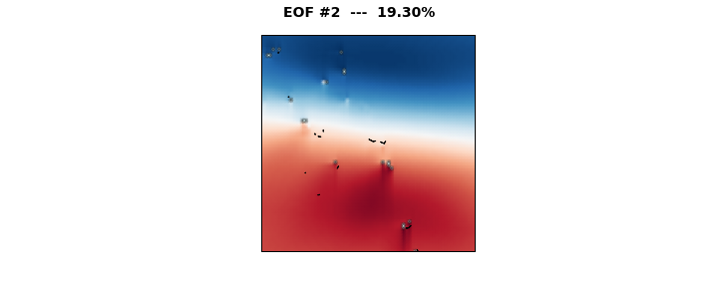
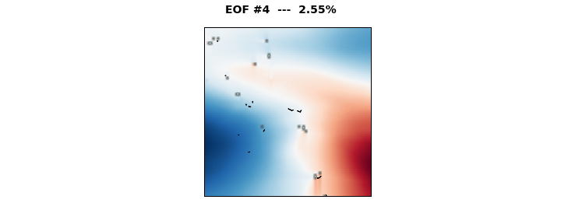
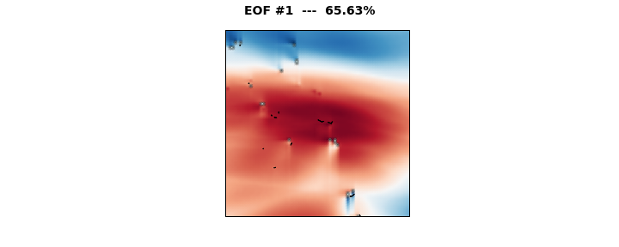
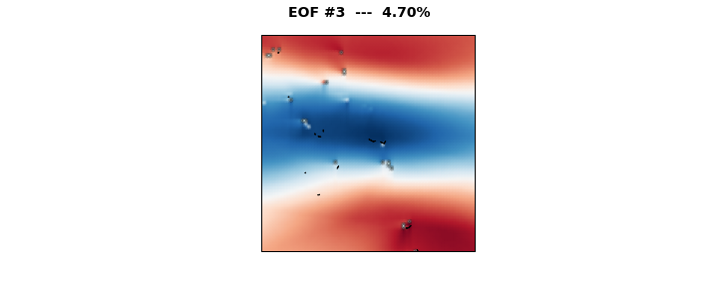
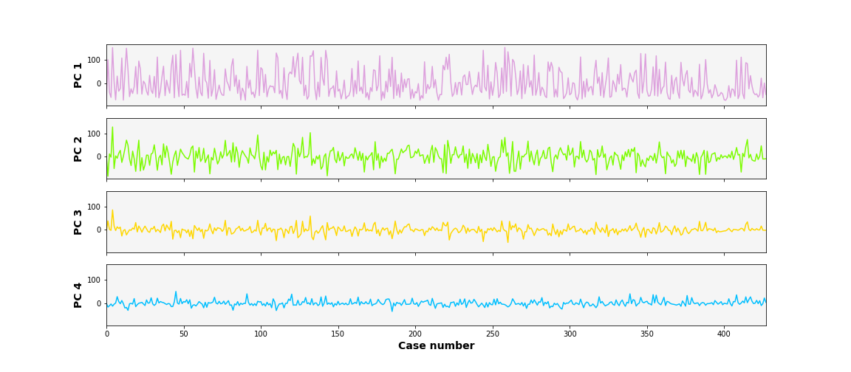
HyTCWaves: Reconstruction
HyTCWaves
Principal Components Analysis
M cases
Hsmax_{i}
Simulated (case 100)
50 PCs composition

Slide 11
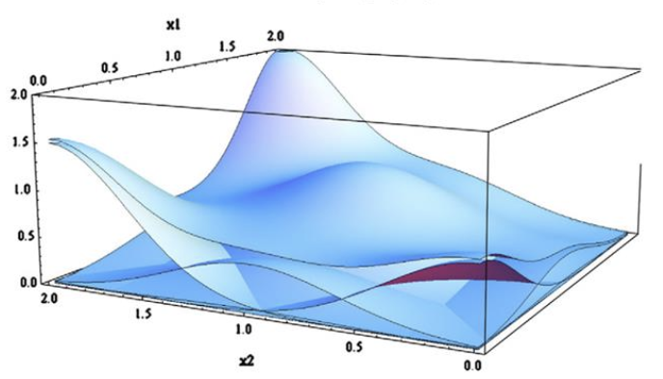
HyTCWaves: Reconstruction
HyTCWaves
Camus et al. 2011
Interpolation based on
Radial Basis Functions
Design vectors
M=500 simulated tracks
$$X_{j}={\left\{P_{min},{ V}_{mean},δ, γ\right\}}_{j=1,M}$$
$$D_{j}={\left\{{PC}_{1},{PC}_{2},…,{PC}_{50}\right\}}_{j=1,M}$$
Input vector
N=8.773 synthetic tracks
$$X_{i}={\left\{P_{min},{ V}_{mean},δ, γ\right\}}_{i=1,N}$$
$$y\left(X_{i}\right)≅RBF\left(X_{i}\right)=p\left(X_{i}\right)+ \sum_{j=1}^{M}{a_{j} φ\left(\left\|X_{i}−D_{j}\right\|\right)}$$
Interpolation functions for each PC
$$φ\left(\left\|X_{i}−D_{j}\right\|\right)=\exp\left(−\frac{{\left\|X_{i}−D_{j}\right\|}^{2}}{2c^{2}}\right)$$
CROSS VALIDATION
Reconstructed
Reconstructed
Reconstructed
Reconstructed

Slide 12
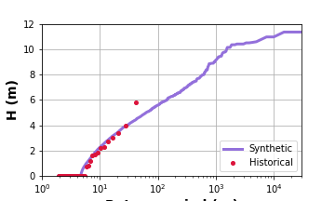
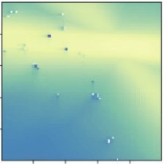
HyTCWaves: Extreme Value Distribution
HyTCWaves
22 tracks
1979-2021
$λ=0,52$
tracks/year
40y - Historical
40y - Synthetic
8.773 tracks
~15.000 years
Poisson distribution of number of events per year
Extreme value distribution of TC-induced maximum wave height (at CP )
0
1
0
2
1
0
·····
3
0
1
1
0
200y - Synthetic
Year_{i}
Random reconstructed Hsmax
Annual maximum
Return period (years)

Slide 13
HyTCWaves: Conclusions
HyTCWaves
A metamodel capable of estimating wave conditions from geometric, kinematic and dynamic parameters of a tropical cyclone has been developed
Estimation of the extreme value distribution of TC-induced maximum significant wave height
The hybrid approach allows to reduce computational effort
Future lines of work:
Sensitivity analysis on the number of selected cases
Improve the track parameterization with additional variables to characterize the temporal variability of the TC intensity
Better approximation of the track geometry to also account for time-series swell waves

Slide 14
Coastal Dynamics 2021
June 28th - July 2nd
Thank you
sara.ovanvloten@unican.es
Acknowledgements
This work is funded by the Spanish Ministry of Science and Innovation, National Project “Beach4Cast” (PID2019-107053RB-I00).

