Slide 1
Hybrid Methods To Downscale Swells To Coral Reef-Lined Coasts
Alba Ricondo,
Laura Cagigal, Nicolás Ripoll, Ana Rueda and
Fernándo J. Méndez
Geomatics and Ocean Engineering Group. Universidad de Cantabria, Santander, Spain
alba.ricondo@unican.es
Ge cean
UNIVERSIDAD DE CANTABRIA
Image from www.freepik.es

Slide 2
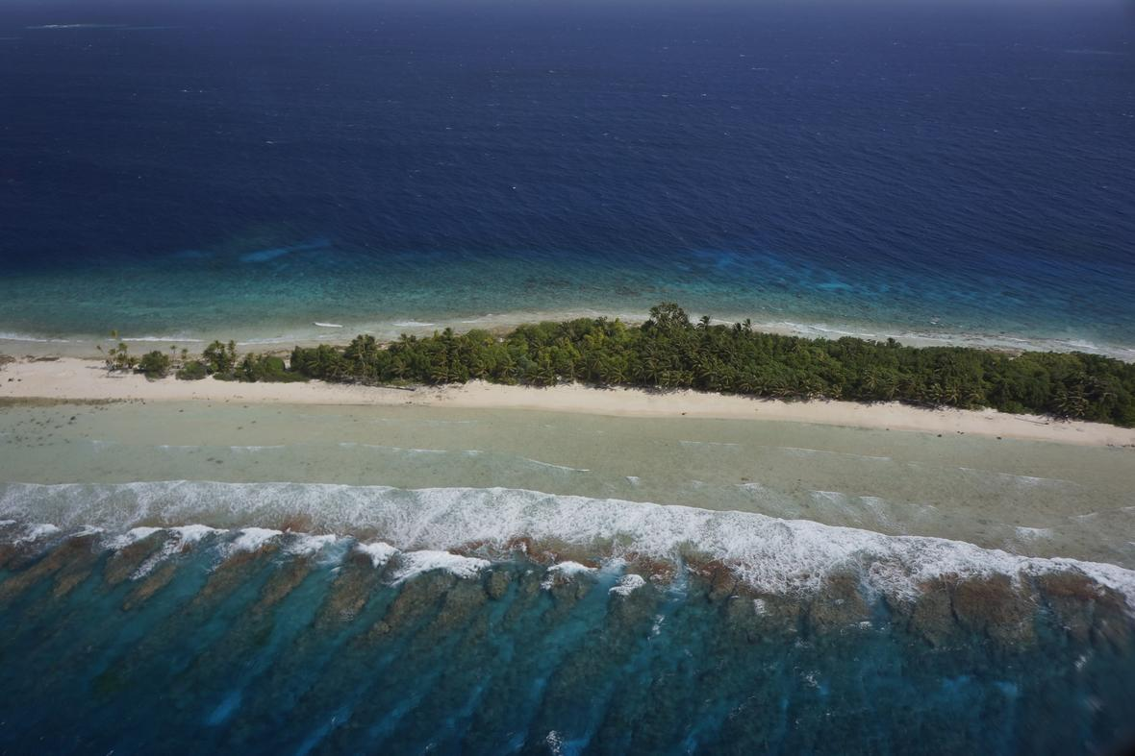
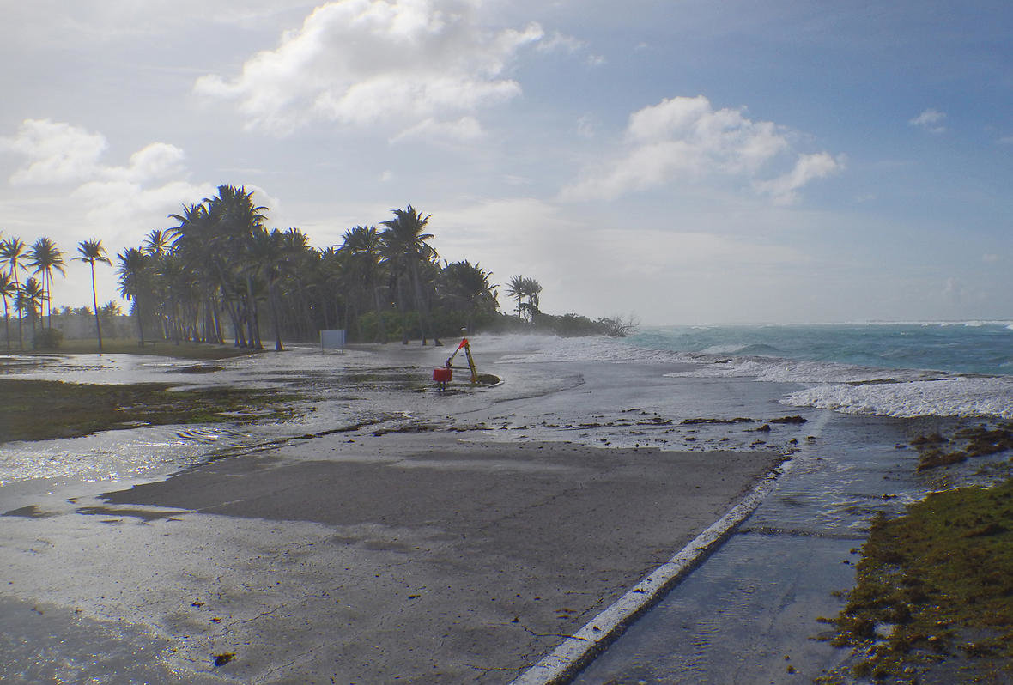
Introduction: Coral Reefs
Coral reefs provide a natural barrier to protect coastal cities, communities and beaches from storm surges and waves
Low-lying atolls (< 3m altitude) frequently exposed to wave-driven inundation events
Coastal hazards are expected to increase in the future with predicted climate change
Kwajalein coral reef, Source: USGS
1/17
Inundation event in Roinamur, Source: USGS

Slide 3
Motivation
Classical Dynamical Downscaling
Hybrid Methods
Huge amount of data
Accurate but computationally expensive
Statistical + Dynamical Tools
Reduce significantly the amount of data
Fast and efficient
Early Warning Systems
Inundation forecast
2/17

Slide 4
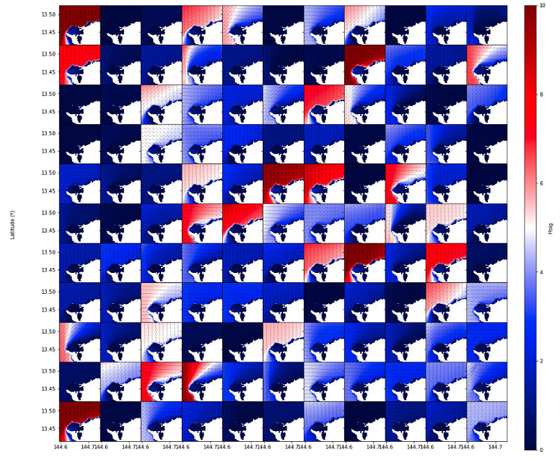
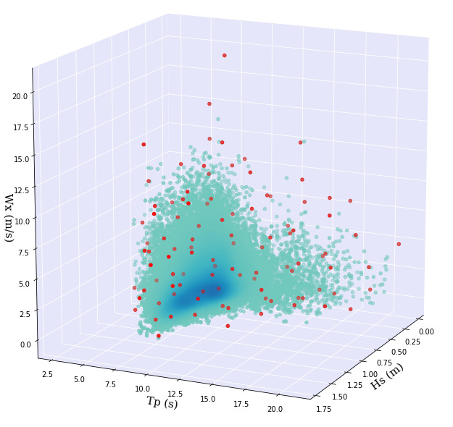
Wave-driven inundation metamodels
MDA
Maximum Dissimilarity Algorithm
Dynamical Modelling
SWAN - SWASH
RBF
Radial Basis Functions
Propagation
Interpolation
Selection
dataset
subset
3/17

Slide 5
Wave-driven inundation metamodels
Offshore
Nearshore
Flooding
Wind-Wave conditions
Wind-Wave conditions
Overtopping volumes
+
Sea: $H_{s}, T_{p}, θ_{m}, σ,γ$, $W_{spd}$, $W_{dir}$
Tide
Swells: $H_{s}, T_{p}, θ_{m}, σ,γ$
$$q, R_{u2\%}$$
$H_{s}, T_{p}$, $W_{spd}$, $W_{dir}, η$
HyWaves
HySwash
4/17

Slide 6
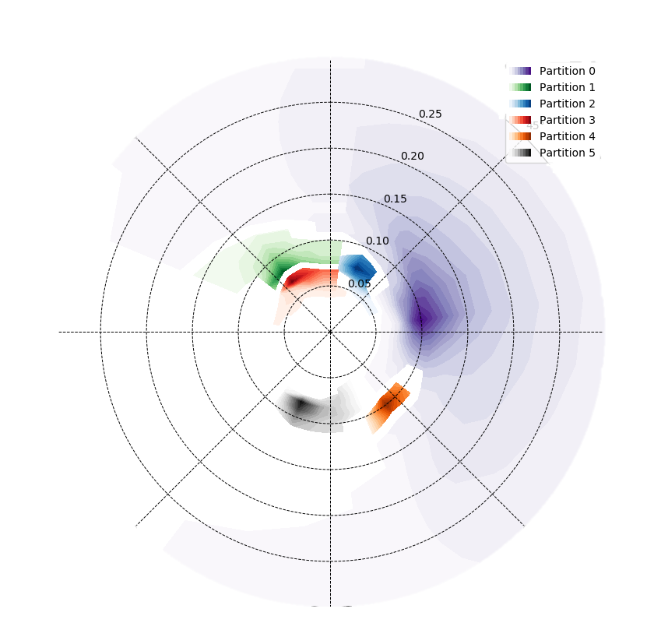
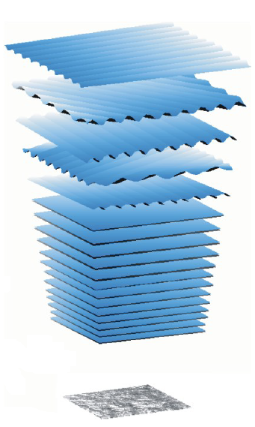
HyWaves: Methodology
Offshore wave dataset
SPECTRAL PARTITIONING
Sea
$$H_{s}, T_{p}, θ_{m},$$
$σ,γ$, $W_{spd}$, $W_{dir}$
Swells
$$H_{s}, T_{p}, θ_{m},$$
$$σ,γ$$
MDA
MDA
SWAN
SWAN
RBF
RBF
AGGREGATION
(Holthuijsen, 2007)
$$S_{t}\left(f,θ\right)=\sum_{i=1}^{N_{wave systems}}{S_{i}\left(f,θ\right)}$$
VALIDATION
5/17

Slide 7
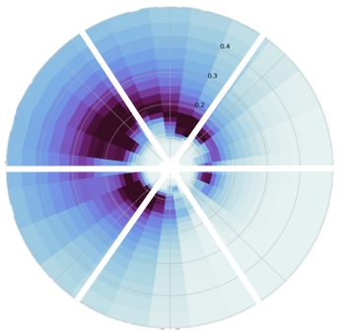
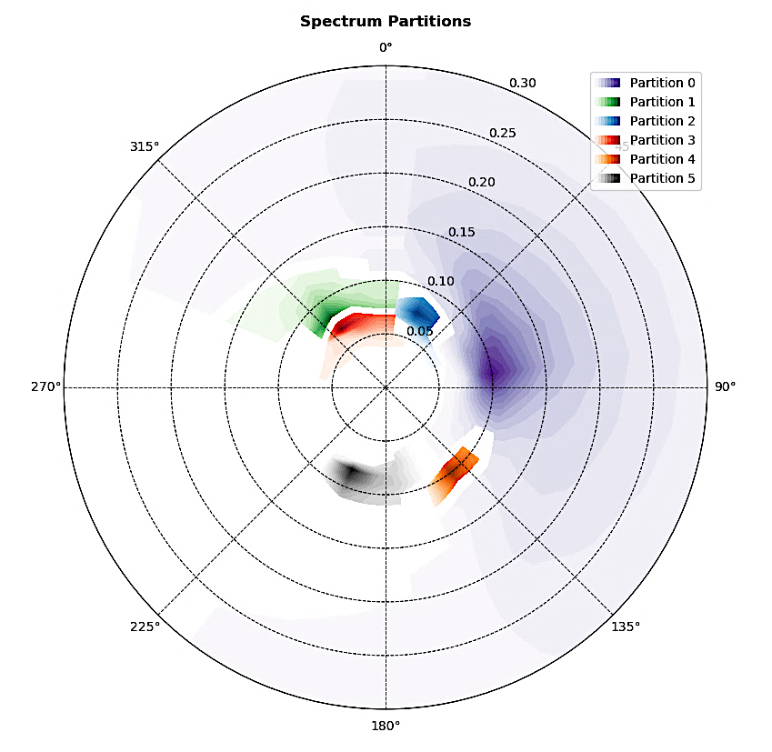
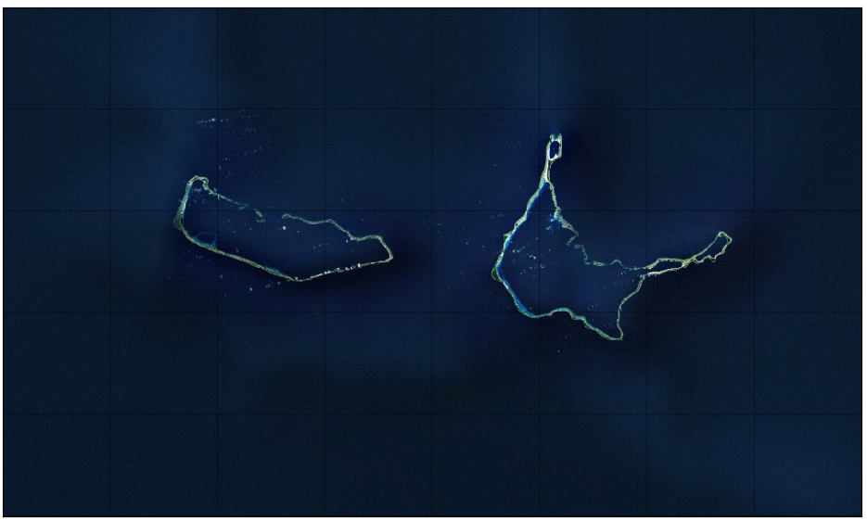
HyWaves
St. 2914
1. “Super-point”
2. Spectral Partitioning
St. 2913
St. 2915
Global wave hindcast stations
St. 2856
St. 2858
St. 2857
Wavespectra Library
developed by MetOcean Solutions
Watershed Method
(Hanson and Philips, 2001)
St. 2913
St. 2914
St. 2915
Majuro
Arno
3. Parameterization of sea-swells systems
St. 2856
St. 2857
St. 2858
Sea
$$H_{s}, T_{p}, θ_{m},$$
$σ,γ$, $W_{spd}$, $W_{dir}$
Swells
$$H_{s}, T_{p}, θ_{m},$$
$$σ,γ$$
6/17

Slide 8
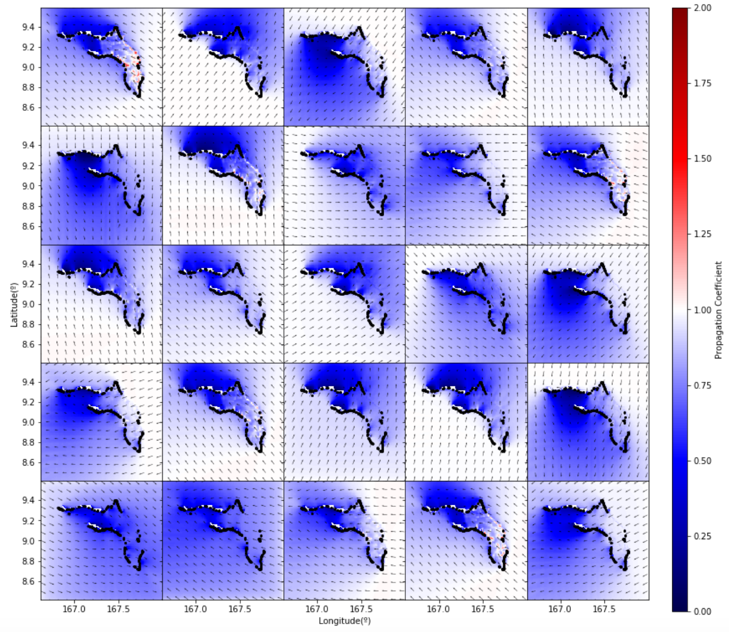
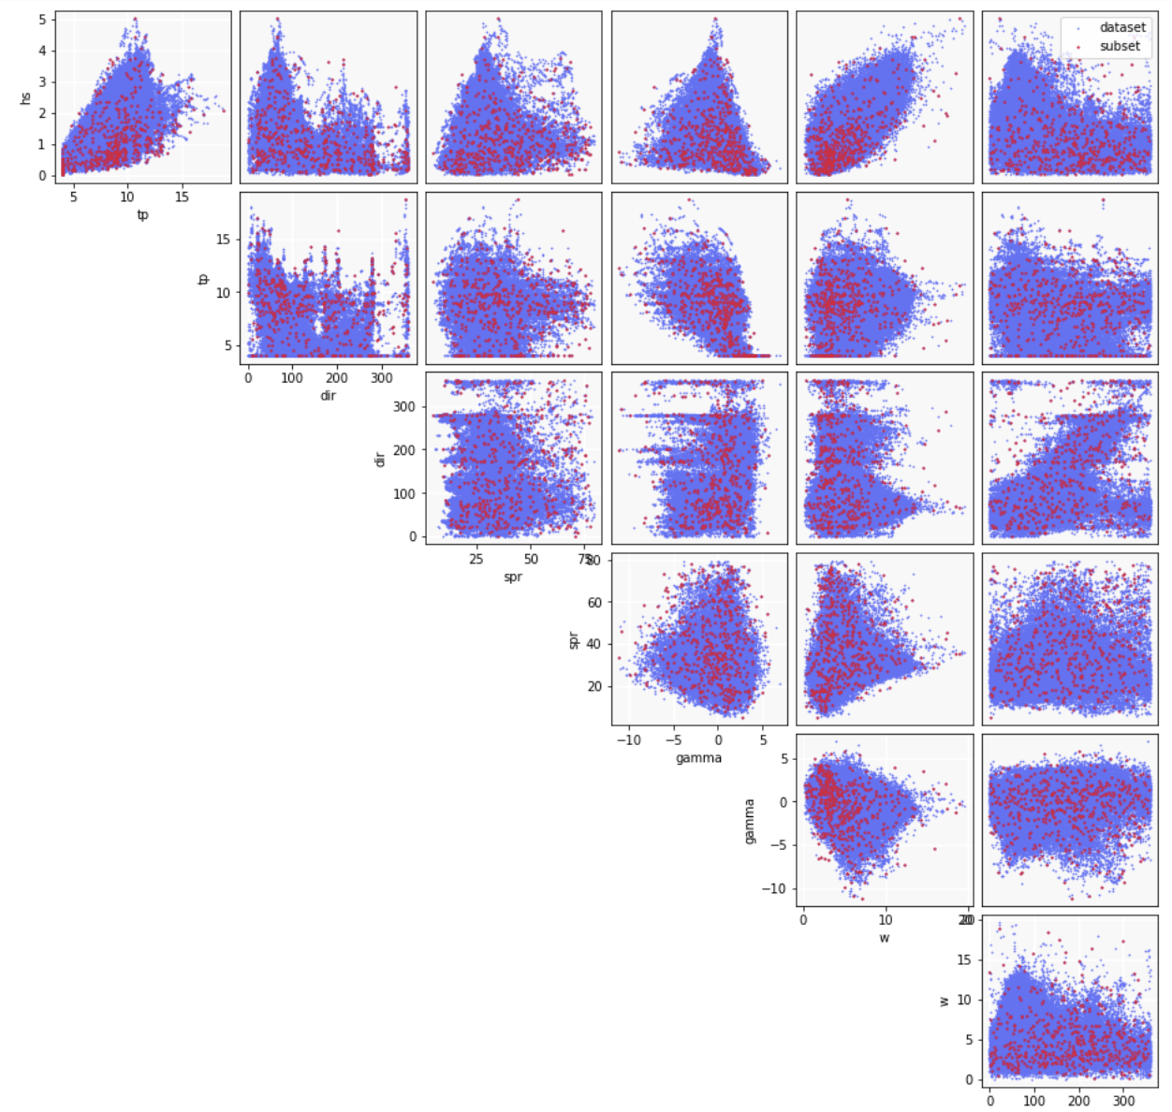
HyWaves
4. MDA
Maximum Dissimilarity Algorithm
5. SWAN
Dynamical Downscaling
Simulating WAves Nearshore (TUDelft)
500 seas + 500 swells (Camus et al., 2011)
7/17

Slide 9
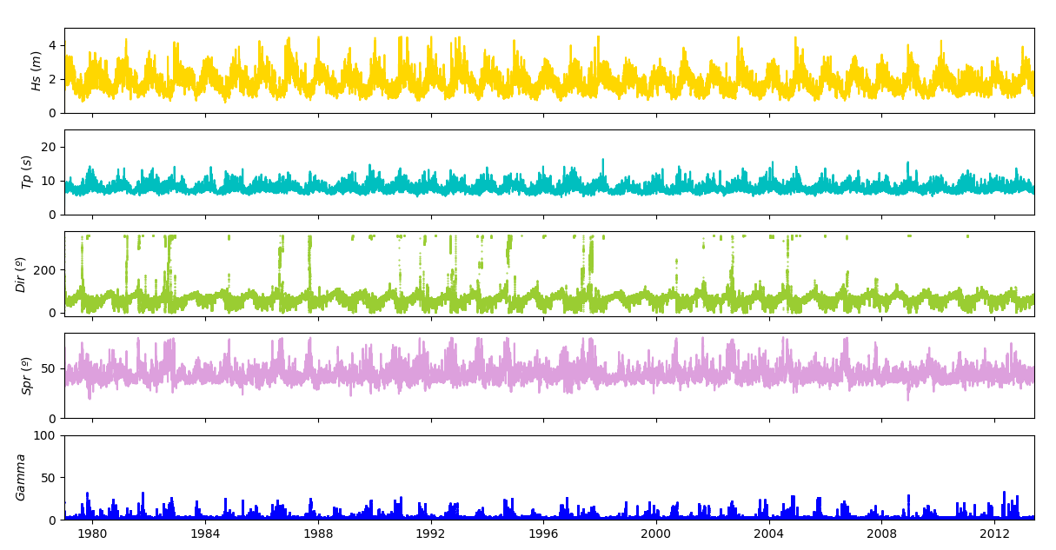
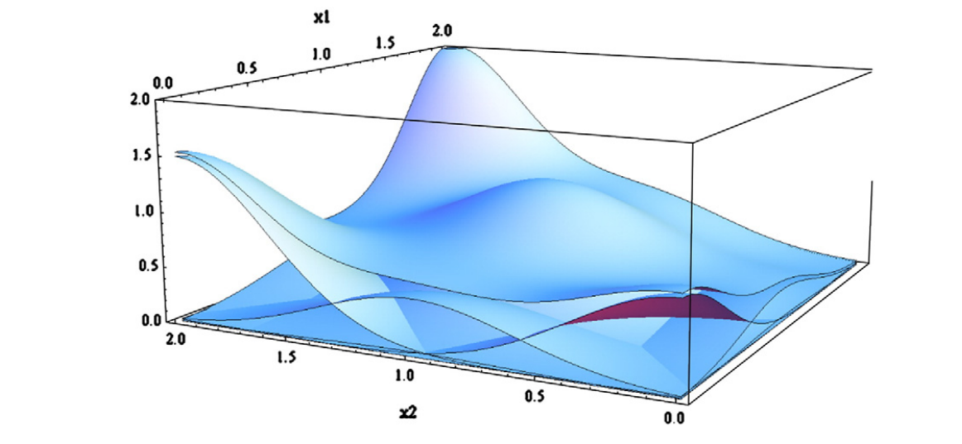
HyWaves
6. RBF
Radial Basis Functions
Based on the 500 + 500 MDA
simulated cases
Interpolation Algorithm
(Rippa 1999)
The historical wave climate can be reconstructed at any location in the domain
“a weighted sum of radial basis functions”
(Camus et al., 2011)
8/17

Slide 10
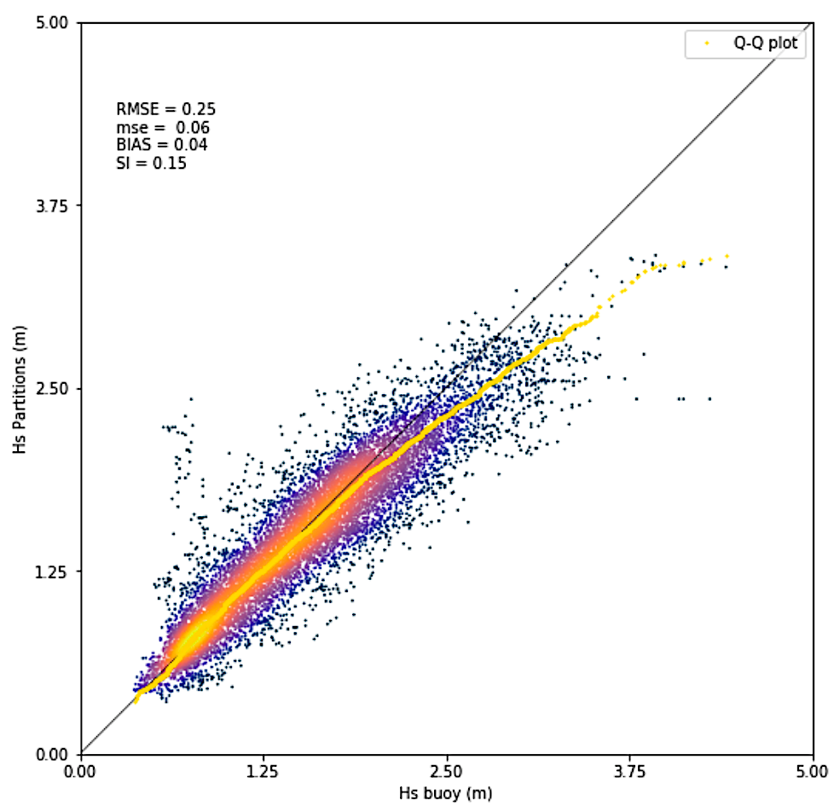
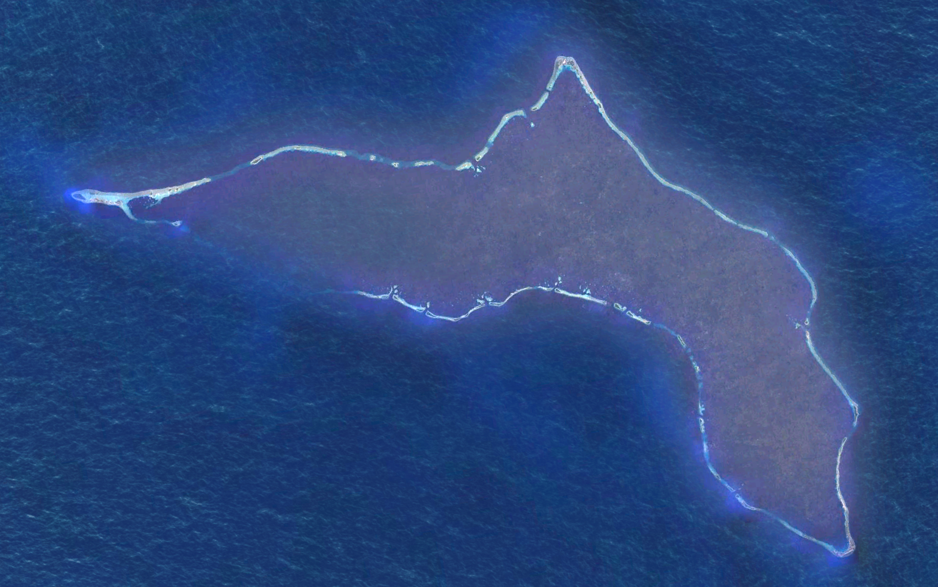
HyWaves: Validation Sites
Majuro Atoll
Kwajalein Atoll
Roinamur
Kwajalein
9/17

Slide 11
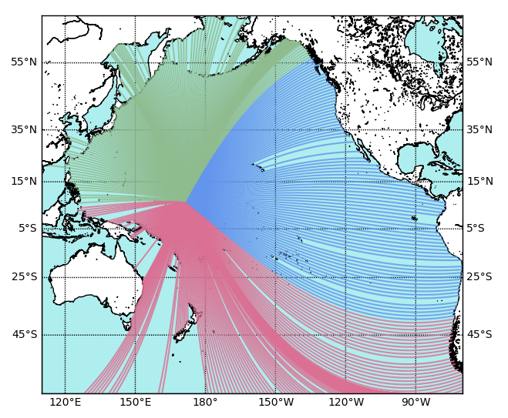
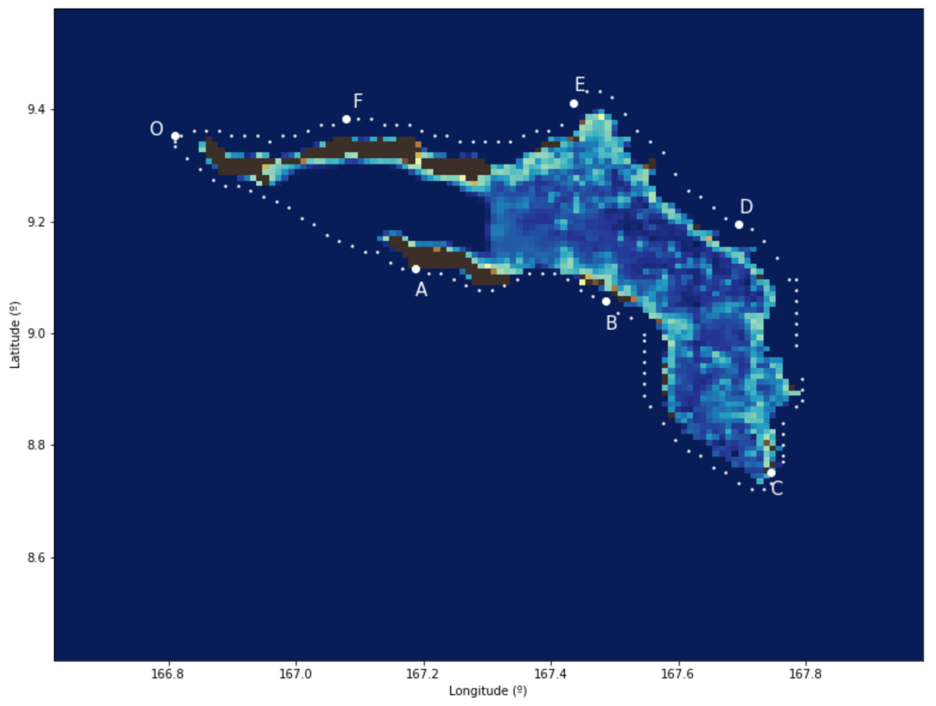
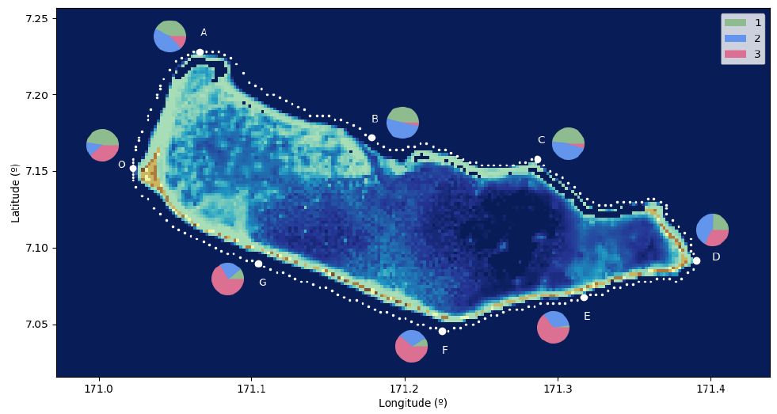
HyWaves: Spectral Wave Climate
Majuro Atoll
Kwajalein Atoll
F
E
D
A
B
C
Northwest Swells
Southwest Swells
Eastern Swells
Swell 1
Swell 2
% Energy Flux Contribution
Sea
% Energy Flux Contribution
O
O
A
B
C
D
E
F
G
O
A
B
C
D
E
F
10/17
Notes:
Energy flux contribution
Seasonality
Interannual variability
ENSO events

Slide 12
Wave-driven inundation metamodels
Offshore
Nearshore
Flooding
Wind-Wave conditions
Wind-Wave conditions
Overtopping volumes
+
Sea: $H_{s}, T_{p}, θ_{m}, σ,γ$, $W_{spd}$, $W_{dir}$
Tide
Swells: $H_{s}, T_{p}, θ_{m}, σ,γ$
$$q, R_{u2\%}$$
$H_{s}, T_{p}$, $W_{spd}$, $W_{dir}, η$
HyWaves
HySwash
11/17

Slide 13
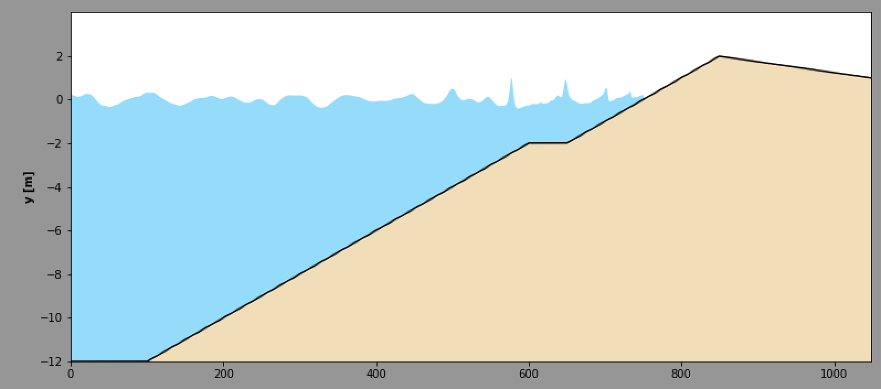
HySwash: Methodology
Offshore wave dataset
(historical / emulated)
HyWaves
Nearshore wave dataset
reconstructed at the beginning of the profile
Forcings
Wind-Waves-Tide
MDA
SWASH
Reef bathymetry and coastal topography
RBF
TIME-SERIES
FLOODING VARIABLES
$$R_{u2\%}, q$$
EWS
Flooding model
Inundation maps
12/17

Slide 14
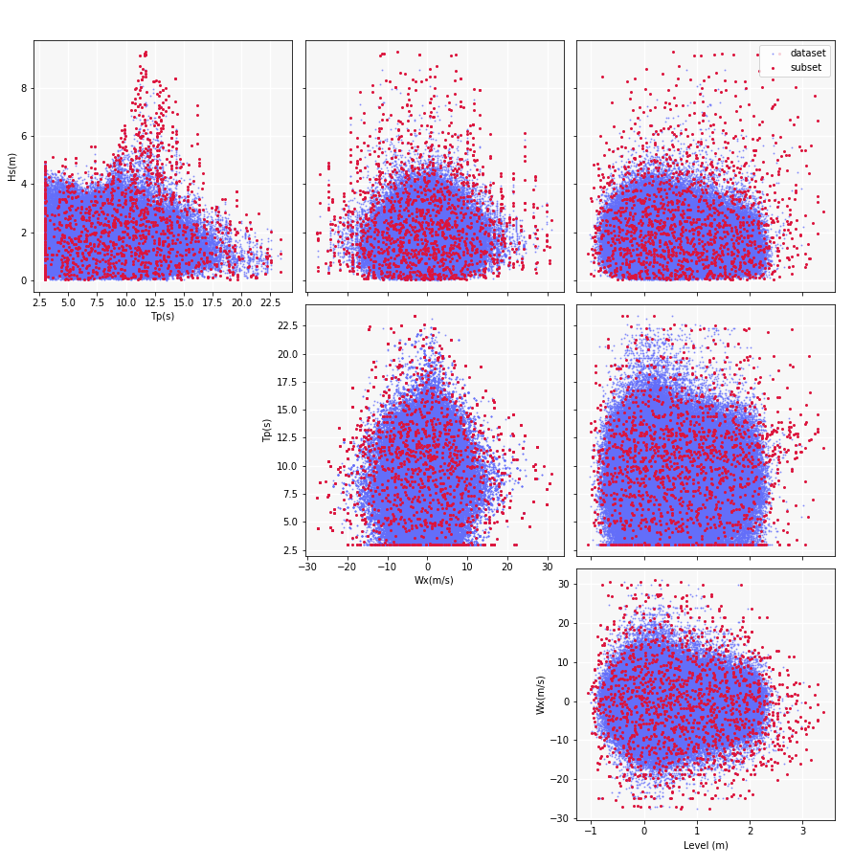
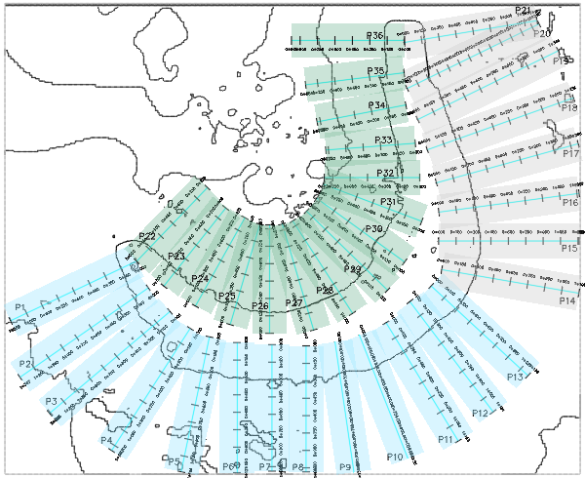
HySwash
1. Profiles definition
2. MDA
$$H_{s}, T_{p}, W_{x}, msl$$
500 cases / profile
2D domain
two dimensional hydrodynamic models
1D profiles
Assuming constant forcing along width wi
Kwajalein Atoll
13/17
Notes:
However, 2D effects on the wave propagation on the reef are not included, which might produce inaccurate results due resonance phenomena for example (this aspect might need to be further analyzed).

Slide 15
HySwash
Wave-driven coastal inundation: Metamodels
2. Dynamical Donwscaling
SWASH
Simulating WAves till SHore (TUDelft)
Reef bathymetry and coastal topography
Modelling water levels along the reef
Output / profile
Wave-runup
Overtopping rates
14/17
Notes:
The variables used to describe the inundation

Slide 16
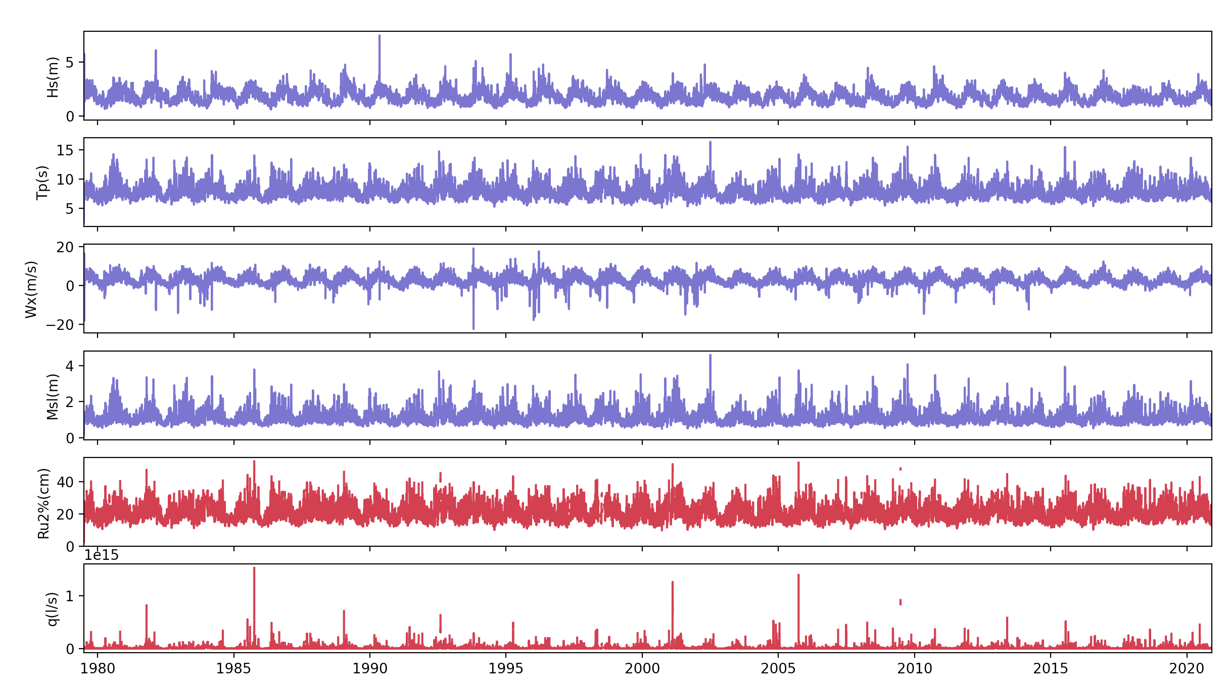
HySwash
3. RBF Interpolation
Historical reconstruction of runup and overtopping rate series
15/17

Slide 17
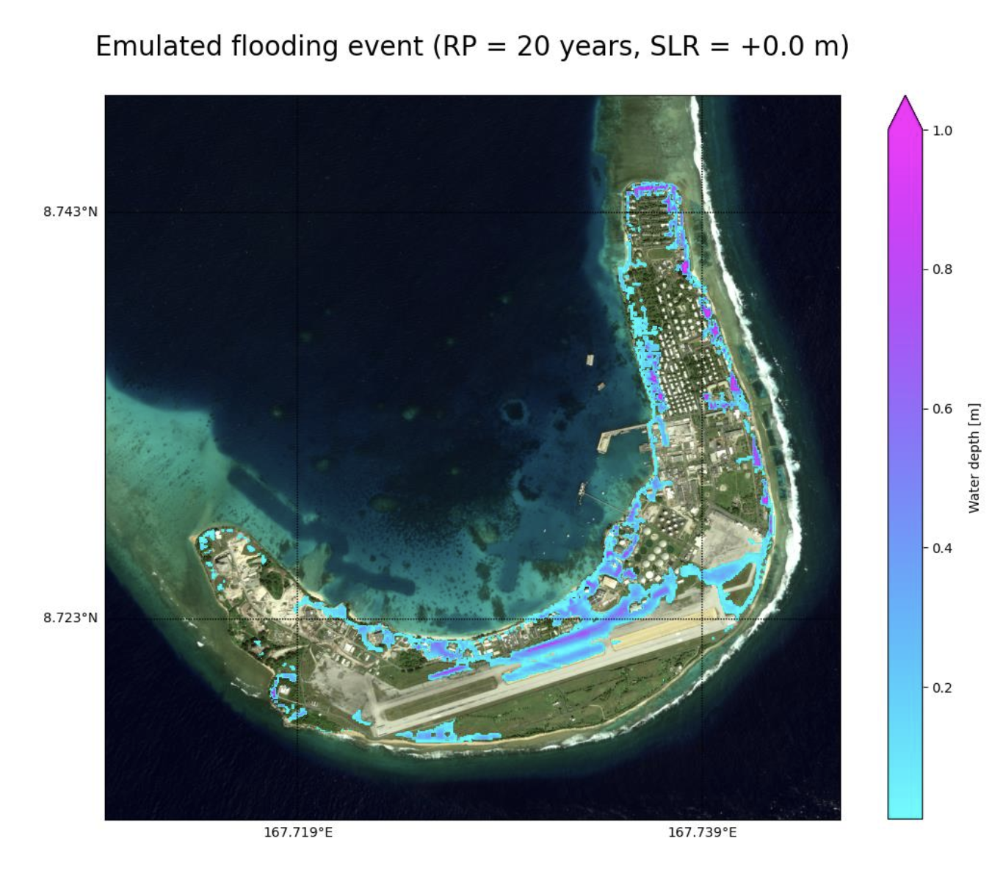
Coastal flooding
Wave-driven coastal inundation: Metamodels
Historical, present and future climates
LisFlood-FP (University of Bristol)
2D hydrodynamic model
Kwajalein flooding inundation extents
Climate change scenarios
Hindcast TWL timeseries
Forecast TWL timeseries
Synthetic time series of waves and water level conditions
Flood Inundation Model
Zornoza-Aguado et al.
16/17

Slide 18
Conclusions
2 Nested hybrid models are presented to downscale wave climate from deep waters to the beach crest of coral-reef shorelines
HyWaves methodology has been positively validated with in-situ wave measurements while HySwash methodology still needs validation
Metamodels provide efficient and faster tools when limited by computational resources
17/17

Slide 19
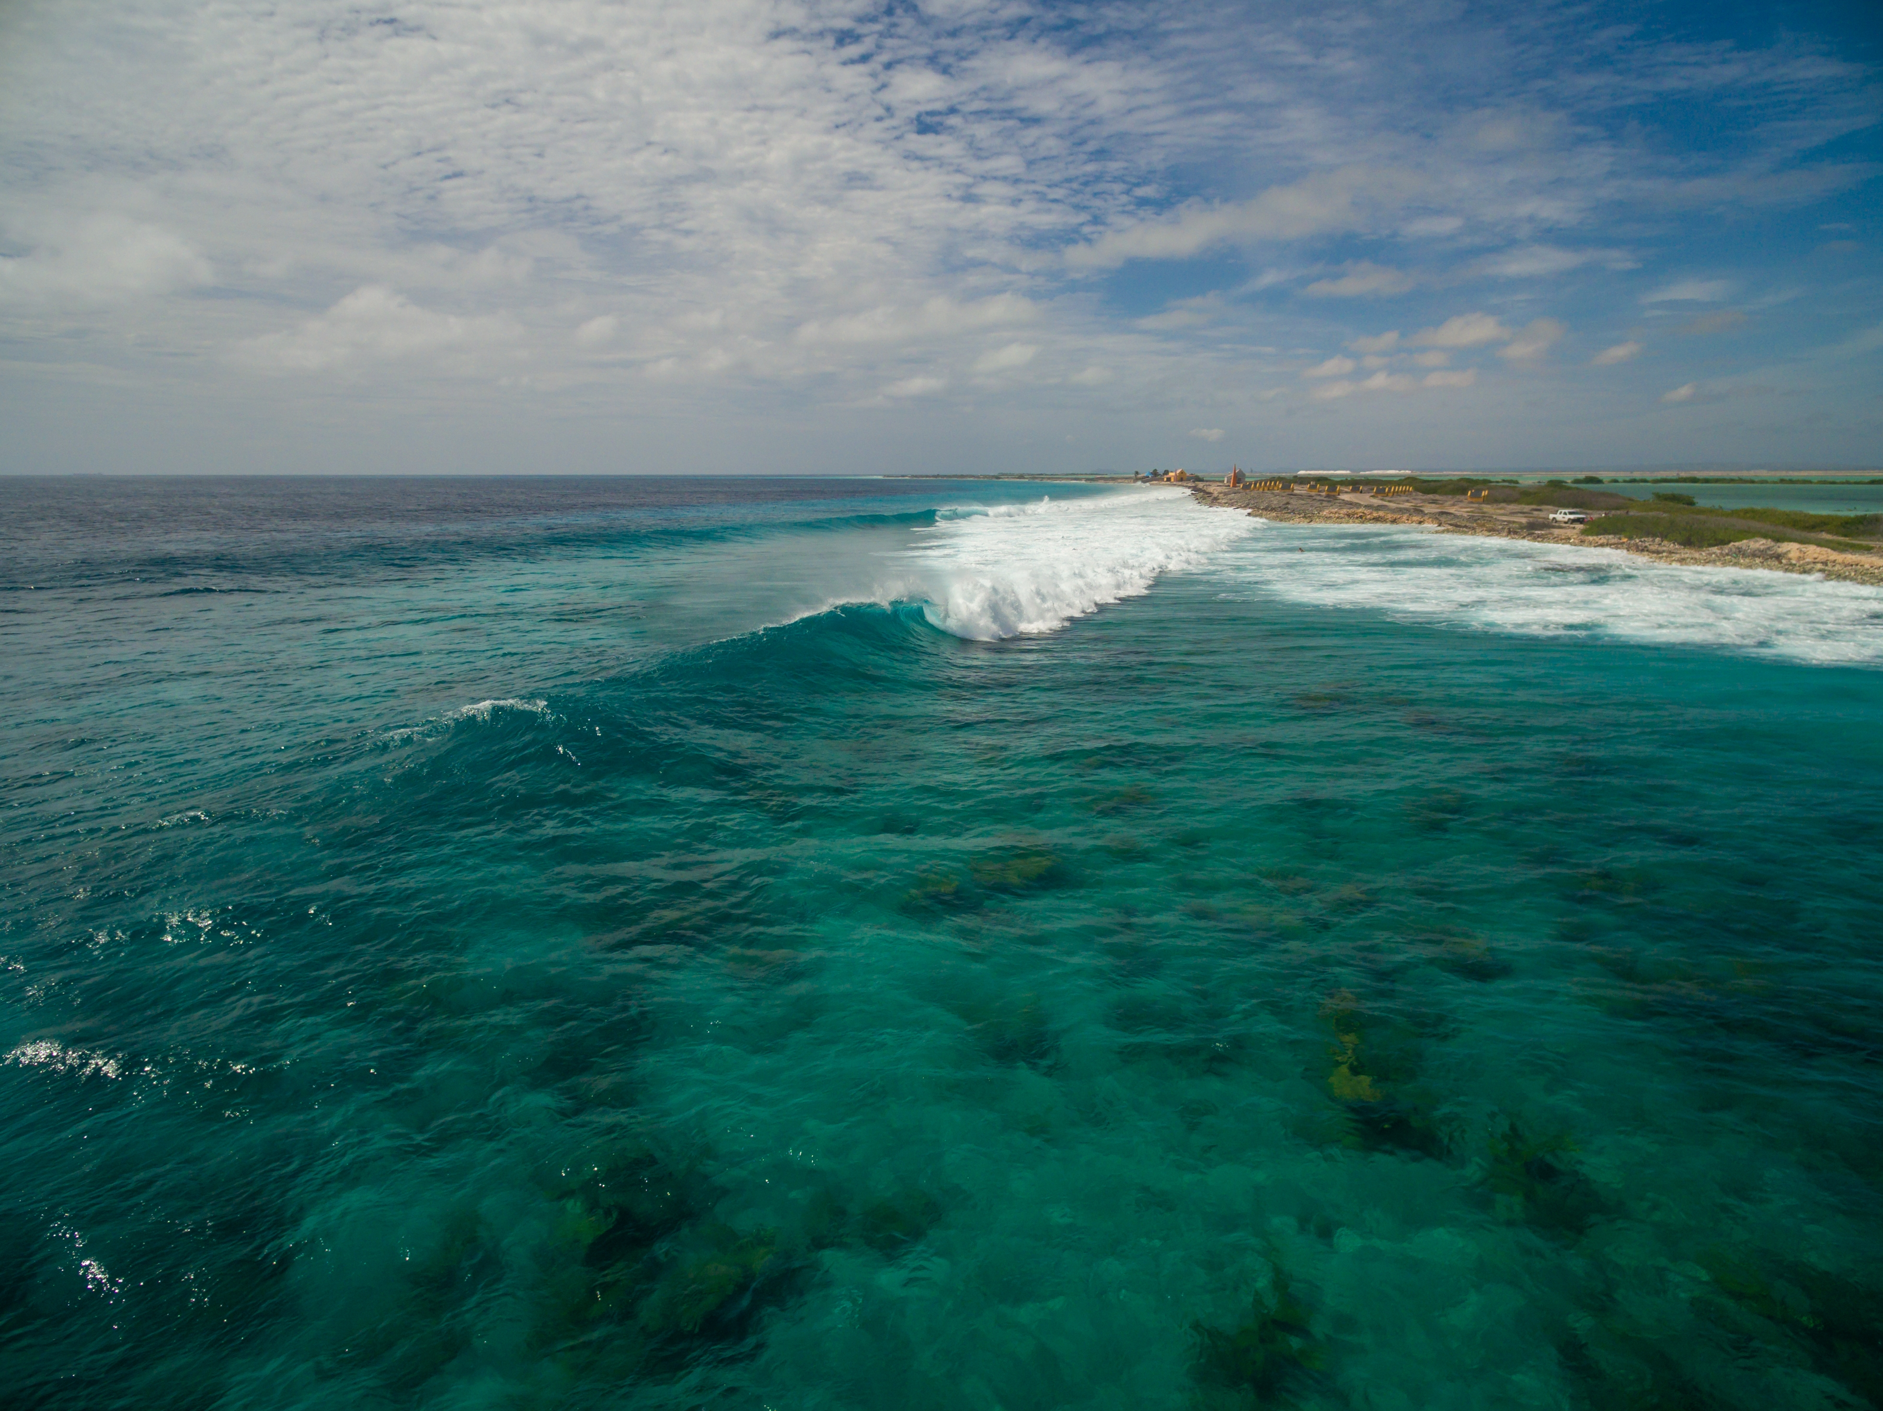
Ocean after the hurricane in Bonaire, Caribbean (www.freepik.com)
Thank you very much for your attention
Alba Ricondo
alba.ricondo@unican.es
Ge cean
Acknowledgements
This work is funded by the Spanish Ministry of Science and Innovation, National Project “Beach4Cast” (PID2019-107053RB-I00).
UNIVERSIDAD DE CANTABRIA
Notes:
<a href='https://www.freepik.com/photos/food'>Food photo created by wirestock - www.freepik.com</a>

