Slide 1
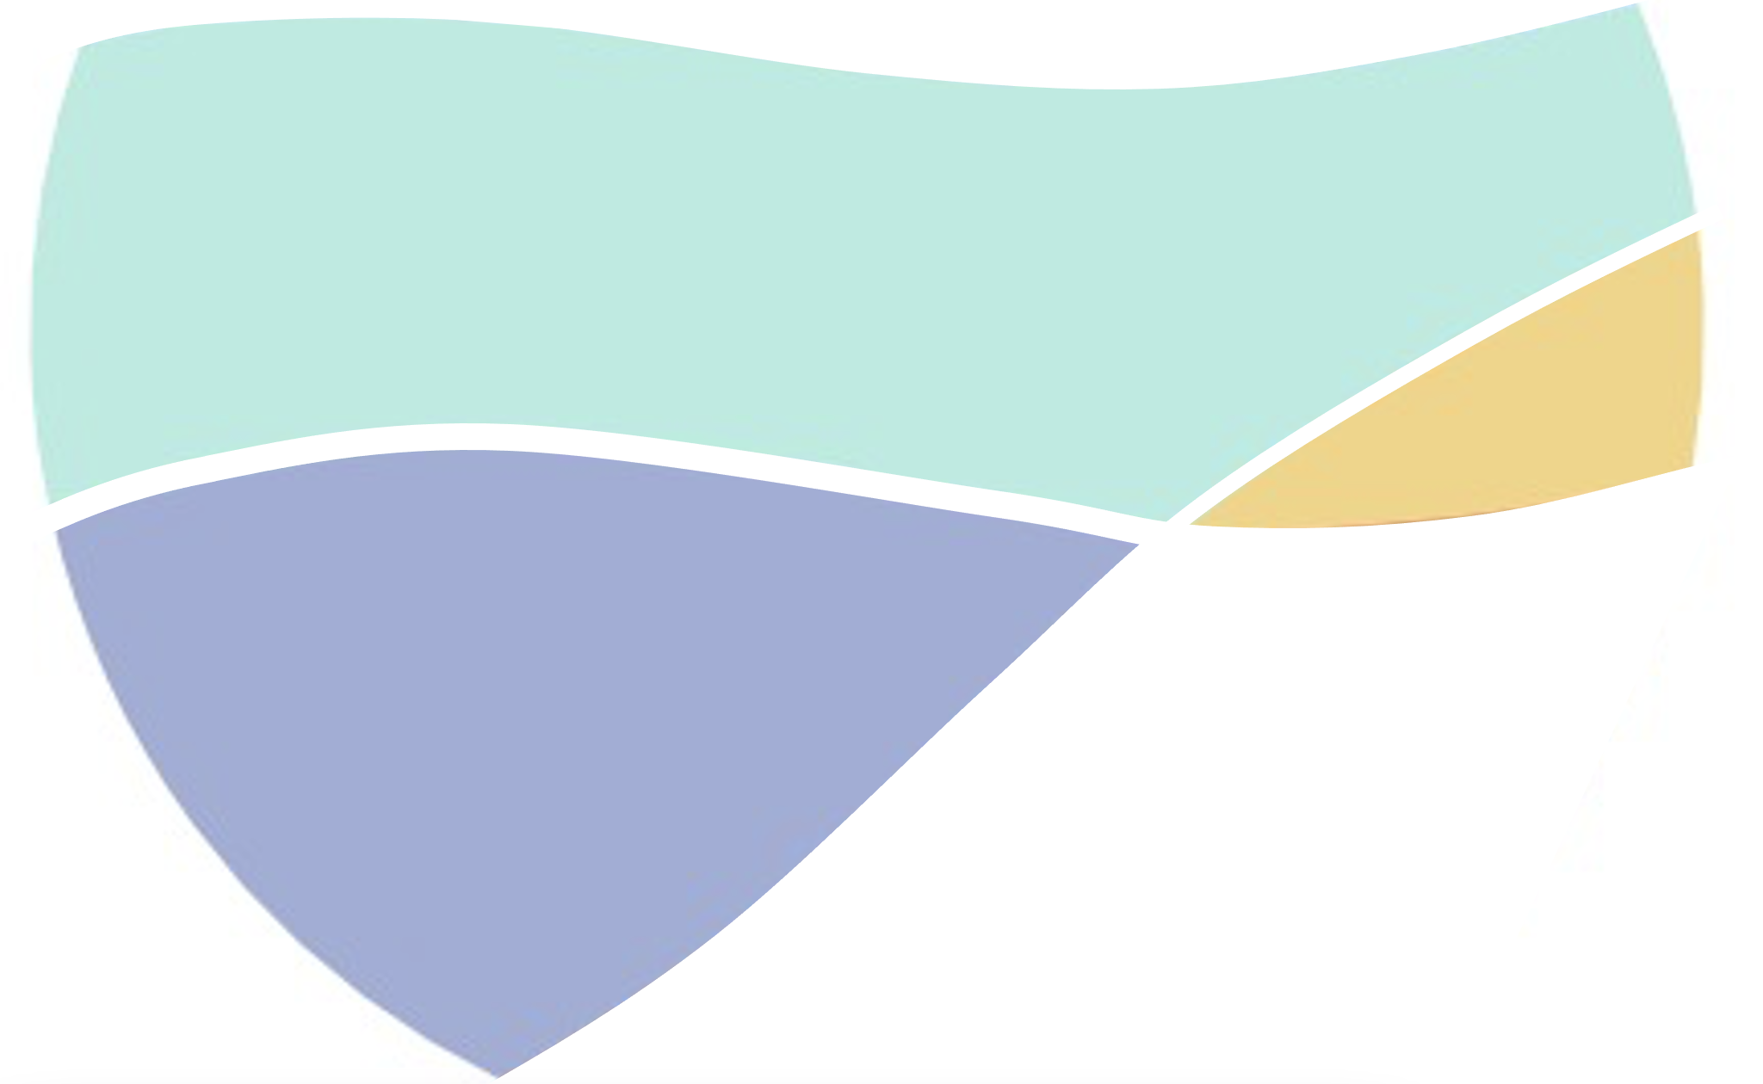
Hybrid flooding system under varying morphodynamic beach states
Manuel Zornoza-Aguado, Beatriz Pérez-Díaz, Sonia Castanedo, Laura Cagigal, Fernando J. Méndez, Javier Sánchez-Espeso, Ignacio García-Utrilla
Geomatics and Ocean Engineering Group, University of Cantabria

Slide 2
Introduction
Early Warning Systems (EWS): communication systems that help communities prepare for hazardous climate-related events.
Computationally expensive : executions in near real time
Need to be fast → libraries of pre-run cases
HYBRID SYSTEMS
Numerical models (dynamical downscaling) + mathematical tools (statistical downscaling)
2014 Storm in Cantabrian Sea

Slide 3
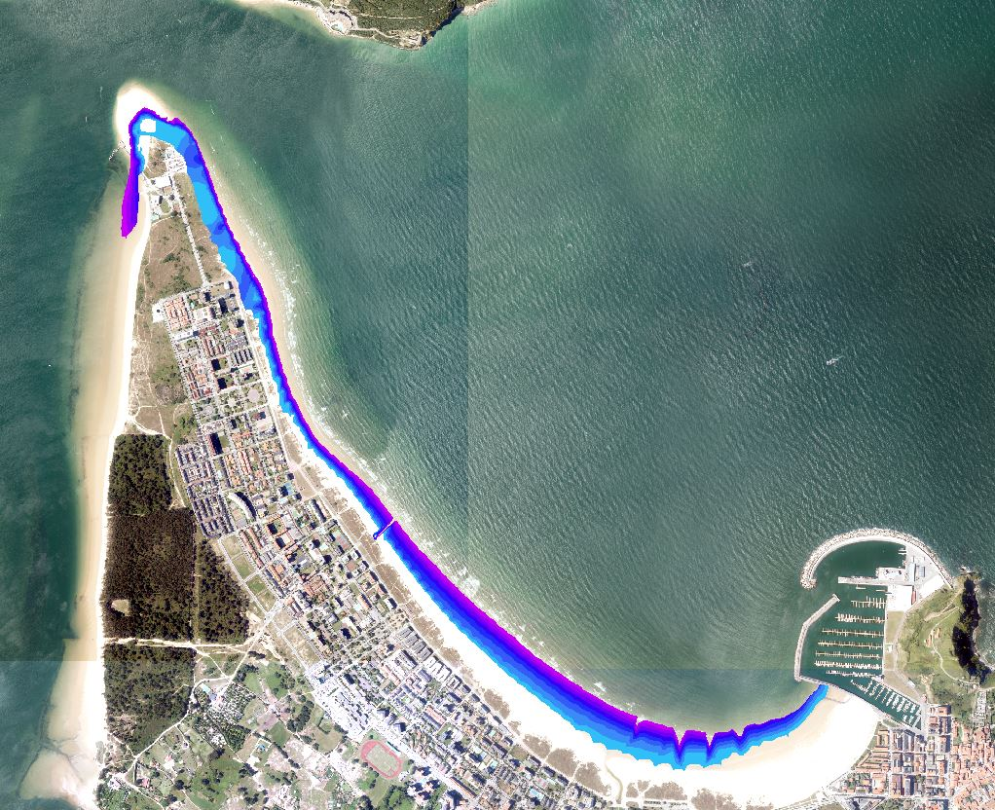
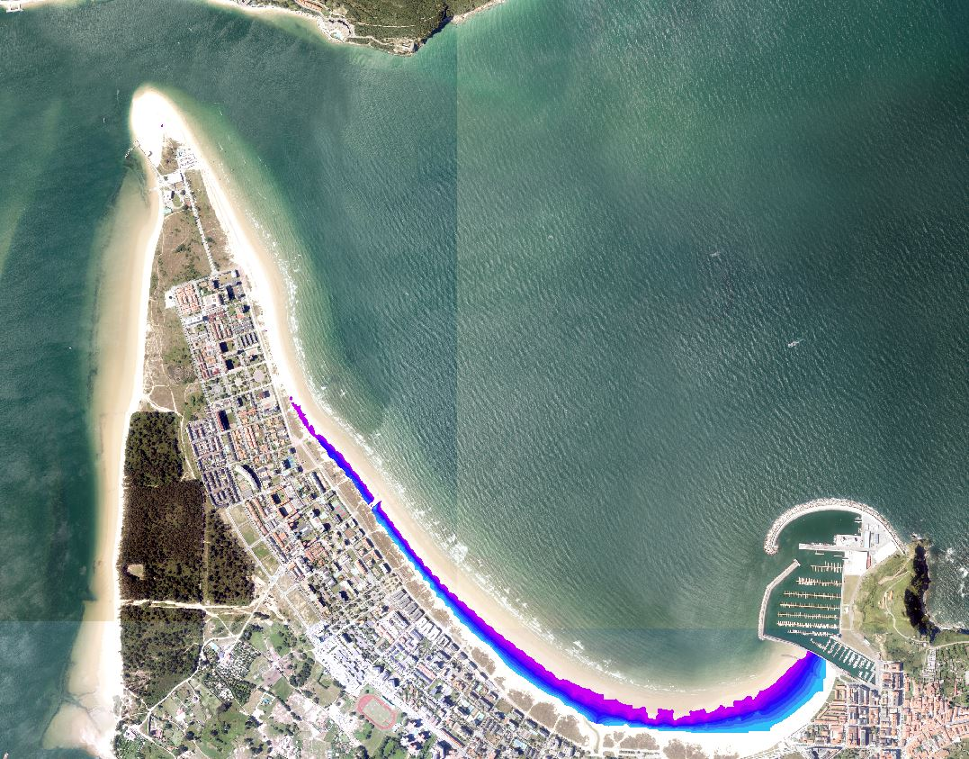
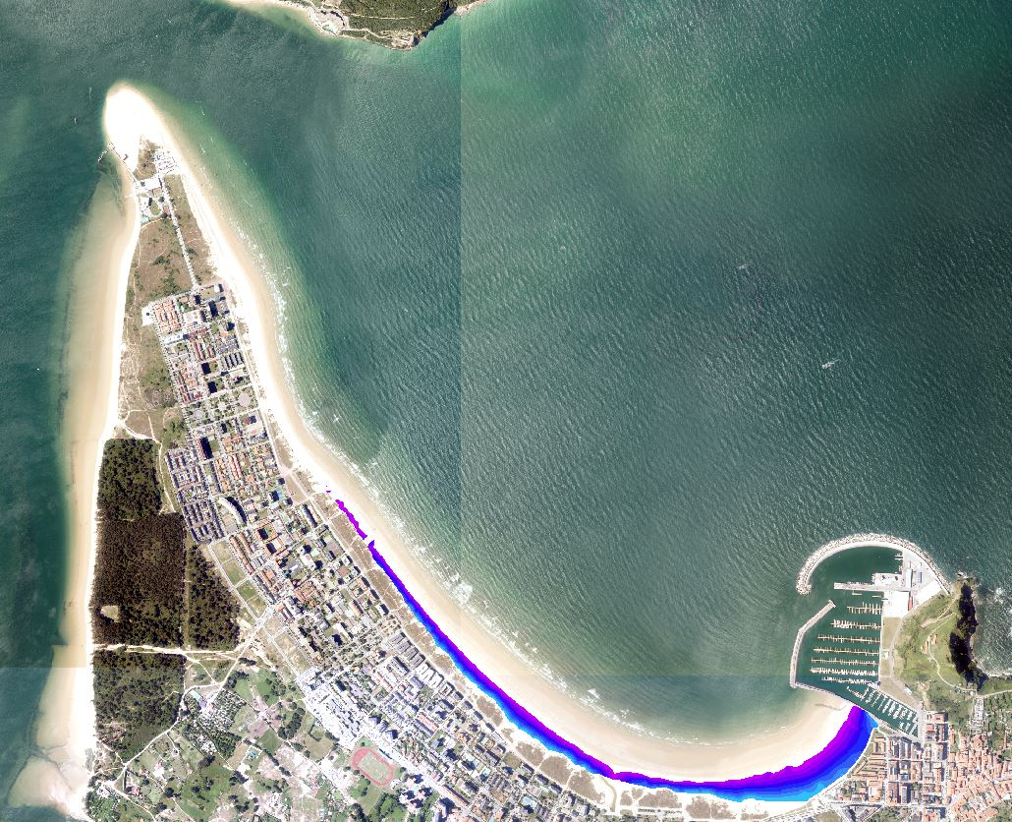
Introduction
EWS based on pre-run cases
Hybrid approach:
Selection algorithms
N Cases
Representative topobathymetry
N Flood Maps
{Hs1, Tp1, θ1, σ1, η1}
Numerical simulations
{Hs2, Tp2, θ2, σ2, η2}
Radial Basis Functions (RBF)
{Hs3, Tp3, θ3, σ3, η3}
…
…
Main constraints:
Morphodynamics not taken into account (topobathymetry remains the same)
Local phenomena (resonance, seiches) conditioned to one morphology

Slide 4
Introduction
EWS based on pre-run cases
Hybrid approach with updated bathymetry:
N Cases
M topobathymetries
MxN Flood Maps
Selection algorithms
Numerical simulations
{Hs1, Tp1, θ1, σ1, η1}
PCA + RBF
{Hs2, Tp2, θ2, σ2, η2}
{Hs3, Tp3, θ3, σ3, η3}
…
…
…

Slide 5
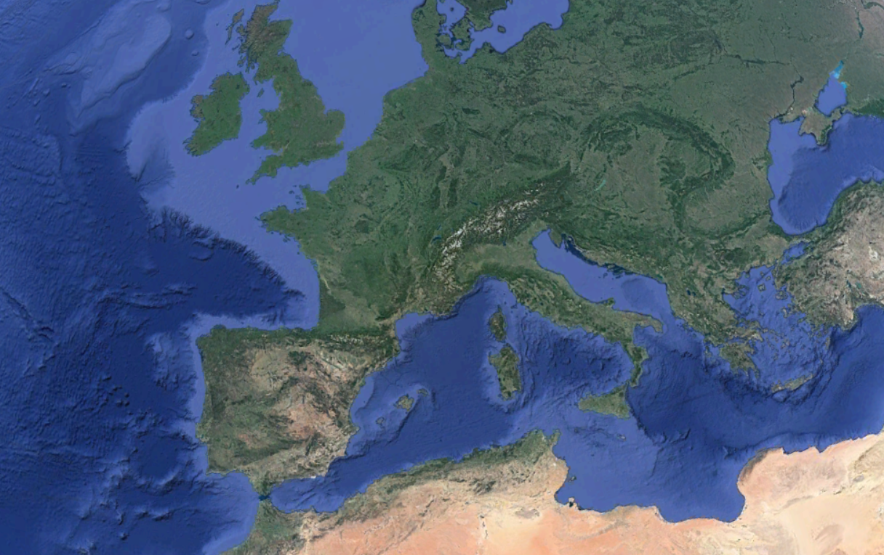
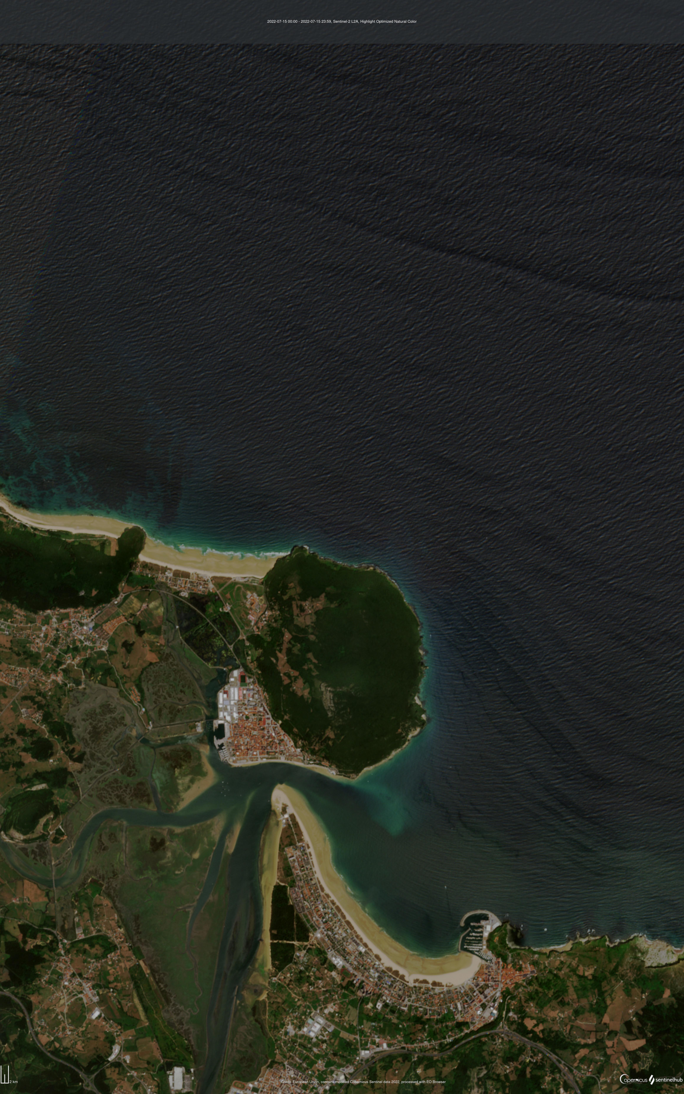
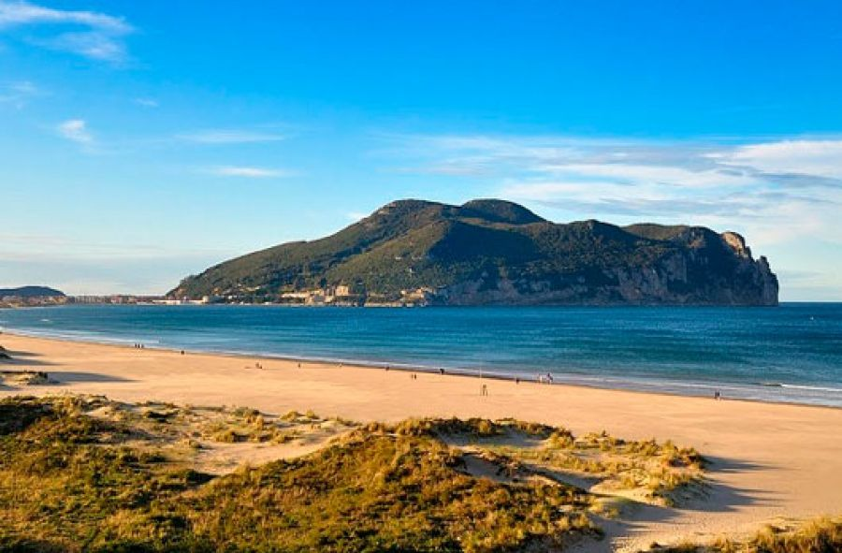
Study area
Mean climate
Hs = 1.5 m
Tp = 10 s
θ = 315º
TR = 4.5 m
D50 = 0.23 mm
Mt. Buciero
Asón river mouth
Google Earth
La Salvé Beach
Laredo Port
Santoña Estuary
La Salvé Beach (Laredo, Spain)
4250 metres long
Dissipative white-sand urban beach
Sand spit in Santoña bar-built Estuary
Macrotidal & semidiurnal
Nearby geographical elements:
Laredo Port
Asón river mouth
Mt. Buciero
Sentinel Hub
SurfCantabria

Slide 6
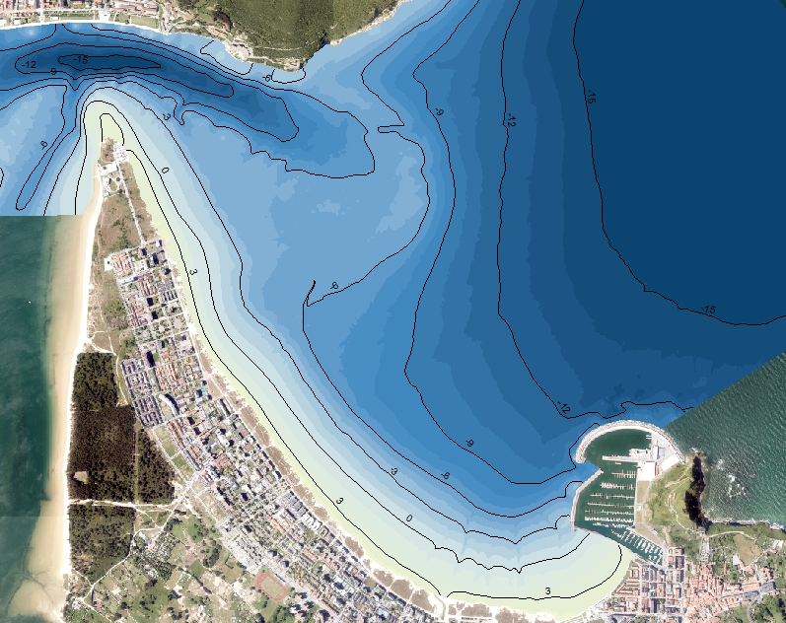
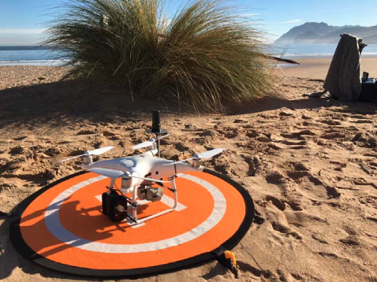
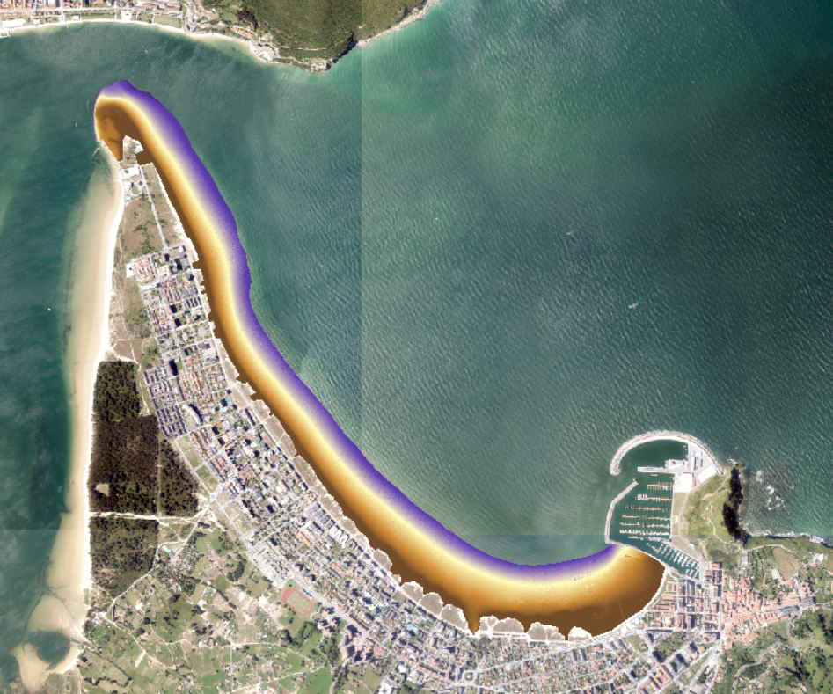
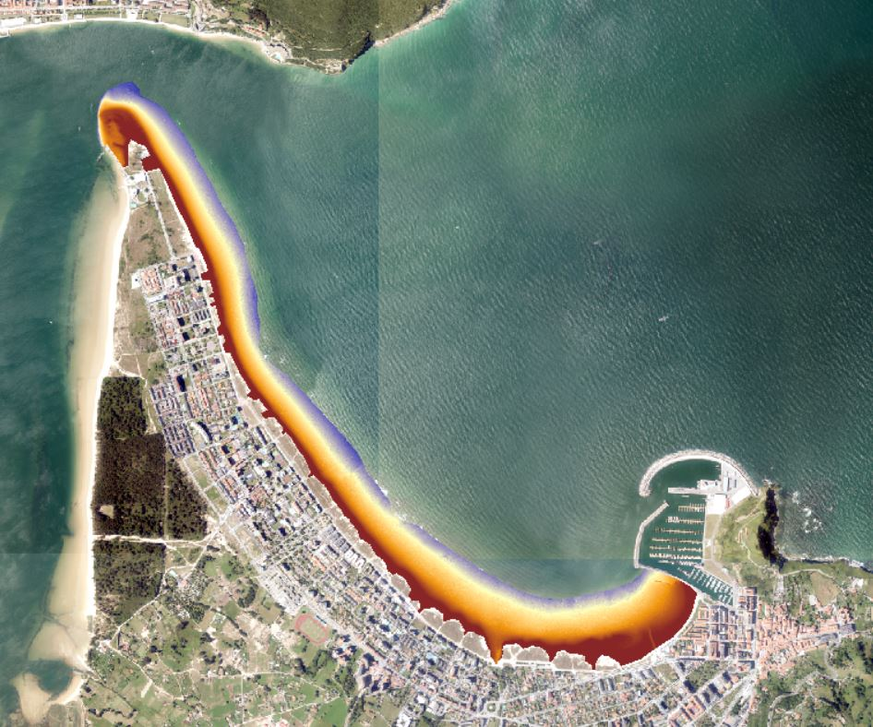
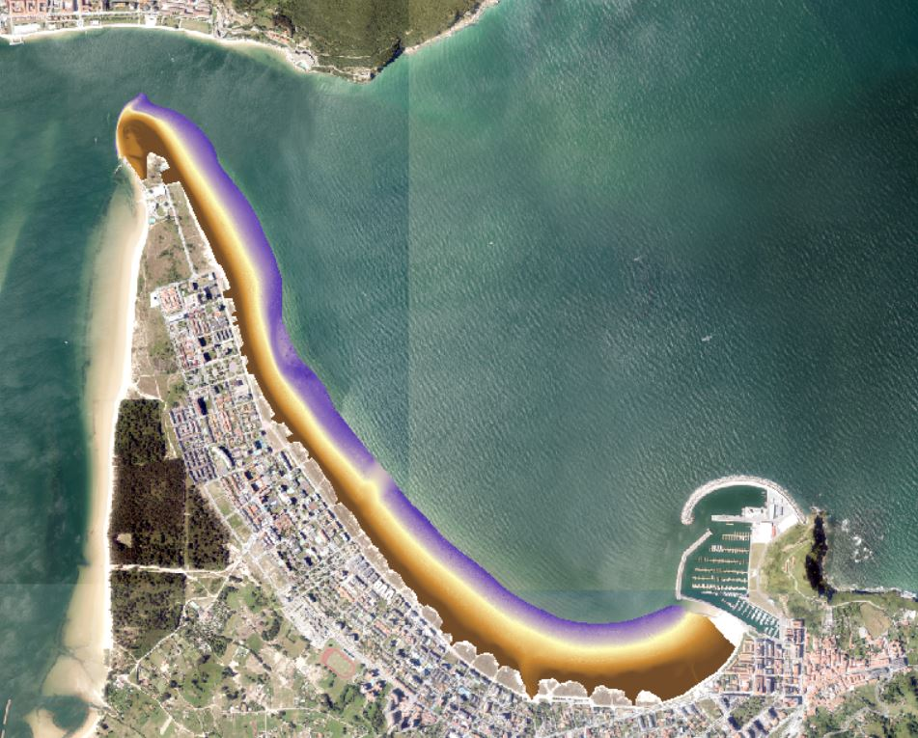
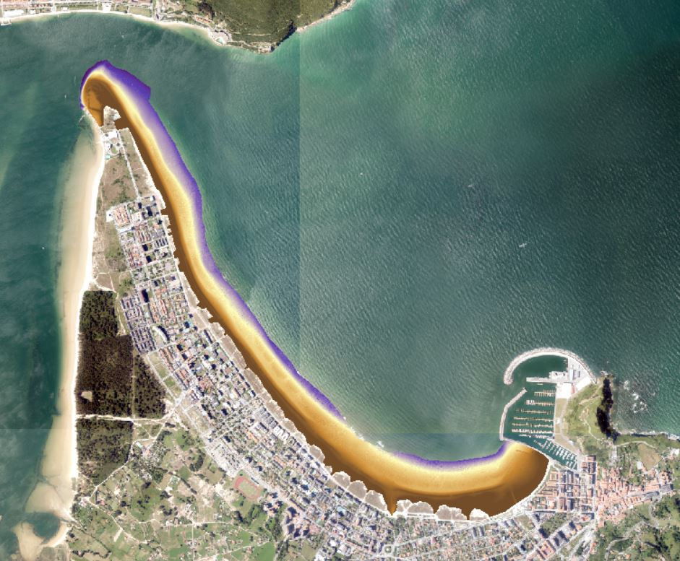
Field data
10 Fieldwork-derived topobathymetries (CEDEX and Nautic Chart)
Δx = 5m
DJI Phantom 4 Pro-V2
RGB camera 20 Mp / 4K
GPS/GLONASS with PPK system
14 UAV-derived topographies + shallow waters (University of Cantabria)
Δx = 0.20m

Slide 7
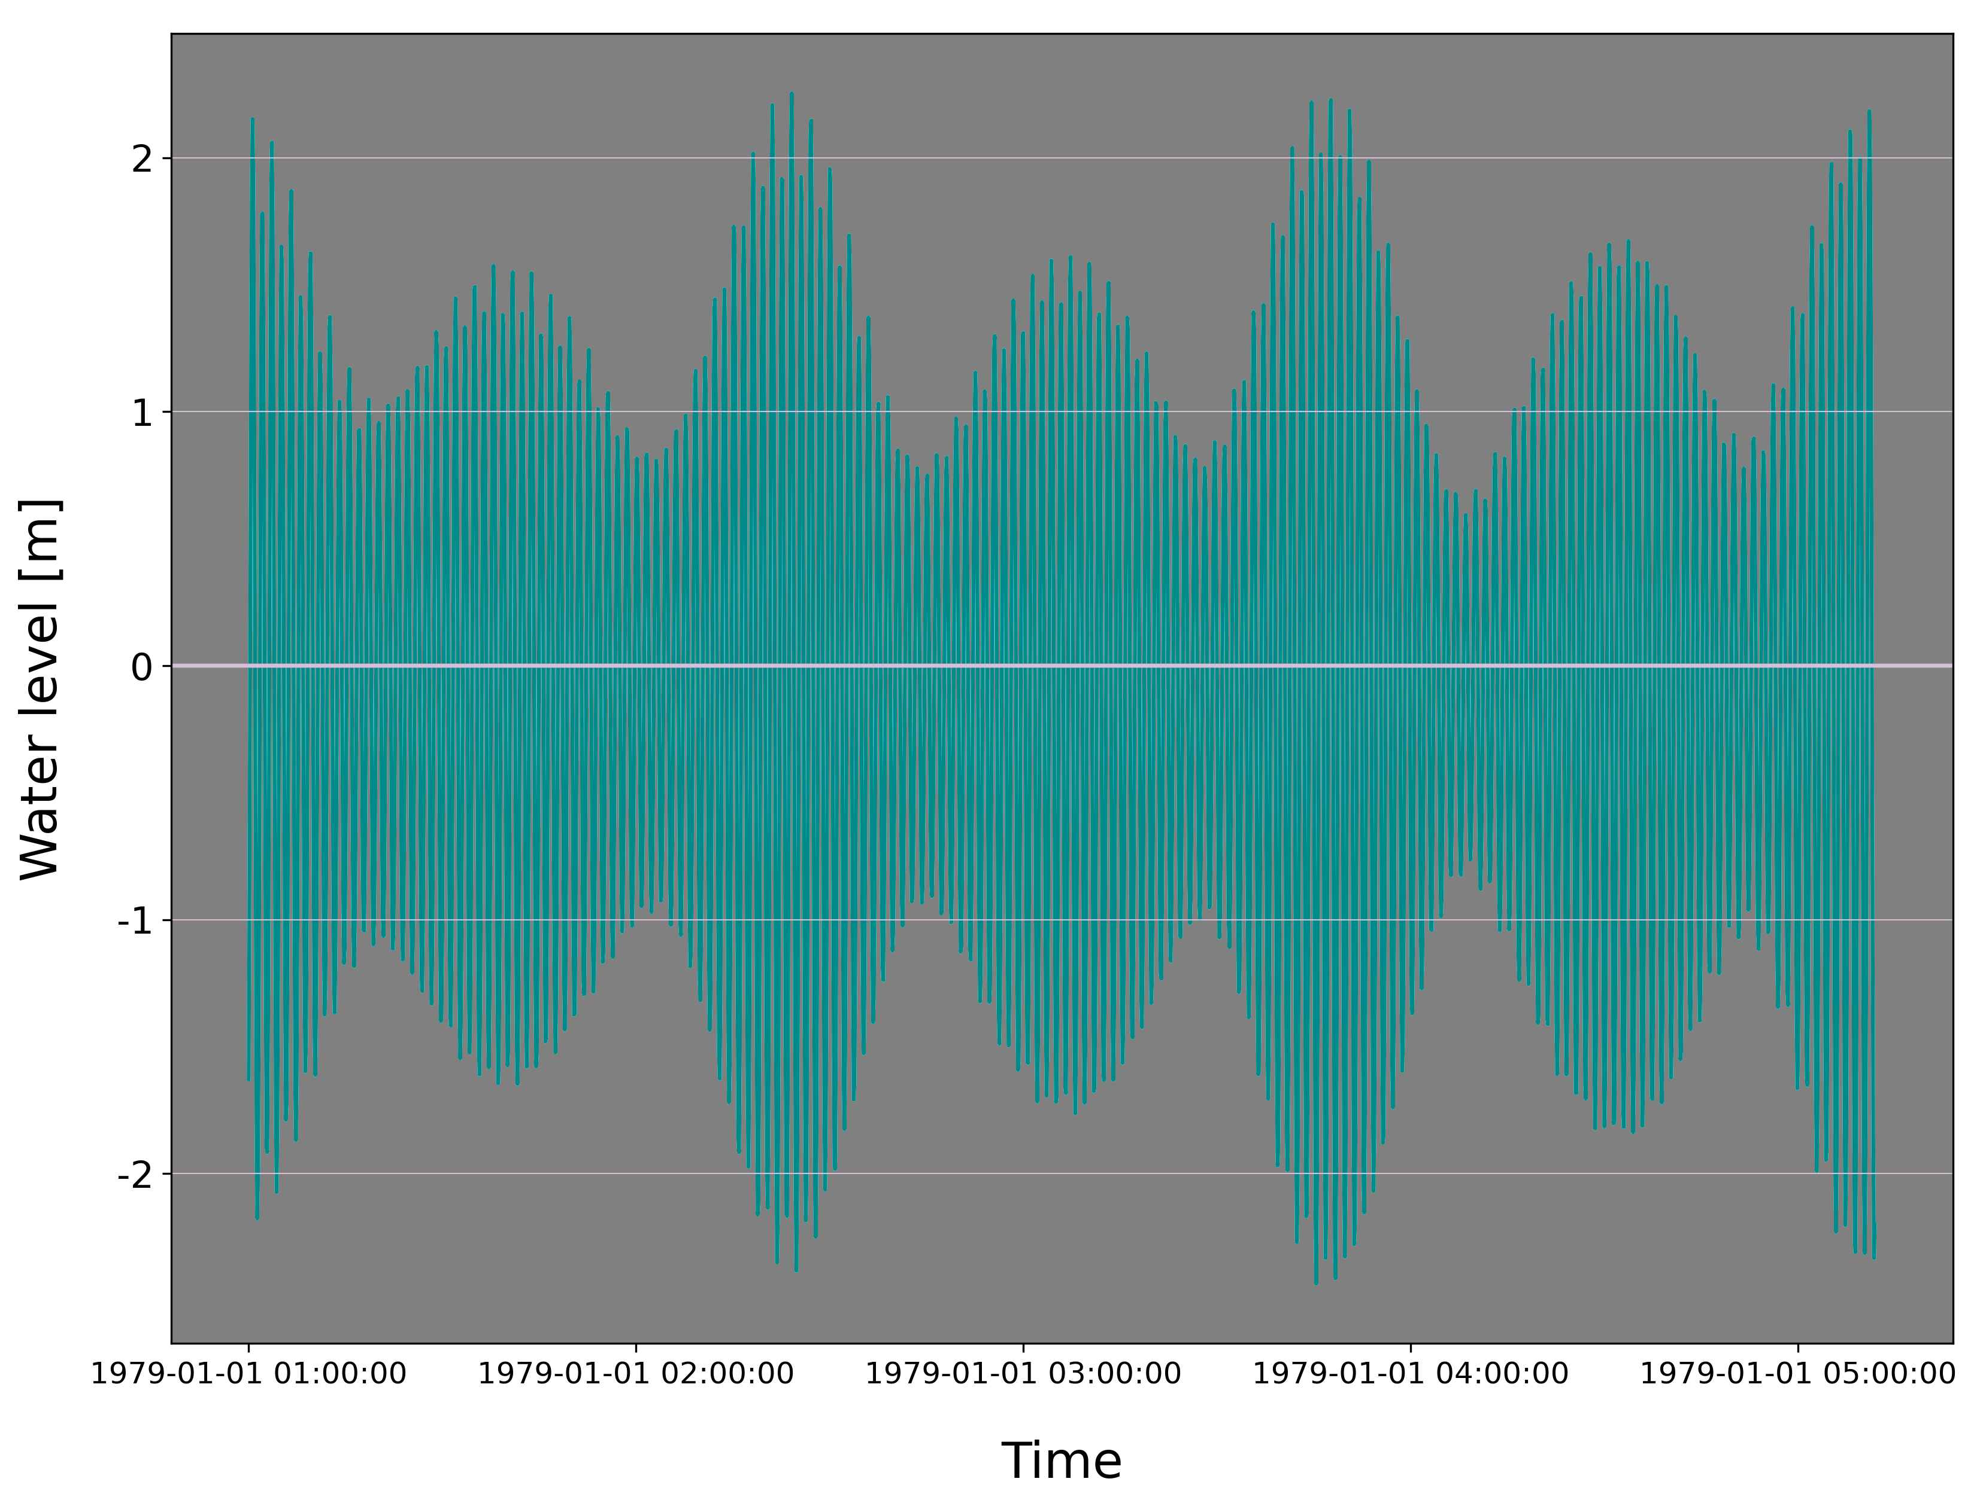
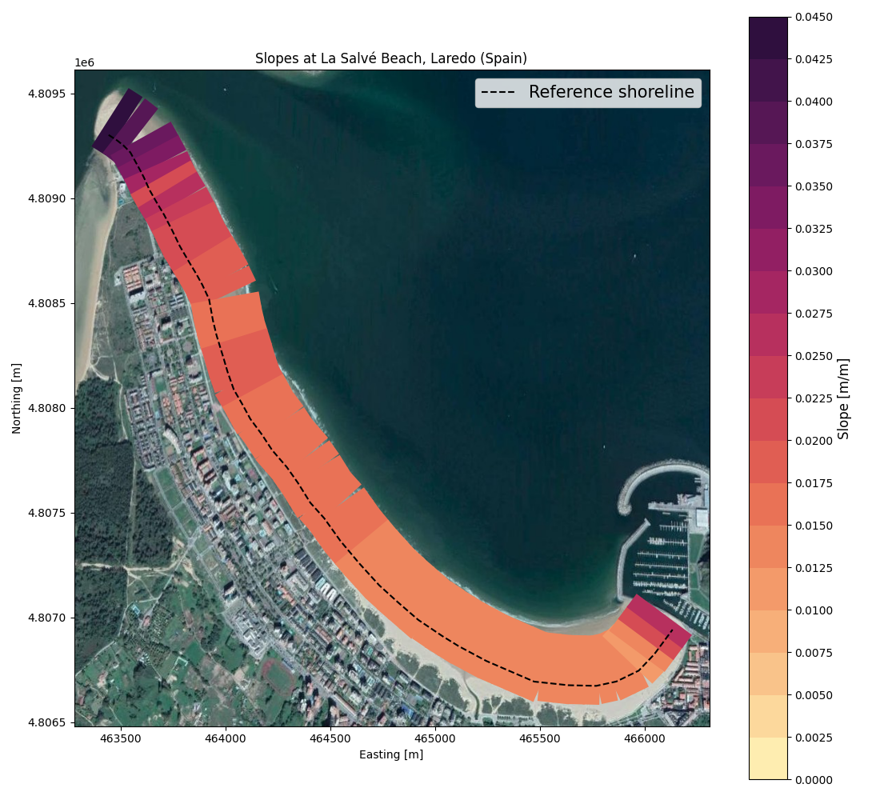
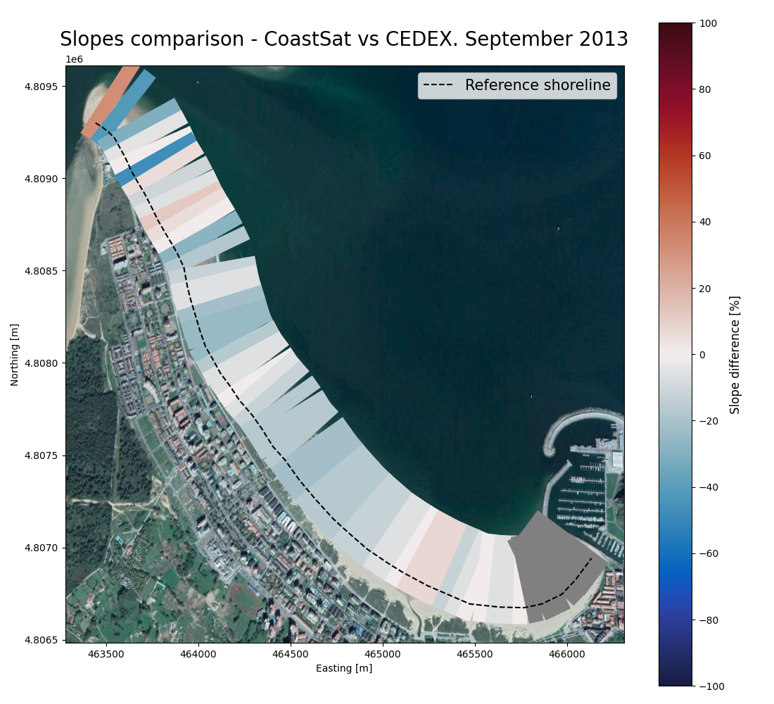
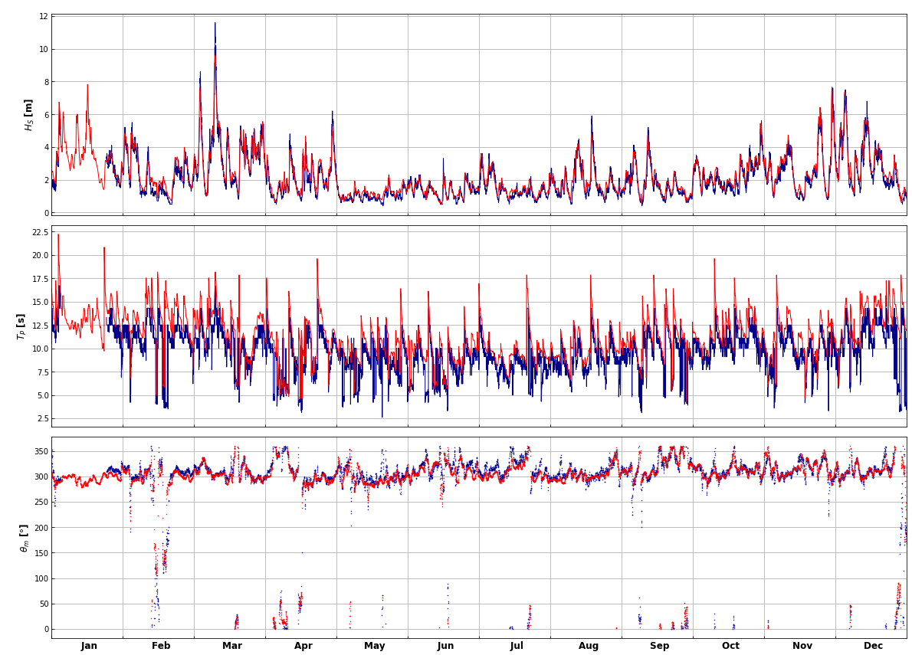
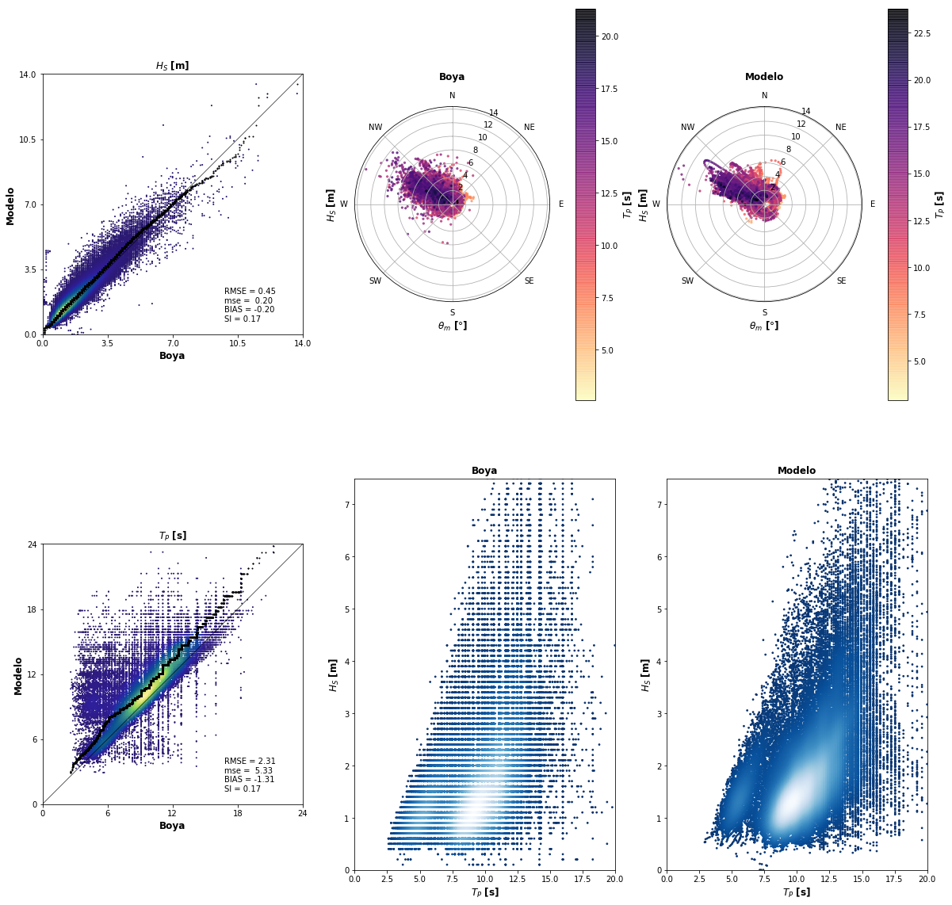
Open data
GEE images + tide levels
Beach-face slopes
CoastSat.slope (Vos et al, 2020)
CSIRO hindcast
Calibrated (1)
Validated (2)
(1) Satellite data
IMOS
(2) Buoy data
Puertos del Estado
HyWaves (Ricondo et al, sub.)

Slide 8
Methodology
Operational
Offshore waves
Tide levels
Satellite images
Topobathymetries
(*)
Beach slopes
Calibration
Validation
Analogue forcings
Analogue topobathy
Cases selection (MDA)
Synthetic cases (LHS + MDA)
Waves propagation (SWAN)
XBeach
Lisflood-FP
Waves reconstruction (RBF)
PCA + RBF
HyWaves (Ricondo et al, sub.)
2D WL maps
Flood extents
(*) CoastSat.slope (Vos et al, 2020)

Slide 9
Methodology
CSIRO hindcast
Albuquerque et al, 2018
Calibrated & Validated
HyWaves (Ricondo et al., sub.)
HyWaves
Selection: MDA
Propagation: SWAN
Reconstruction: RBF
Calibration
Satellite data (IMOS)
Validation
Buoy data (Ports of Spain)
MDA + SWAN + RBF
LHS + MDA
Hs, Tp, θ, σ, WL
XBeach
XBeach
Non-regular mesh
Surf-beat mode
Warm-up: 1h
PCA + RBF
Lisflood-FP
Δx = 5 m
Full SWE
Input: Water Level
Lisflood-FP
Sentinel Hub

Slide 10
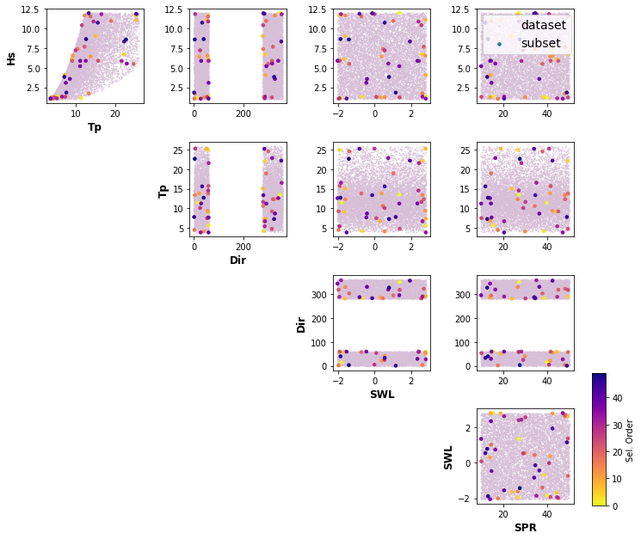
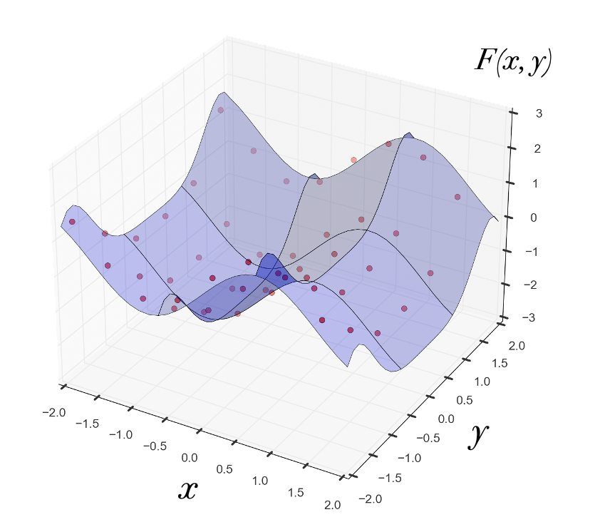
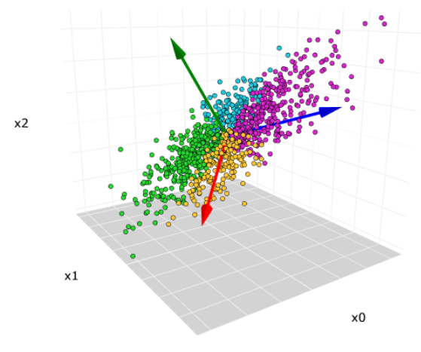
Methodology
Generation of synthetic cases
Latin Hypercube Sampling (LHS)
{Hs, Tp, θ, σ, η}
Selection of cases
Maximum Dissimilarty Algorithm (MDA)
Numerical simulation
XBeach
Principal Components Analysis (PCA)
Series reconstruction
Radial Basis Functions (RBF)
XBeach simulations set-up
Surf-beat mode
Non-regular rectangular mesh
Δx = 5 m in Laredo Bay
Warm-up: 1h
Time series of 2D water level maps

Slide 11
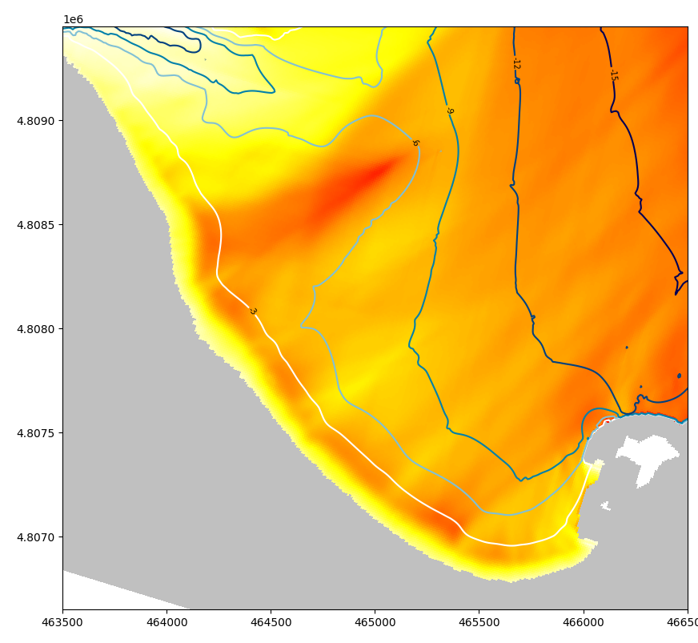
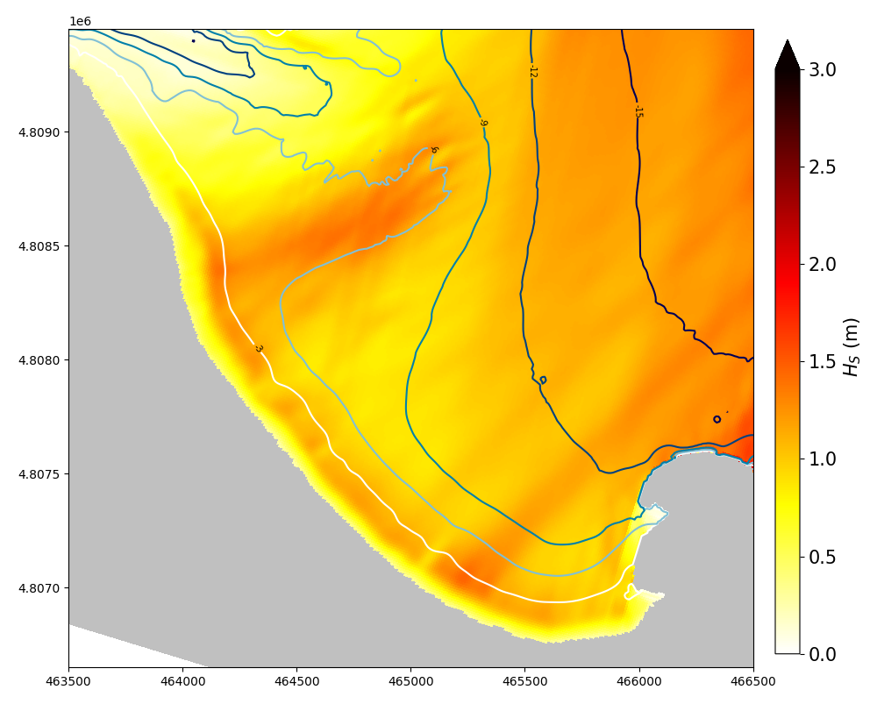
Results
Forcing:
Hs = 4 m
Tp = 15 s
θ = 300º
WL = 0 m
Forcing:
Hs = 4 m
Tp = 15 s
θ = 300º
WL = 0 m

Slide 12
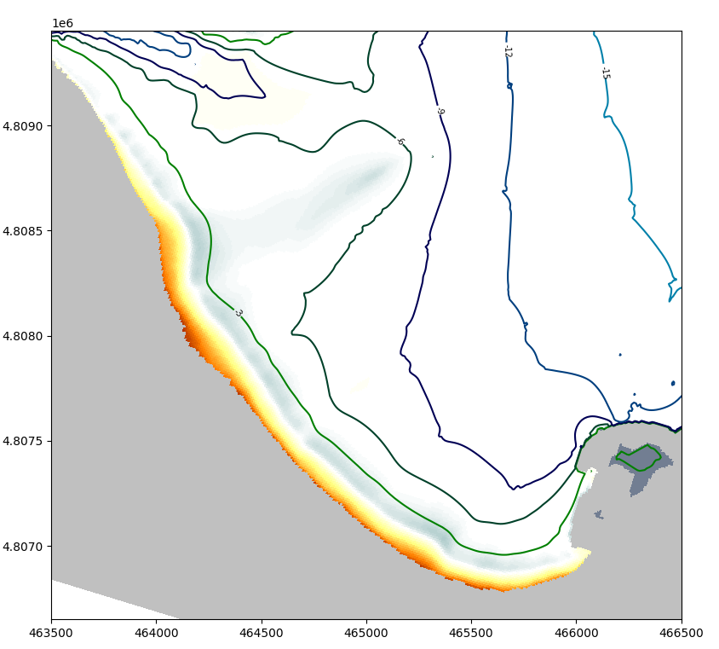
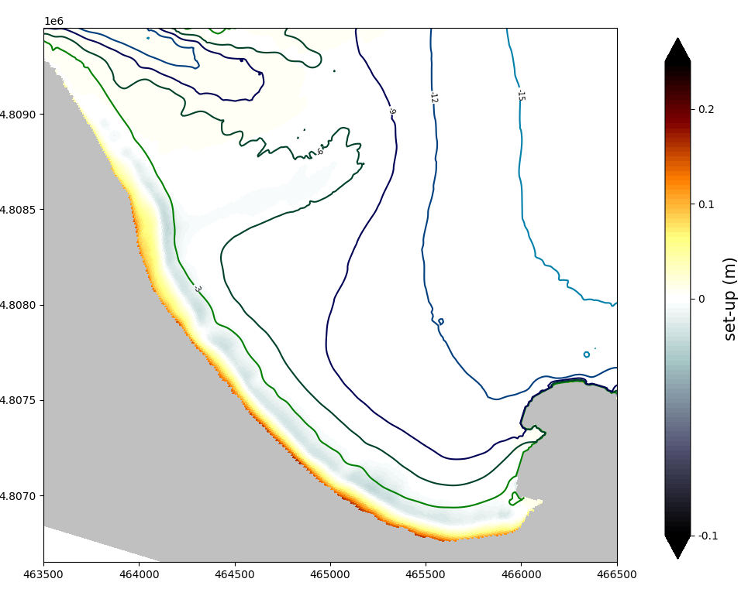
Results
Forcing:
Hs = 4 m
Tp = 15 s
θ = 300º
WL = 0 m
Forcing:
Hs = 4 m
Tp = 15 s
θ = 300º
WL = 0 m

Slide 13
Results

Slide 14
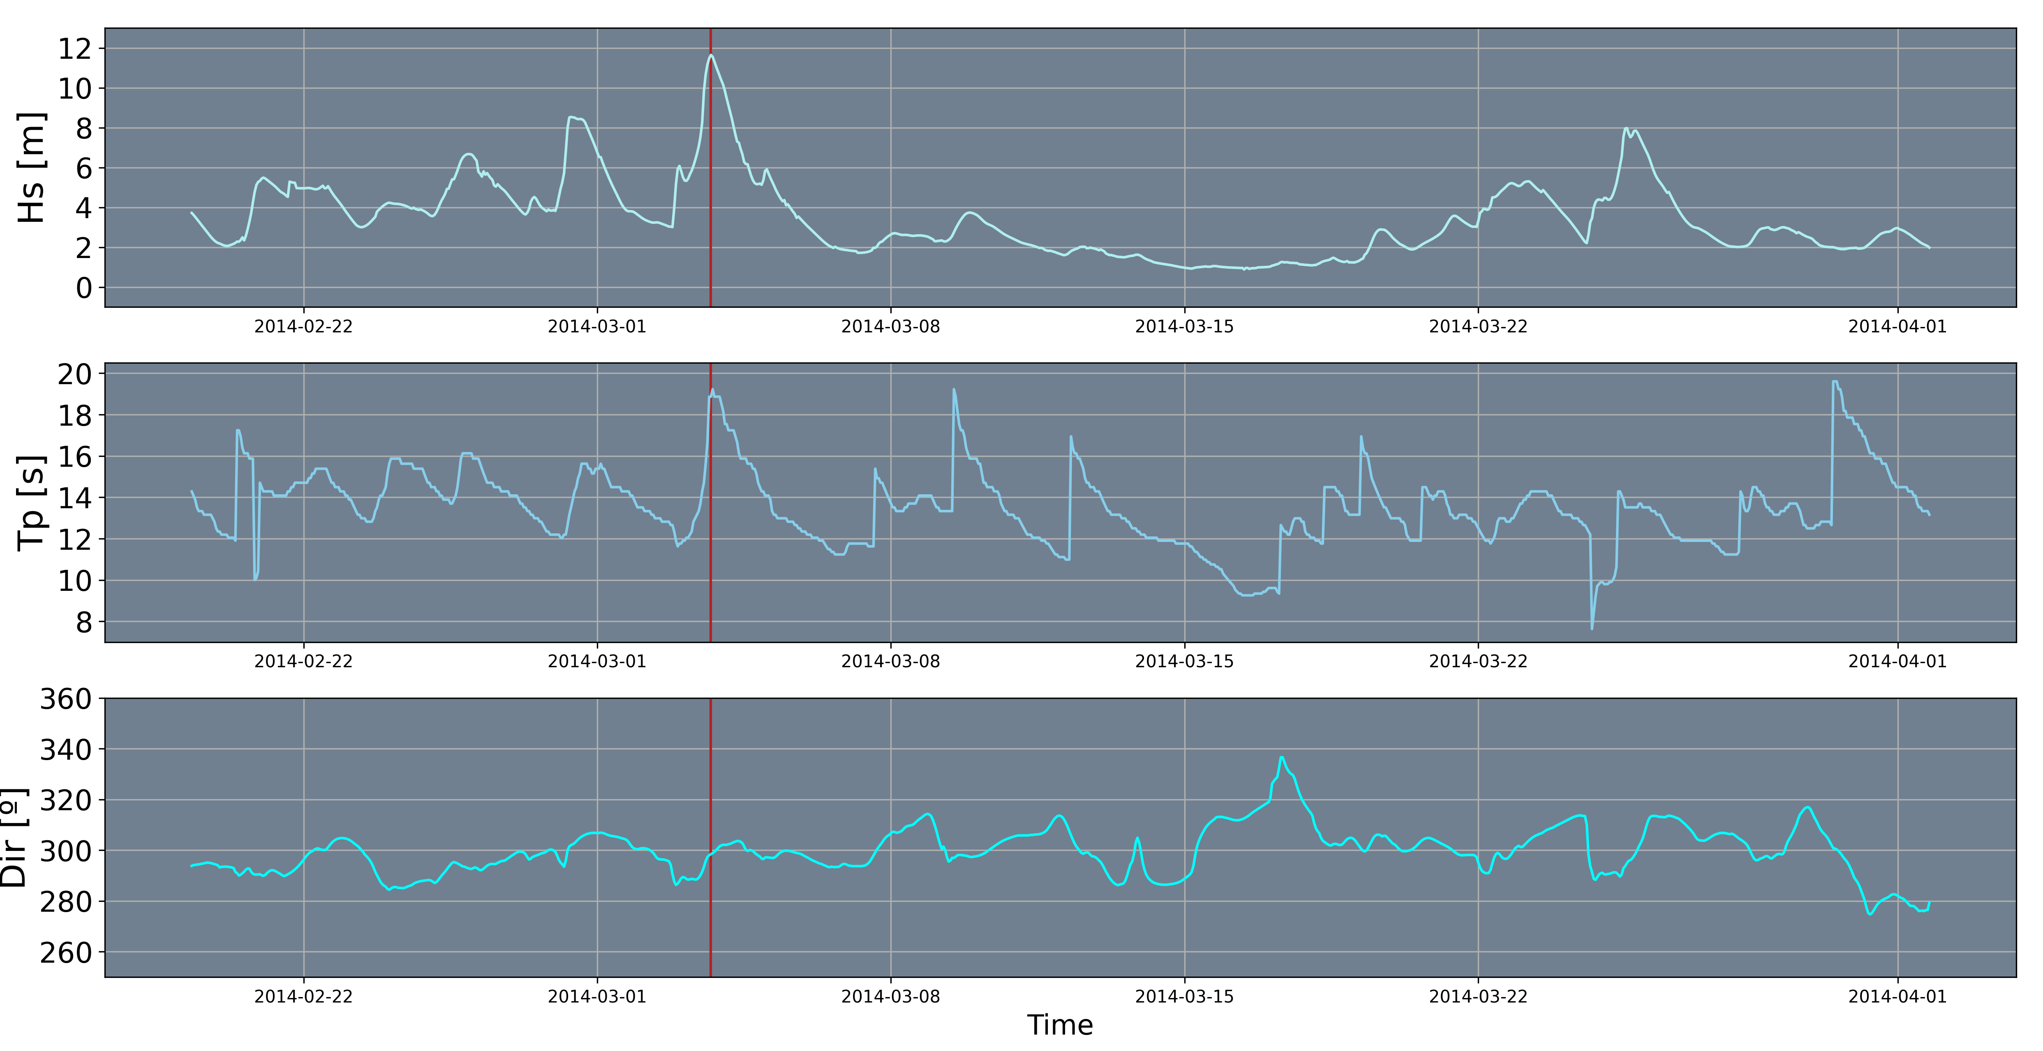
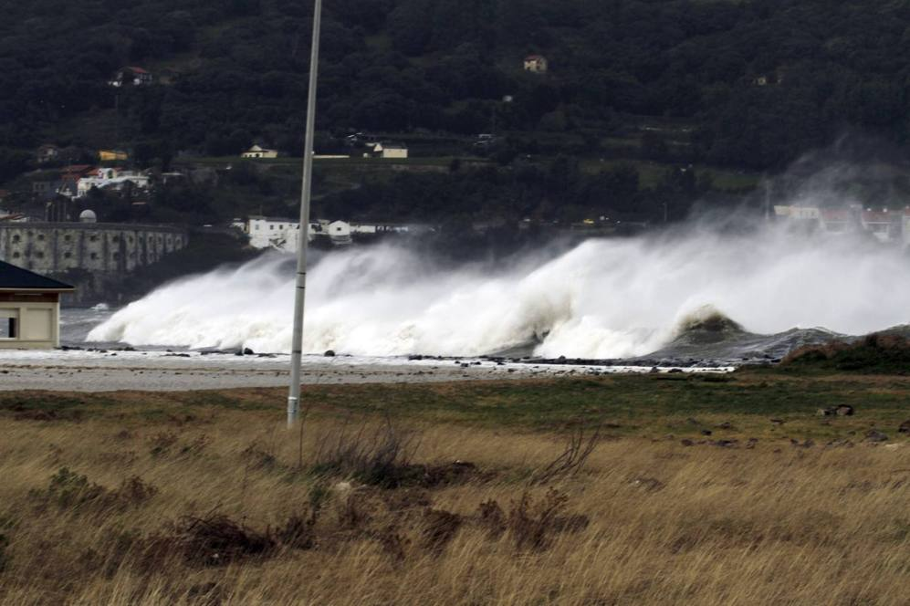
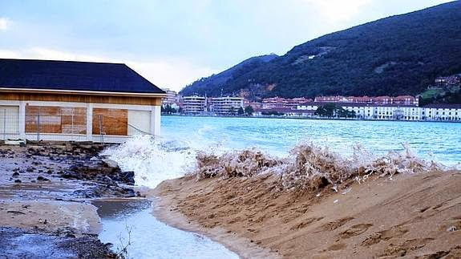
Results
Validation: March 2014 Event
Hs = 11.7 m
Tp = 18.9 s
θ = 298.4º
WL = 2.4 m
(spring tides)
EA2CPG
Javier G. Fraile

Slide 15
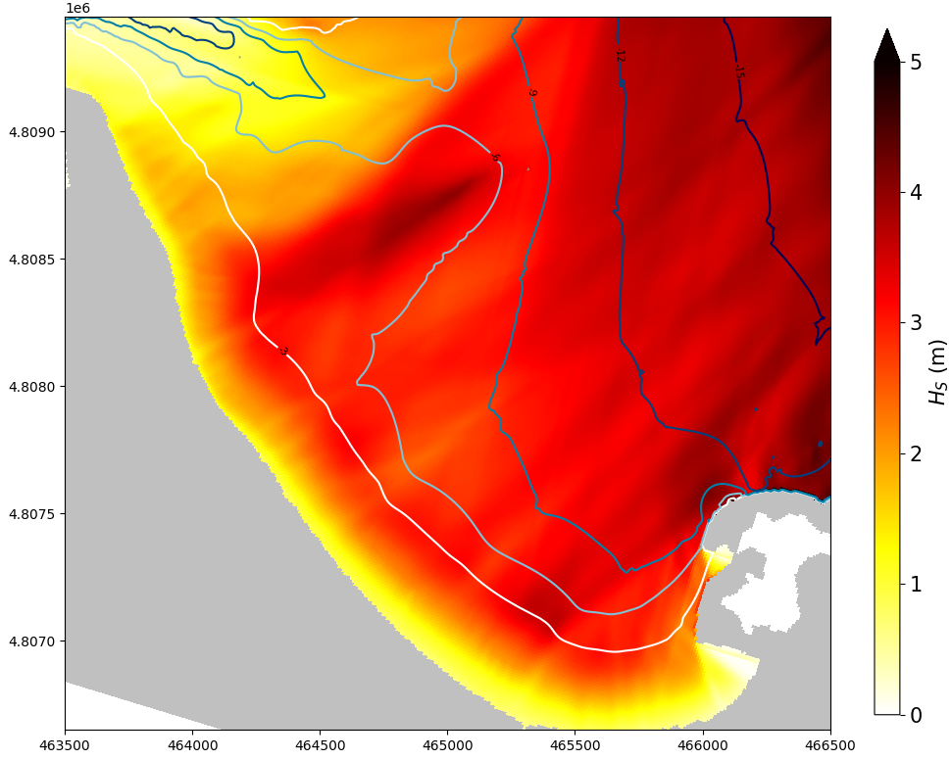
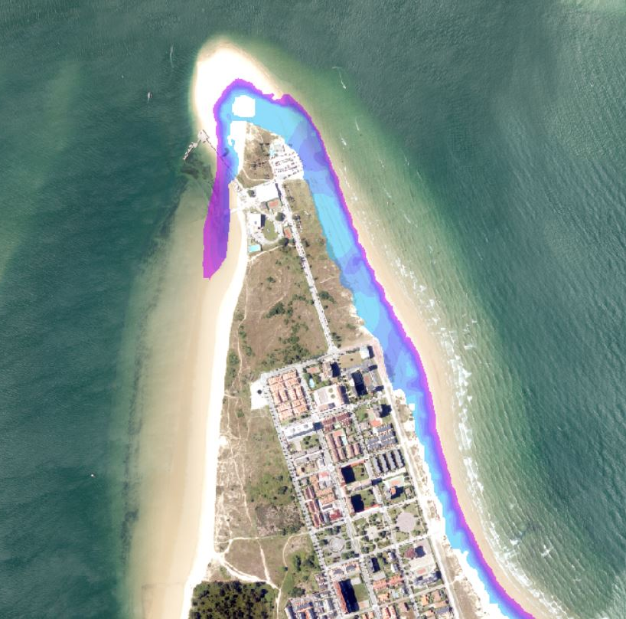
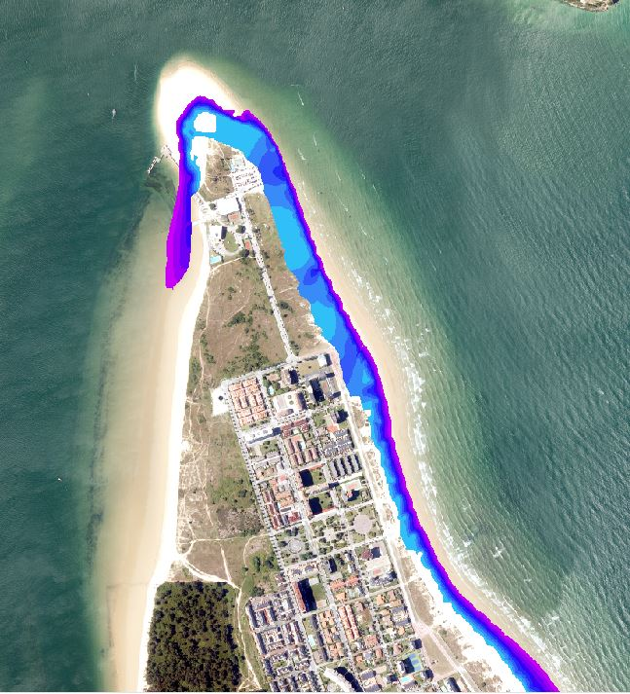
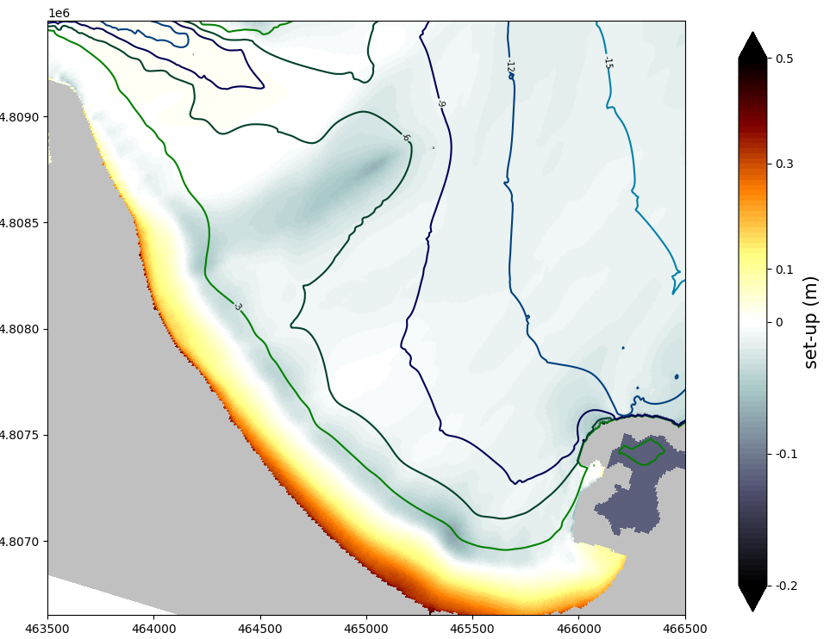
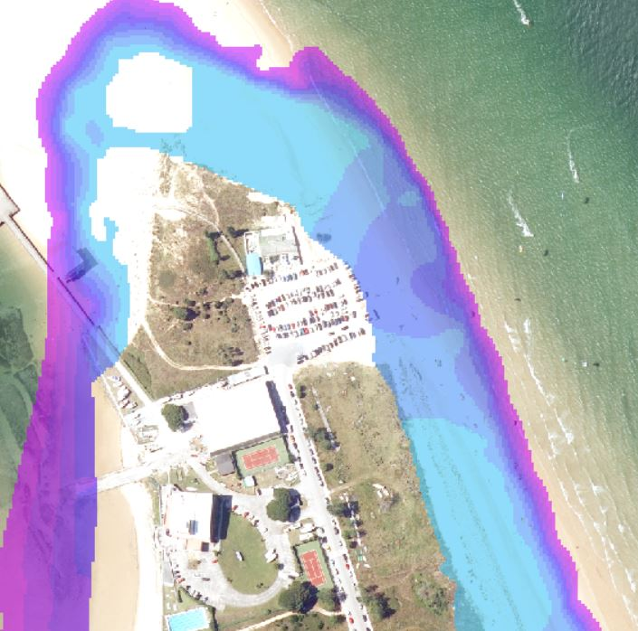
Results
Water Depth (m)
Hs = 11.7 m
Tp = 18.9 s
θ = 298.4º
WL = 2.4 m
Parking lot

Slide 16
Conclusions
Hybrid systems with changing topobathymetries allow fast and precise flooding forecasts, suitable for state-of-the-art EWS. Besides a forecast system, reconstructions can be performed with this methodology.
The modelization of river flow and potential port resonances could result in more precise and realistic simulations.
In complex morphologies where resonances can be generated, having two-dimensional water level maps allows us to identify longitudinal seiches. Moreover, the use of varying topobathys allows the identification of additional resonances.
Water level statistics ($σ_{η}$) obtained with XBeach enable the determination of the IG wave level component. This, along with AT, SS and wave set-up serves as input for Lisflood-FP inundation model.

Slide 17
manuel.zornoza@unican.es
geoocean.unican.es
Manuel Zornoza Aguado
Acknowledgements
This work is funded by the Spanish Ministry of Science and Innovation, National Project “Beach4Cast” (PID2019-107053RB-I00).
Topo-bathymetry and sediment data provided by Centro de Estudios y Experimentación de Obras Públicas (CEDEX).

Slide 18
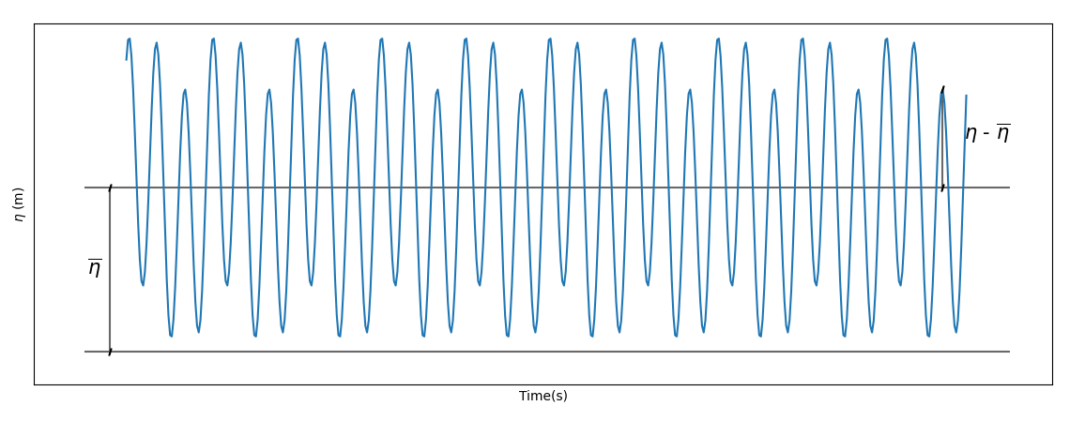
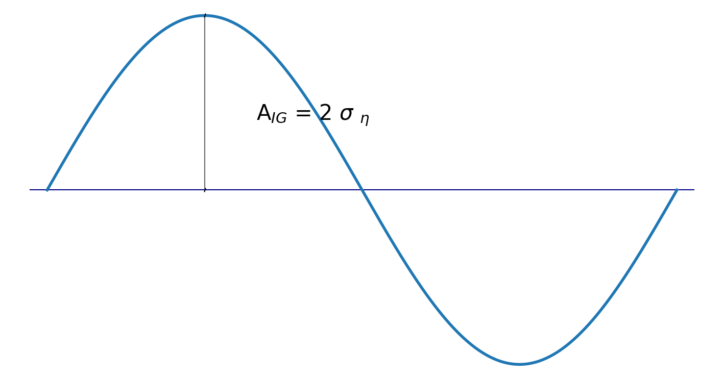
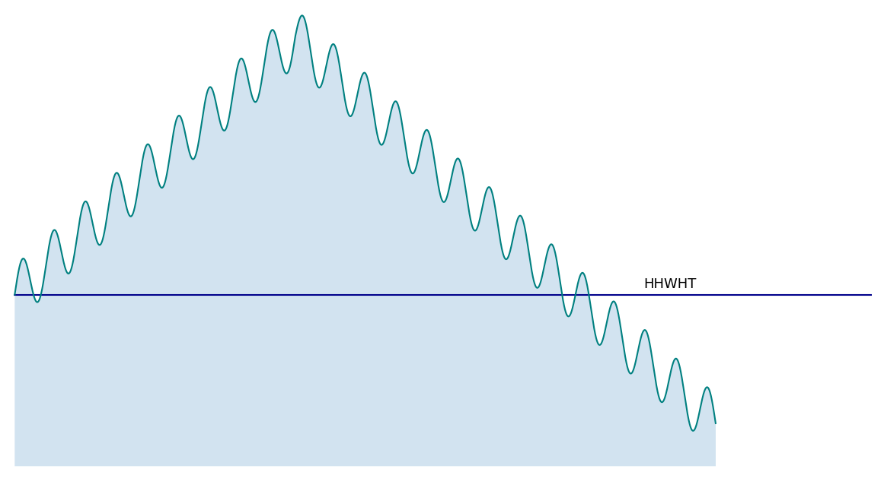
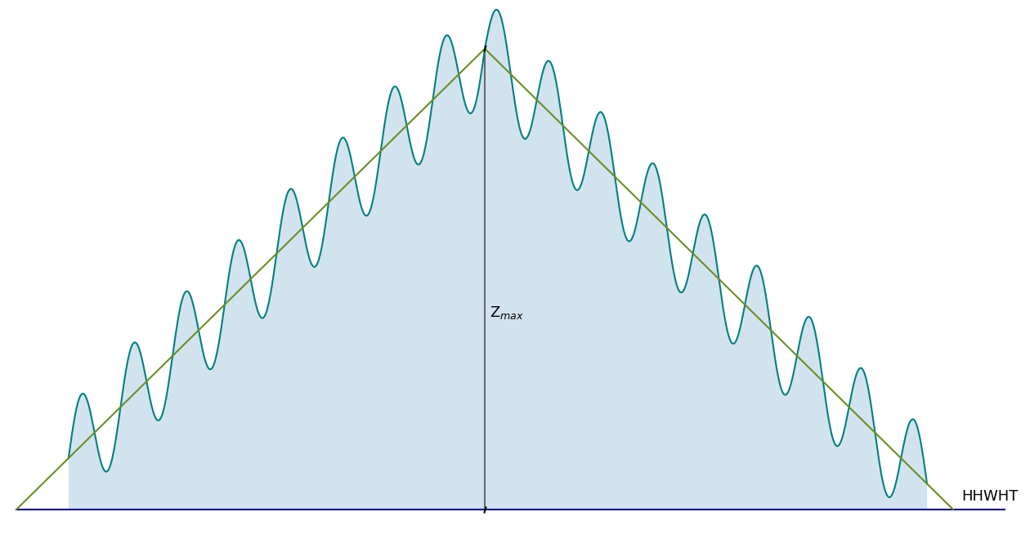
HyFlood
$σ_{η}$ : std of IG wave
$η_{IG}$ from Xbeach → ($η$ , $σ_{η}$)
Boundary Condition for Lisflood-FP:
$H_{s_{IG}}=4 \sqrt{m_{0_{IG}}}=4 σ_{η}$
η$=η^{∗}+ A_{IG}\cos\left(\frac{2πt}{T}\right)$
T $≈200 s$
Each hour:
During an event:
$η_{MWL}\left(t\right)=η^{∗}(t)$+ $η_{IG} (t)$
$$z_{max}$$
Parameters for Lisflood-FP:
$${\{ z}_{max} , Vol , { A}_{IG} \}$$

