Slide 1
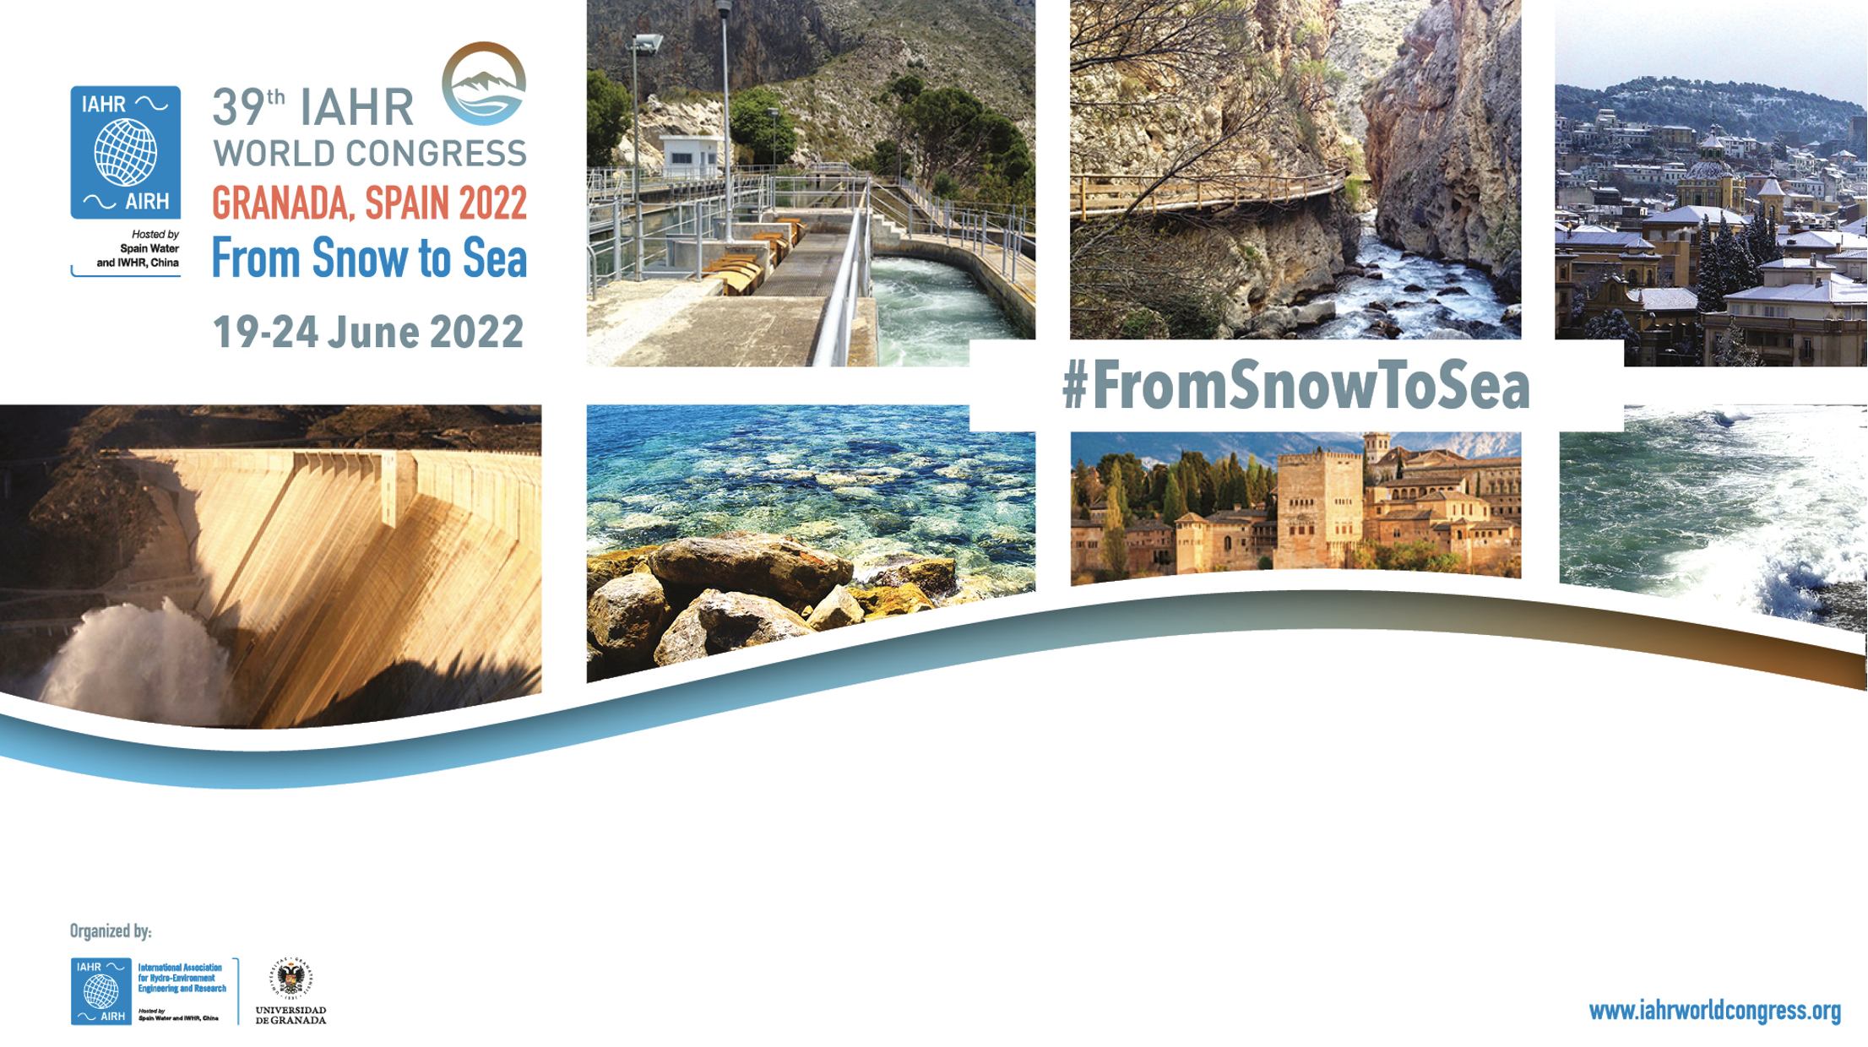

TESLA 2.0: A Climate-Based Emulator of Met-Ocean Parameters for the Analysis of Coastal Flooding Risk in Small Islands affected by Extra-Tropical and Tropical Cyclones
Fernando J. Méndez, Laura Cagigal, Alba Cid, Ana Rueda, Alberto Luceño, Sonia Castanedo, Beatriz Pérez, Nicolás Ripoll, Sara O. van Vloten, Manuel Zornoza, Alba Ricondo, Javier Tausía, Andrea Pozo, Israel Rubio

Slide 2


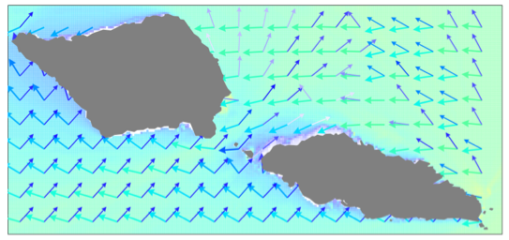
Introduction
Multimodal Sea States

Slide 3
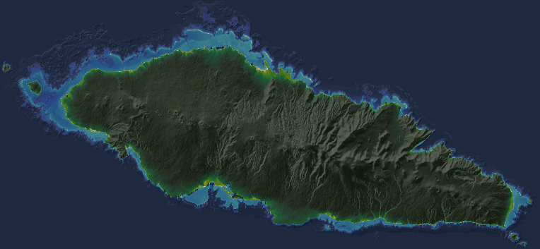
Introduction
Multi Hazard Risk Assessment
Coastal Flooding Damage 1
Rainfall Flooding Damage 2
Wind Damage 3

Slide 4

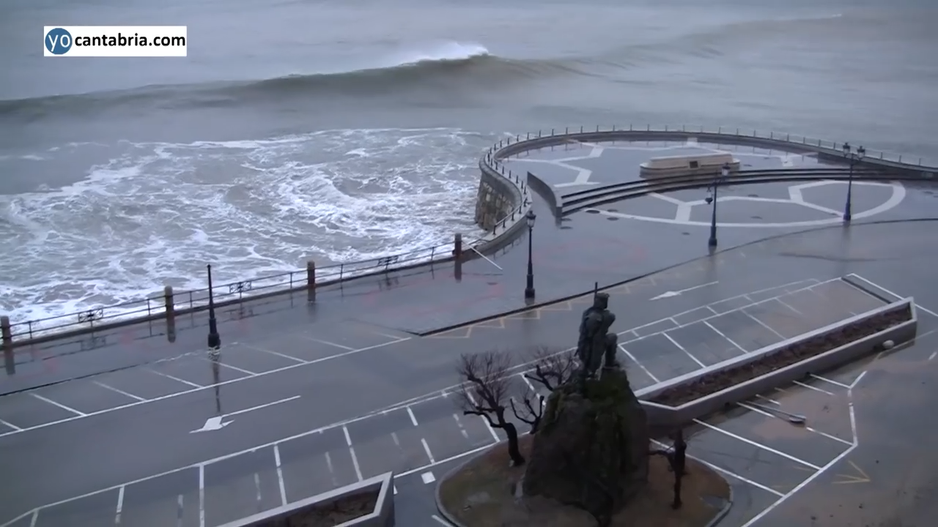
Introduction
Multivariate Coastal Extreme Events

Slide 5
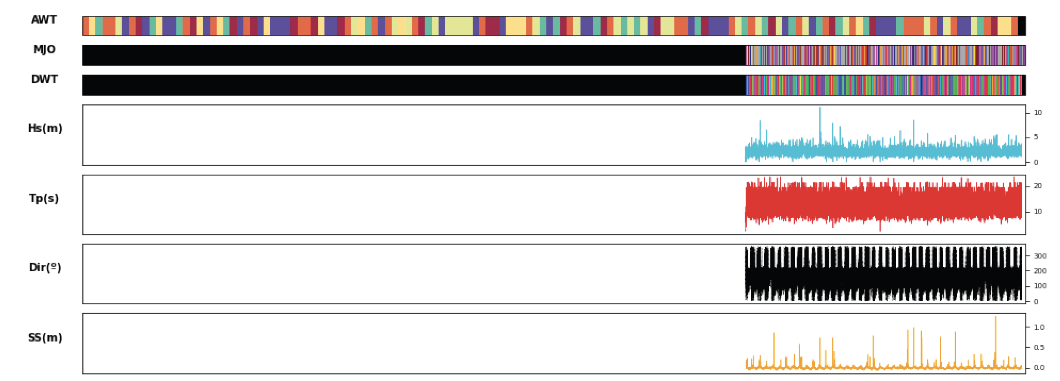
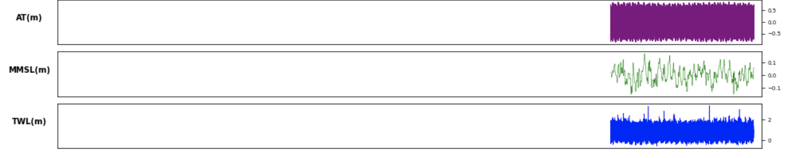
“Study the past, if you would divine the future”
Confucius
1880
Present

Slide 6
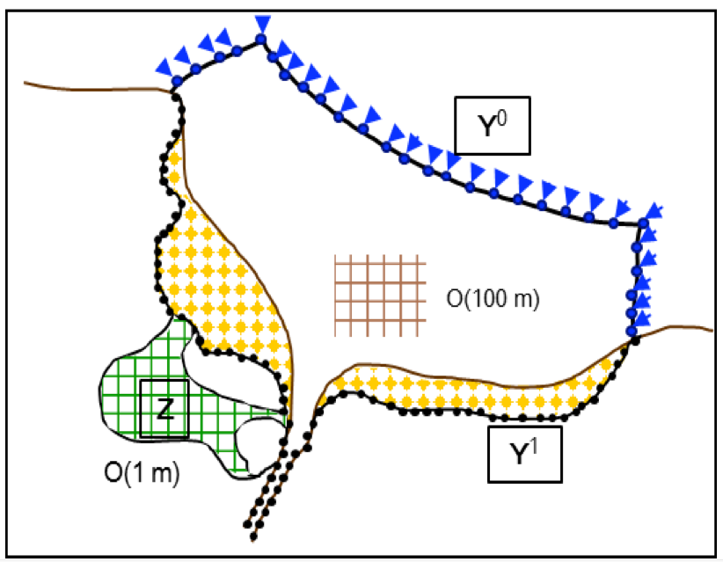
Standard Conceptual Framework
Human Driver
Exposure
Vulnerability
(SLR, SST changes, changes in frequency ENSO, … )
Climatic
Driver
Predictor
Regional
Hazard
Local
Hazard
Impacts
Risk
Change in Risk
Astronomical Tide

Slide 7
Conceptual Framework considering Climate Vairability
Human Driver
Exposure
Vulnerability
(SLR, SST changes, changes in frequency ENSO, … )
Climatic
Driver
Predictor
Regional
Hazard
Local
Hazard
Impacts
Risk
Change in Risk
Astronomical Tide

Slide 8
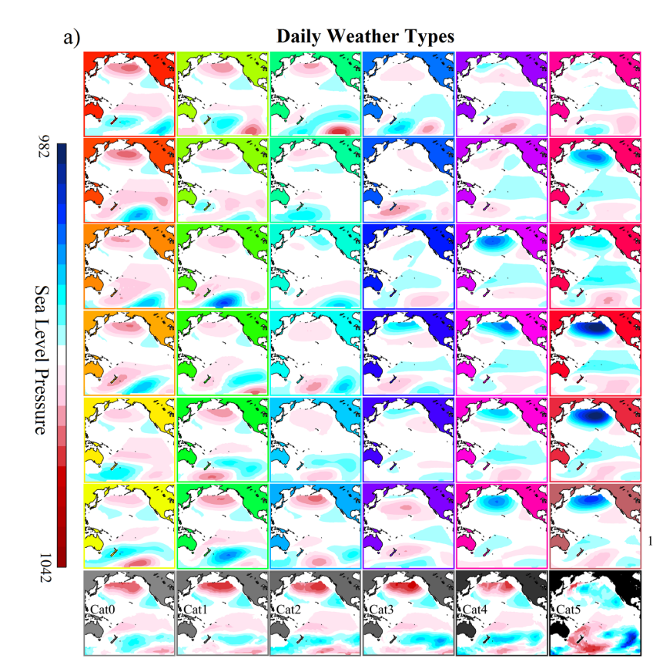
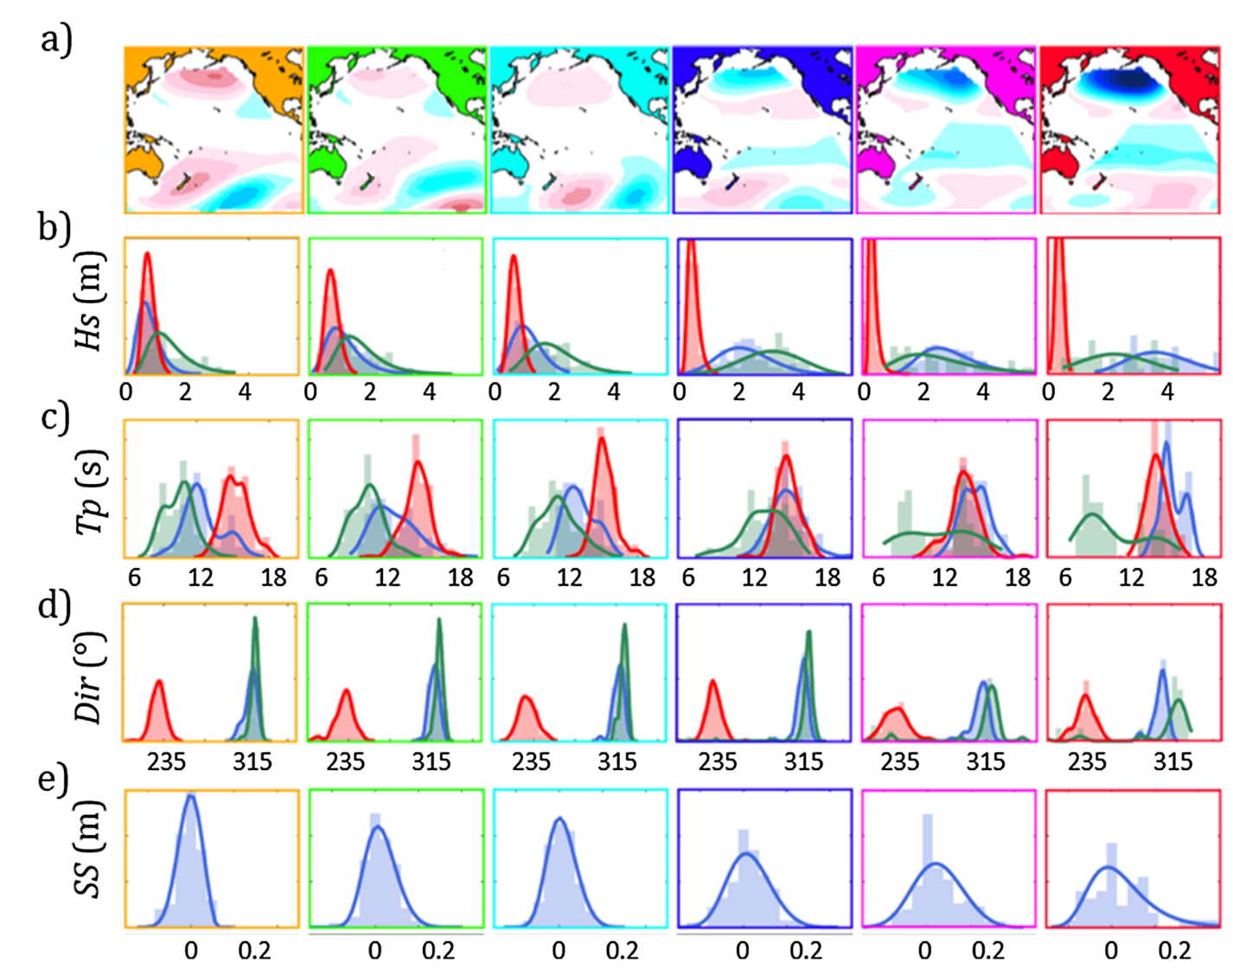
Introduction
X(t)
Y(t)
Statistical Downscaling
Rueda et al 2017 JGR
Anderson et al 2019 JGR
Cagigal et al 2020 OM

Slide 9
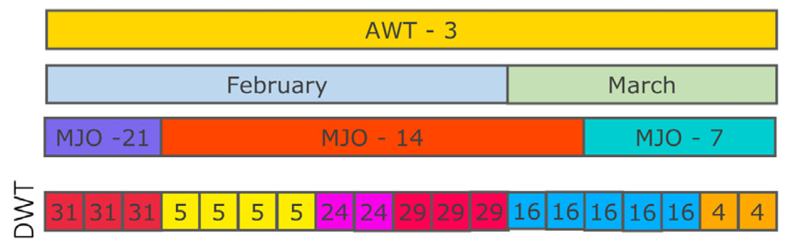
TESLA 1.0
PREDICTOR (DWT)
X(t)
Anderson et al 2019 JGR
Cagigal et al 2020 OM
Autoregressive logistic regression model
ENSO
Covariates
Seasonality
MJO
DWT → f(ENSO, Seasonality, MJO)
Synthetic timeseries
DWT

Slide 10
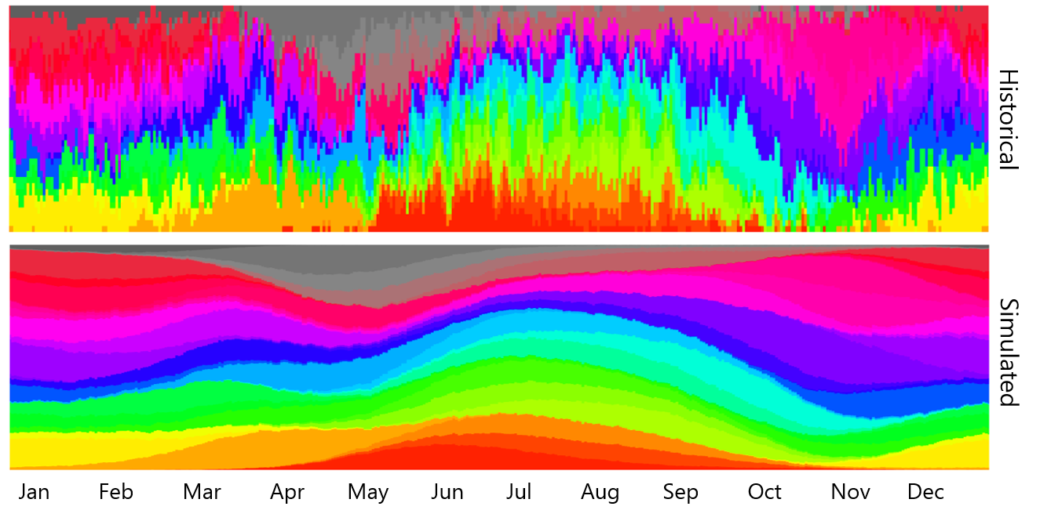
TESLA 1.0

Slide 11
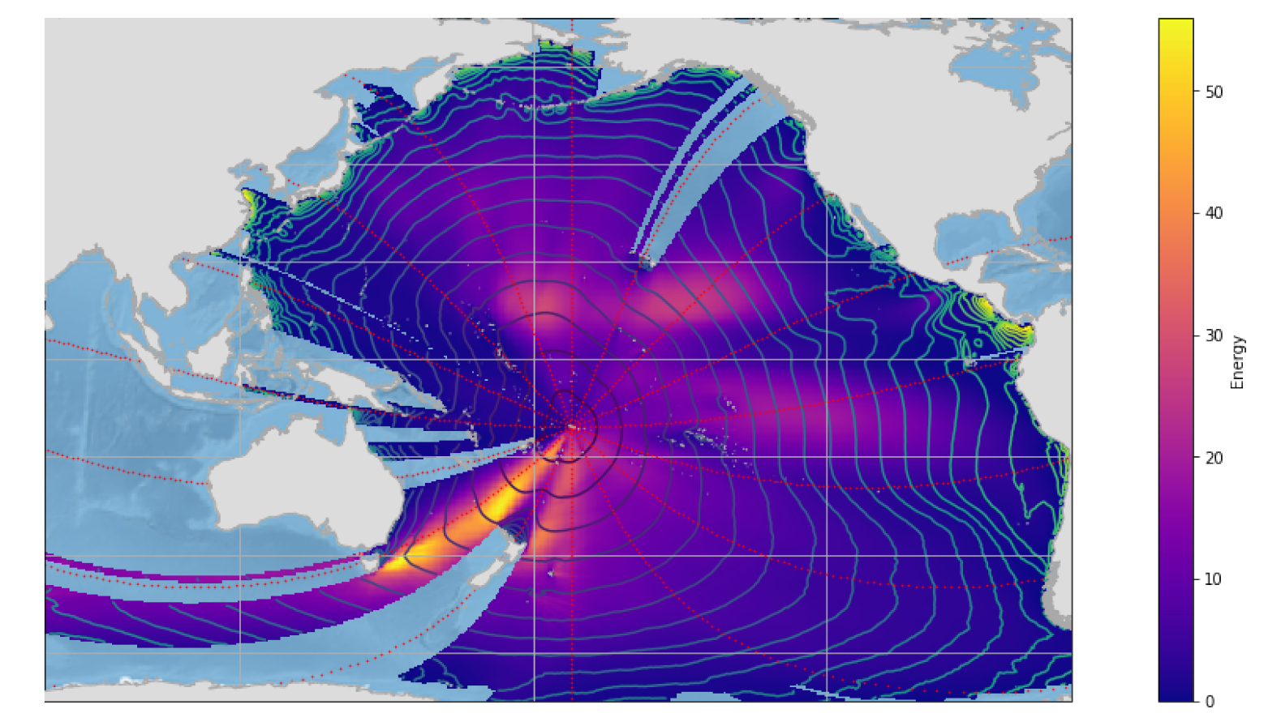

TESLA 2.0
Bulk Parameters
[H_{s}, T_{p}, Dir_{m} ]
Directional Wave Spectra
$$S (f, θ)$$
Y(t)
vs.
TONGA
ESTELA (Pérez et al., 2014)

Slide 12
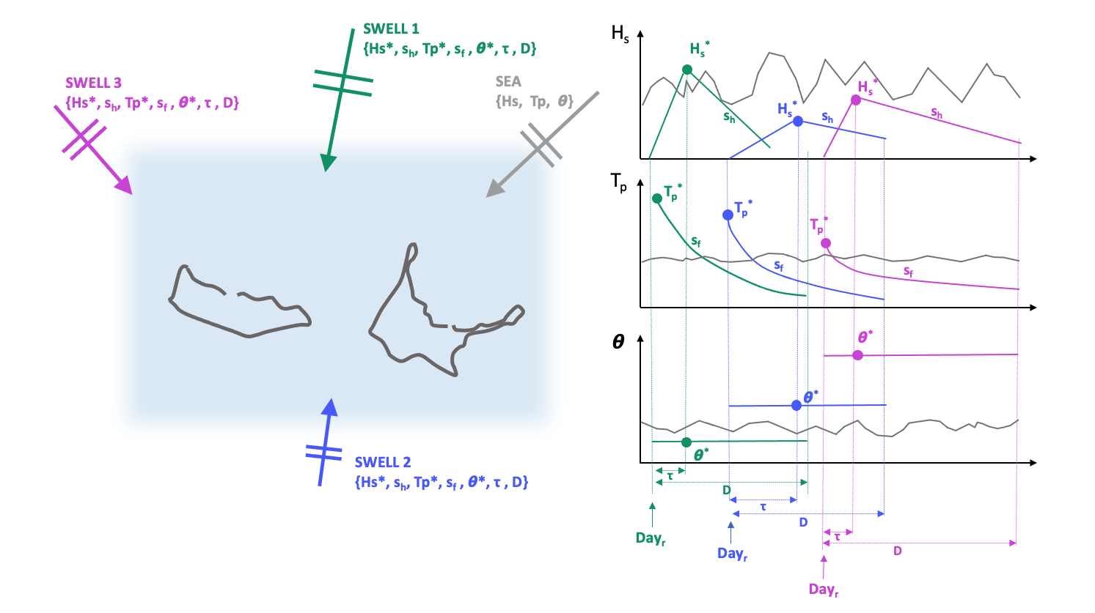
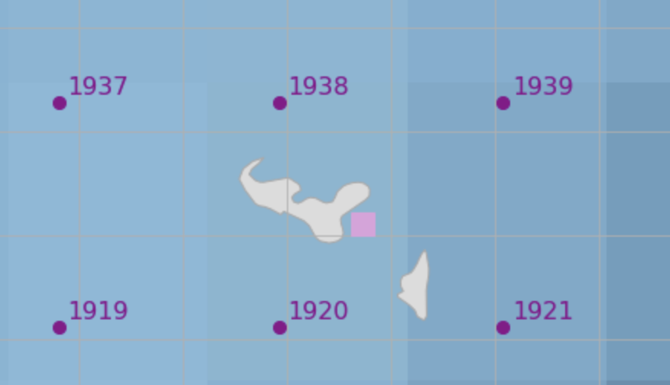
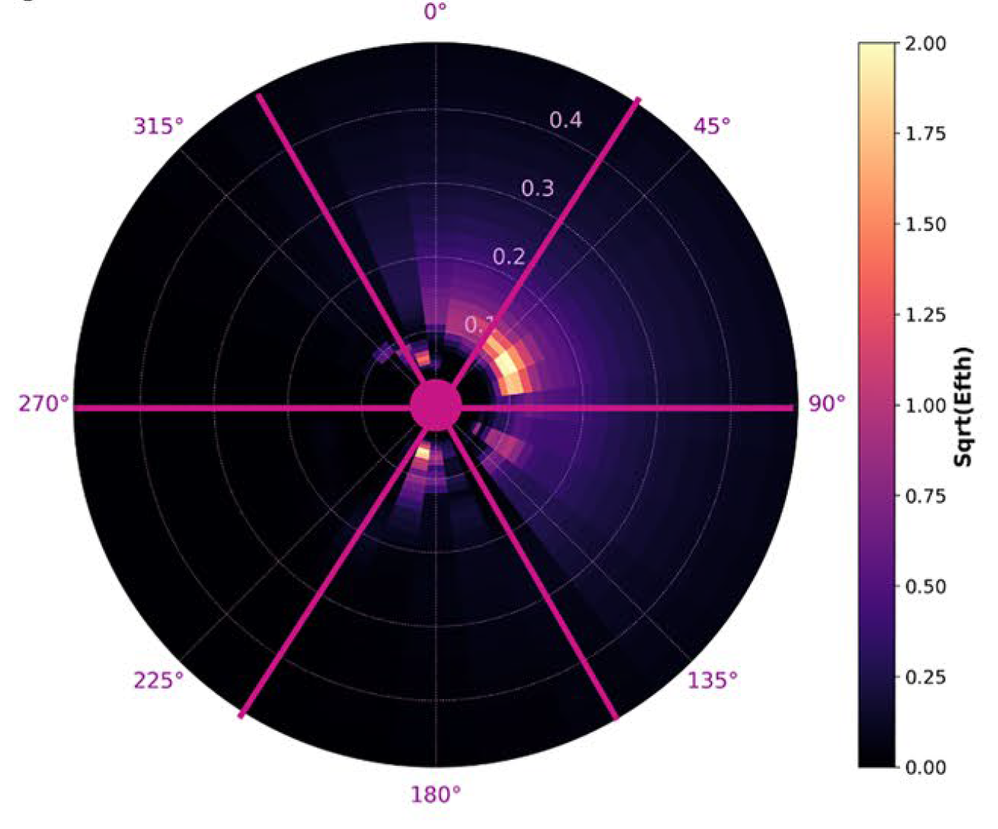
TESLA 2.0 – Multimodal sea states

Slide 13
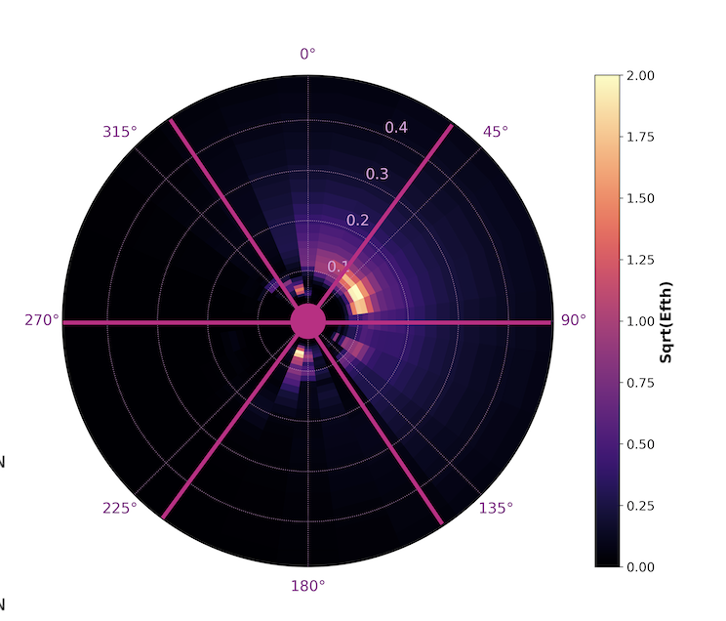
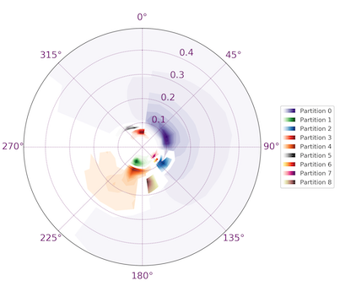
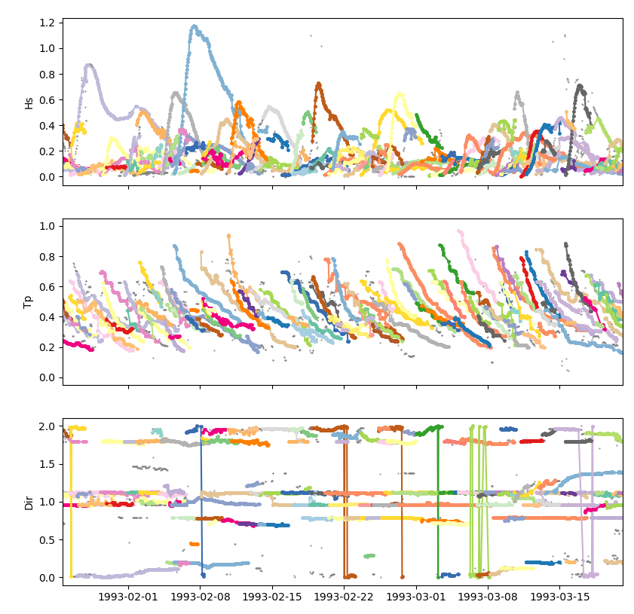


TESLA 2.0 – Multimodal sea states
WAVESPECTRA
https://github.com/metocean/wavespectra/
WW3 Watershed Algorithm, Hanson and Philips 2009

Slide 14
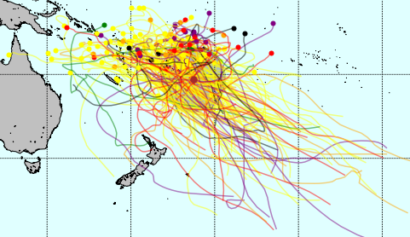
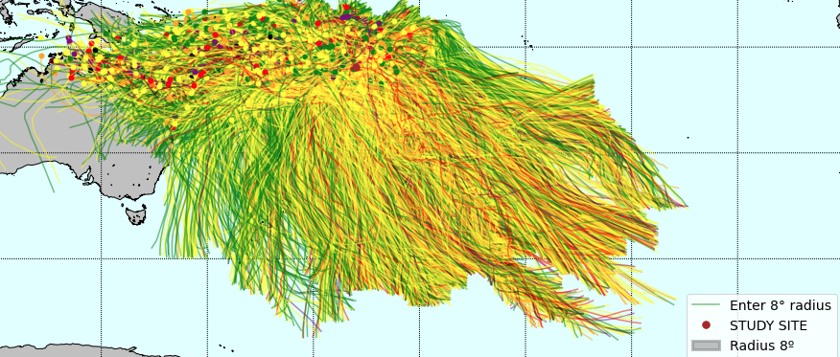
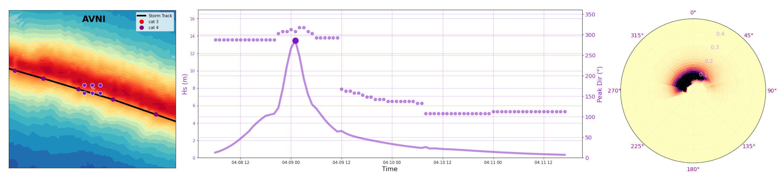
TESLA 2.0 - TCs
+ 6 DWTs
Historical TC tracks from IBTrACS
Expand with synthetic tracks from (Nakajo et al., 2014)
SHyTCWaves (van Vloten et al., (in prep.))

Slide 15
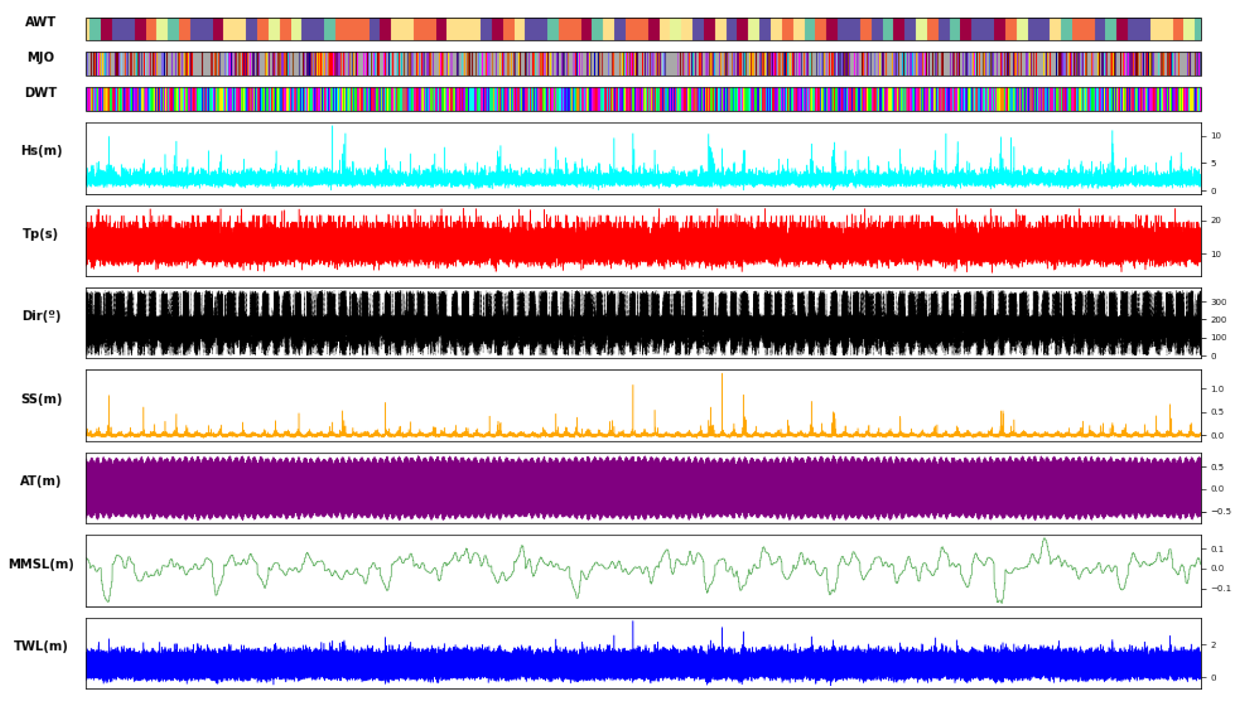
Results
10 Simulations x 100 Years

Slide 16
Conceptual Framework
Human Driver
Exposure
Vulnerability
(SLR, SST changes, changes in frequency ENSO, … )
Climatic
Driver
Predictor
Regional
Hazard
Local
Hazard
Impacts
Risk
Change in Risk
Astronomical Tide

Slide 17
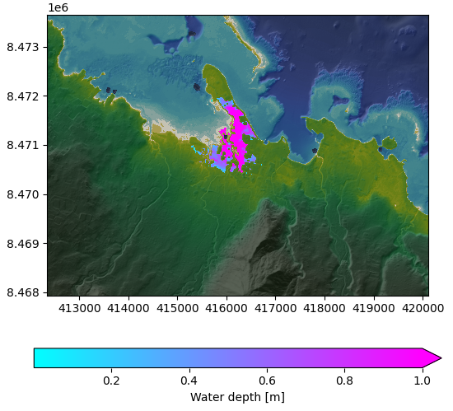
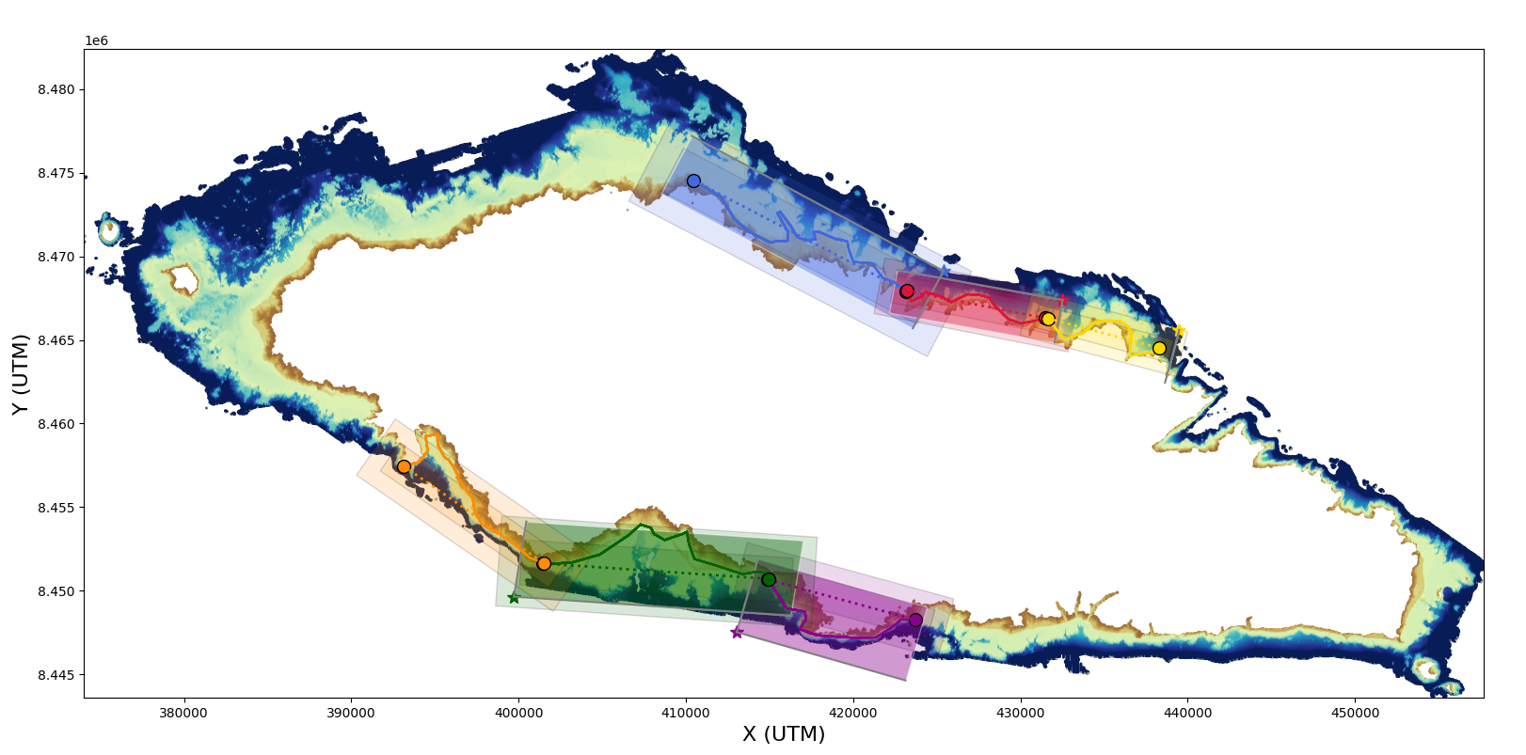
Hybrid Models
BinWaves
GreenSurge
HyBeat
HyFlood
Selection Algorithms
Spectral Bins
Green’s functions
LHS+MDA
LHDS+MDA
Numerical Models
Waves: SWAN
Storm Surge + Tide: Delft3D
IG Wave: Xbeach
Coastal Flooding: LisFlood-FP
Reconstruction
Linear Summation
Linear Summation Binary Forcings
PCA+RBF
Analogs

Slide 18
Conceptual Framework considering Climate Change
Human Driver
Exposure
Vulnerability
(SLR, SST changes, changes in frequency ENSO, … )
Climatic
Driver
Predictor
Regional
Hazard
Local
Hazard
Impacts
Risk
Change in Risk
Astronomical Tide

Slide 19
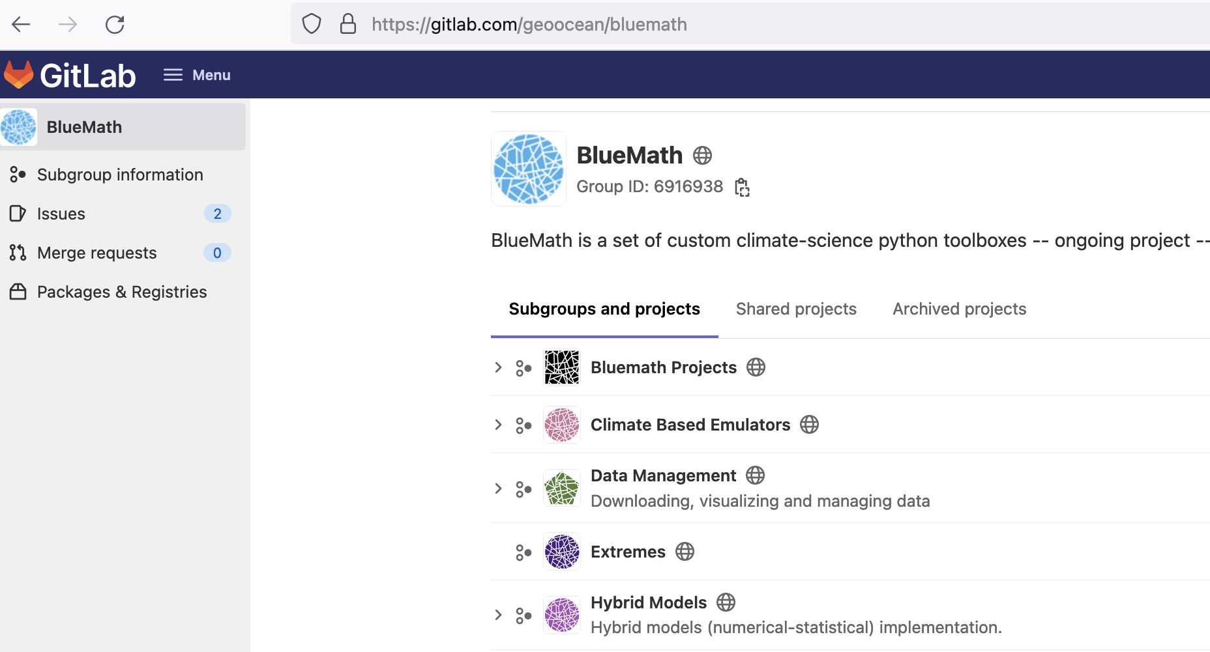
Thanks!
Agradecimientos
Este trabajo está financiado por el Ministerio de Ciencia e Innovación, bajo el proyecto de Plan Nacional “Beach4Cast” (PID2019-107053RB-I00).
https://geoocean.unican.es

