Slide 1
HyWaves: A hybrid method to downscale swells in small Pacific Islands
Geomatics and Ocean Engineering Group. Universidad de Cantabria, Santander, Spain
Alba Ricondo,
Laura Cagigal, Nicolás Ripoll, Ana Rueda and
Fernándo J. Méndez
alba.ricondo@unican.es

Slide 2
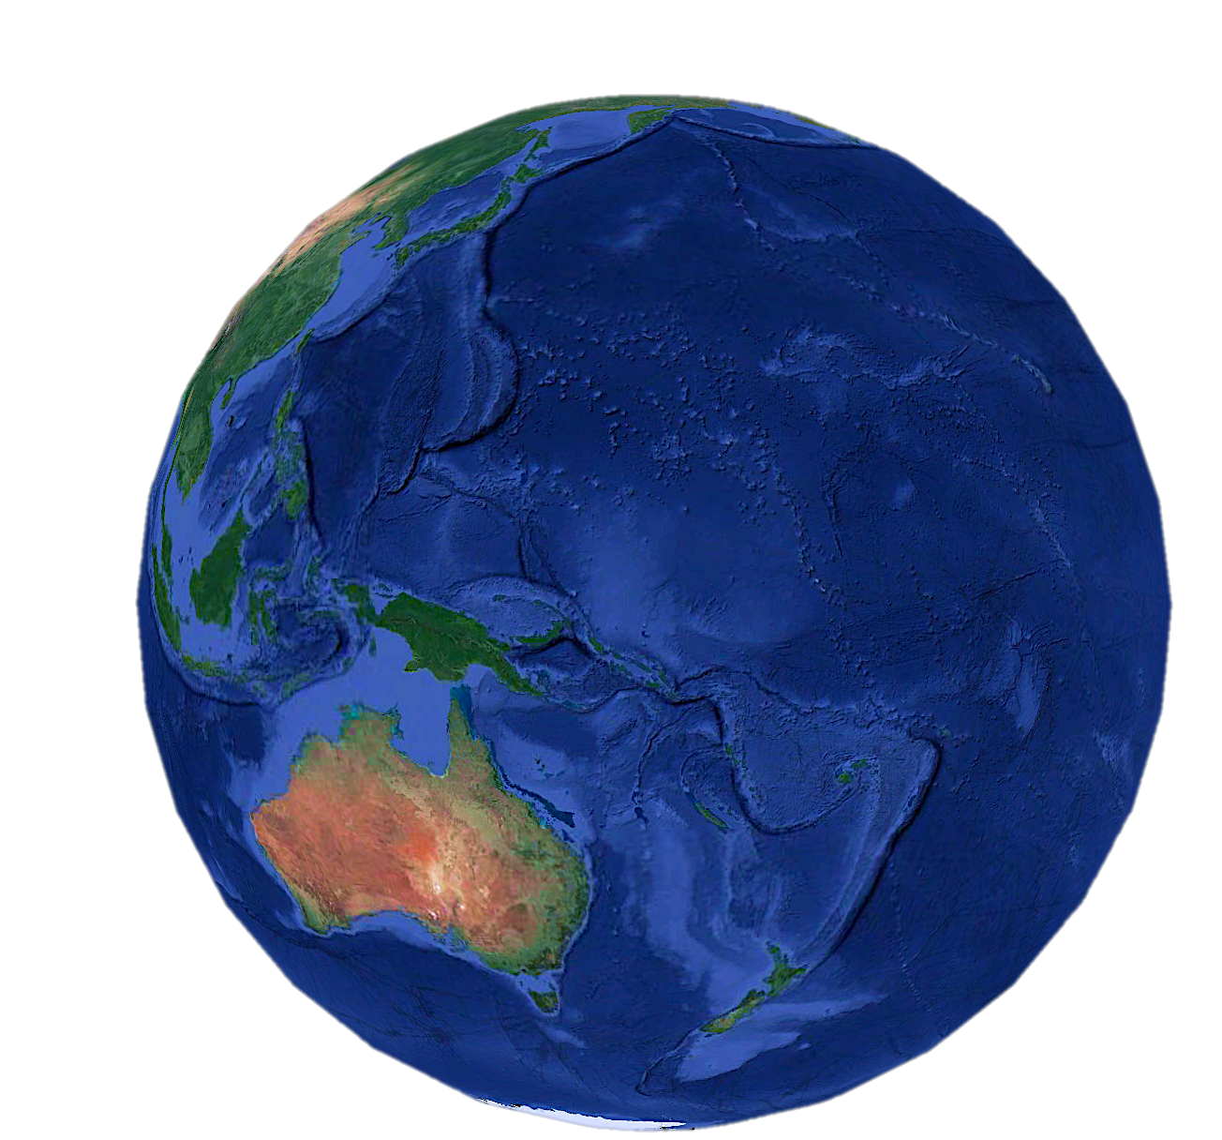
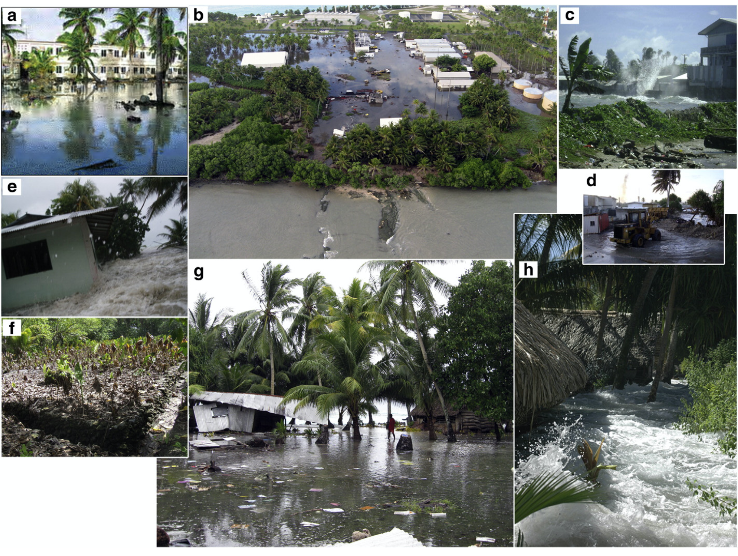
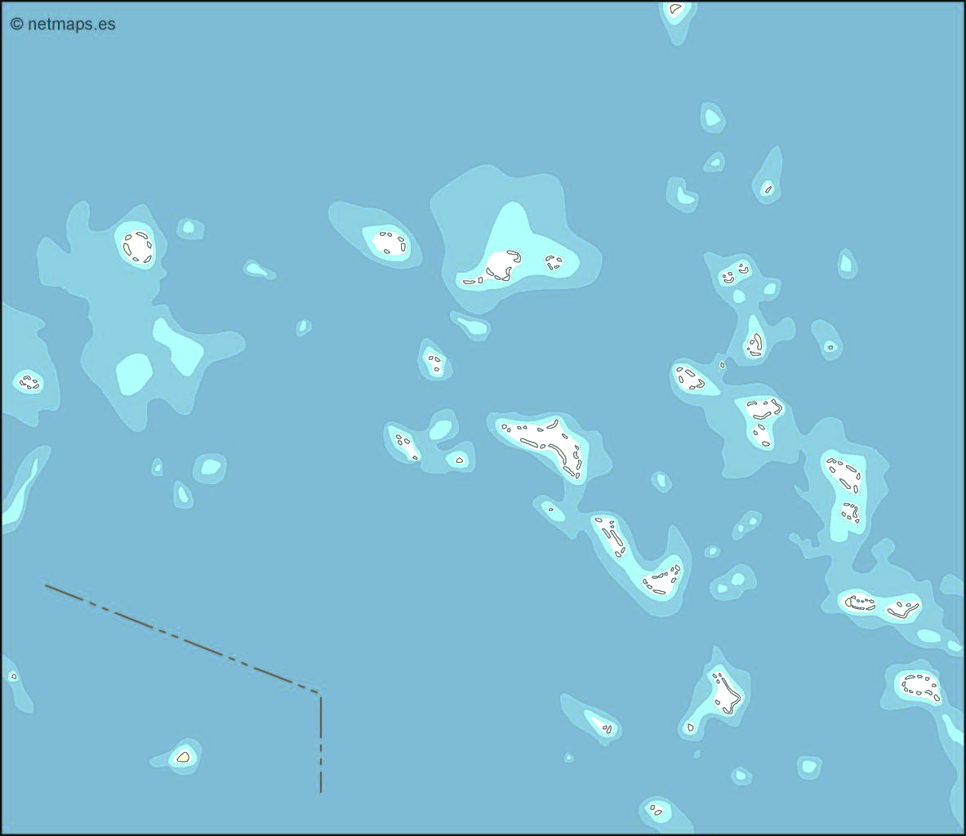
MOTIVATION
Marshall Islands
Hoeke et al,. 2013
Vulnerable to a large number of hazards
DISTANT-SOURCE WIND WAVES
TROPICAL CYCLONES
SEA LEVEL RISE
1 HyWaves : A hybrid method to downscale swells in small Pacific Islands
Alba Ricondo

Slide 3
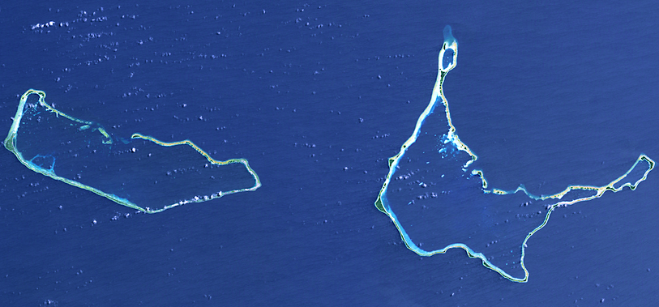
MOTIVATION
(Source: Dr. Murray Ford, the University of Auckland, New Zealand)
MAJURO
Airport
ARNO
The flood event of 24th June 2013
2 HyWaves : A hybrid method to downscale swells in small Pacific Islands
Alba Ricondo

Slide 4
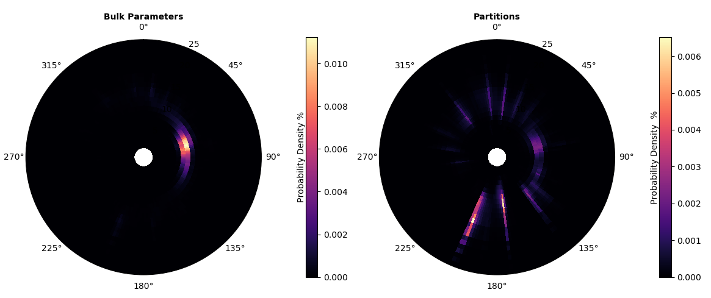
MOTIVATION: The importance of the directional spectra
3 HyWaves : A hybrid method to downscale swells in small Pacific Islands
Alba Ricondo

Slide 5
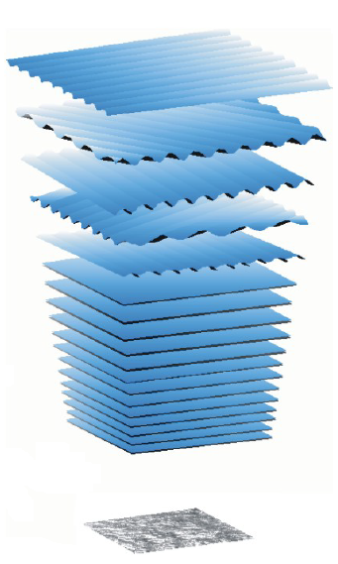
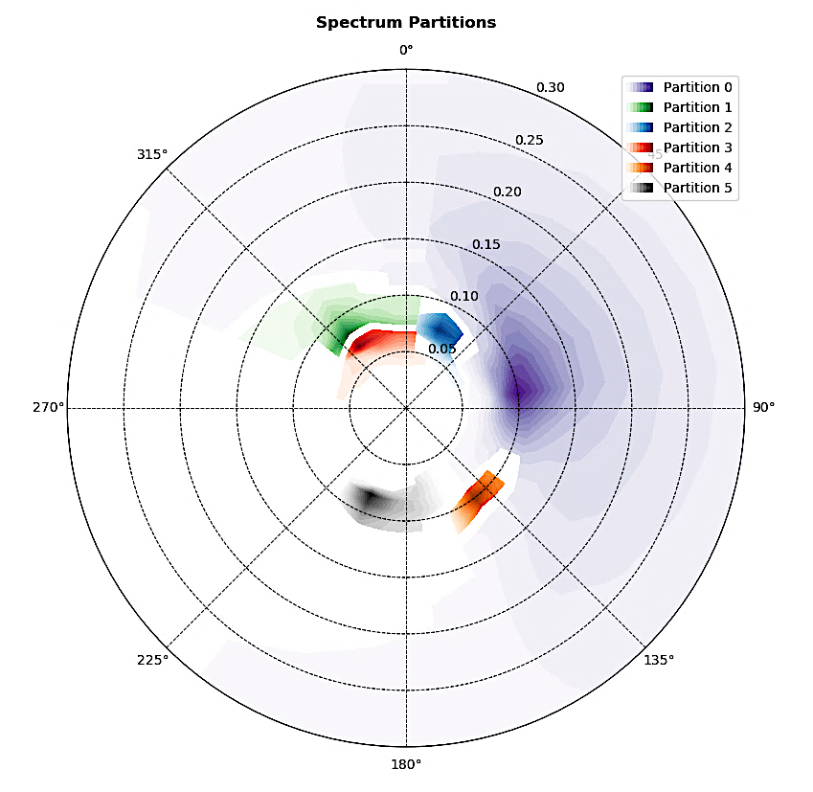
METHODOLOGY
Global wave hindcast
Sea
$H_{s}, T_{p}, θ_{m}, σ,γ$, $W_{spd}$, $W_{dir}$
MDA
SWAN
RBF
(Holthuijsen, 2007)
Reconstruction
Spectral partitioning
$$S_{t}\left(f,θ\right)=\sum_{i=1}^{N_{wave systems}}{S_{i}\left(f,θ\right)}$$
Swells
$$H_{s}, T_{p}, θ_{m}, σ,γ$$
MDA
SWAN
RBF
Validation
Inundation forecast
Early Warning Systems
4 HyWaves : A hybrid method to downscale swells in small Pacific Islands
Alba Ricondo

Slide 6
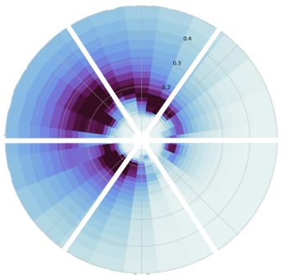
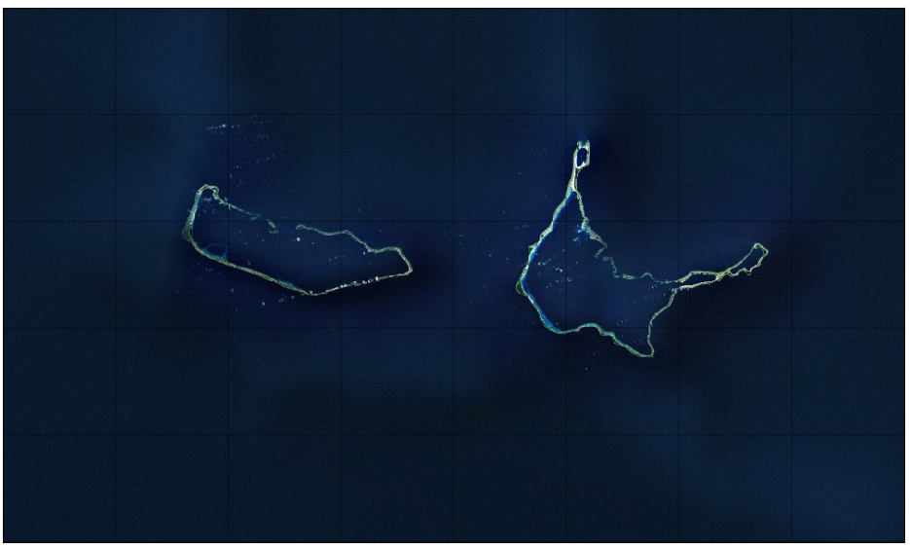
METHODOLOGY: Super-Point
St. 2914
St. 2913
St. 2913
St. 2914
St. 2915
St. 2915
Majuro
St. 2856
St. 2858
Arno
St. 2857
St. 2856
St. 2857
St. 2858
CSIRO stations
CAWCR Wave Hindcast 1979-2019
$$S_{ƞ}(f,θ)$$
5 HyWaves : A hybrid method to downscale swells in small Pacific Islands
Alba Ricondo

Slide 7
METHODOLOGY: Spectral Partitioning
Wavespectra Library
Developed by MetOcean Solutions
Physically-based techniques to identify swell trains
Watershed Method
(Hanson and Philips, 2001)
Max number of Swells = 5
Wave age = 1.7
Minimum energy in partitions
Minimum distance between peaks
6 HyWaves : A hybrid method to downscale swells in small Pacific Islands
Alba Ricondo

Slide 8
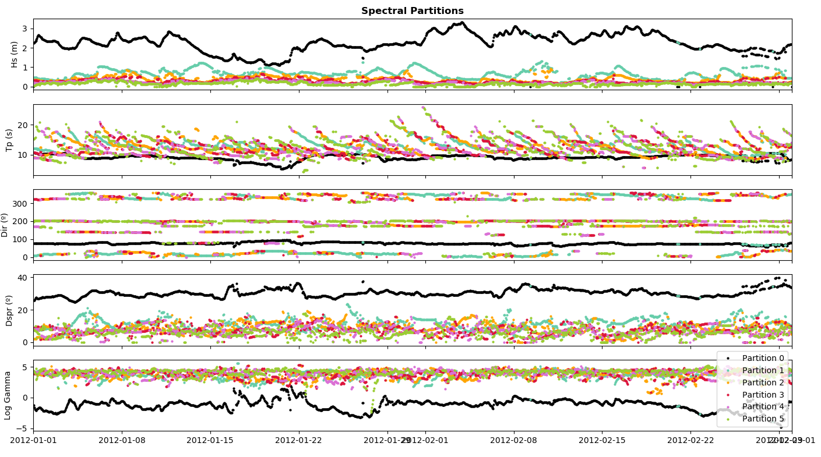
METHODOLOGY: Wave System Parameterization
7 HyWaves : A hybrid method to downscale swells in small Pacific Islands
Alba Ricondo

Slide 9
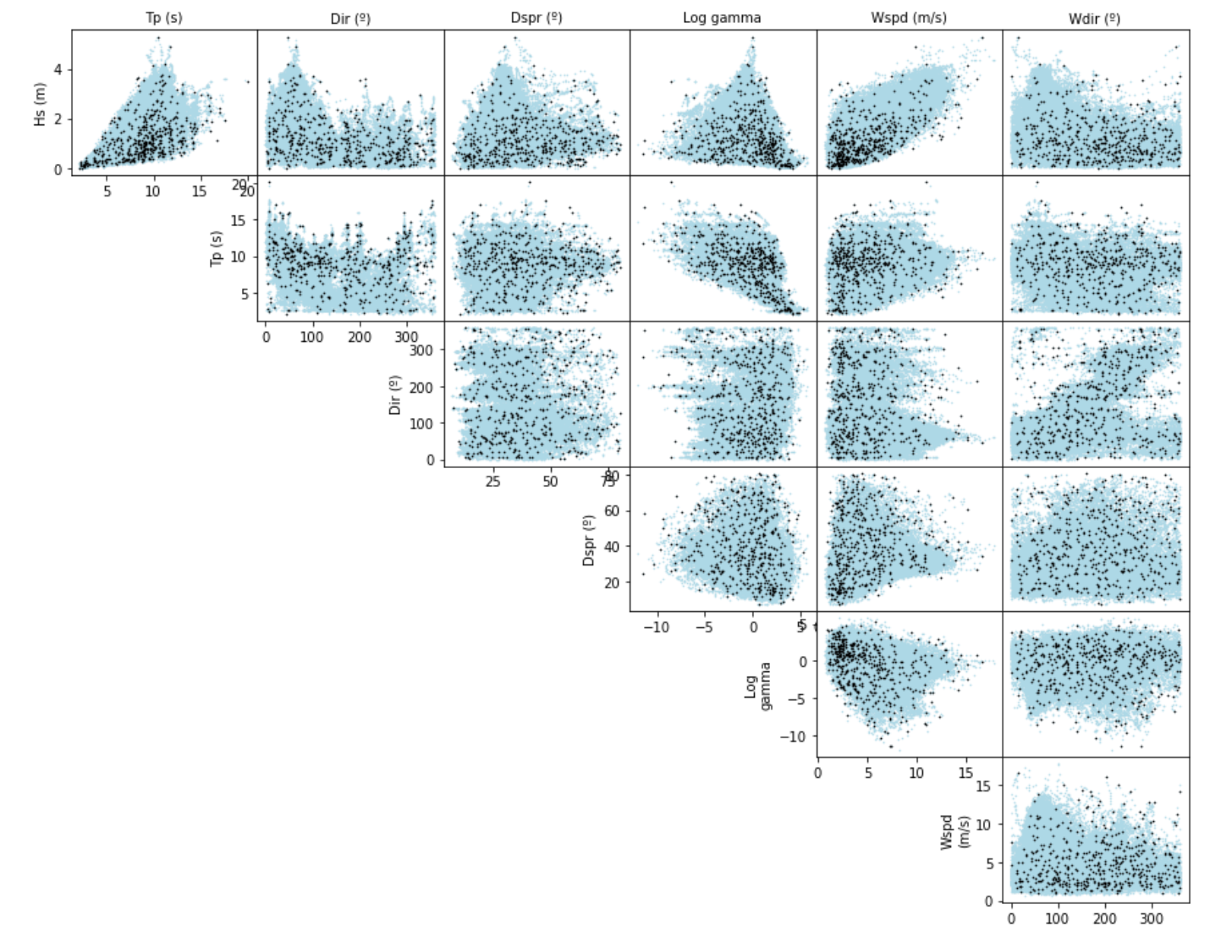
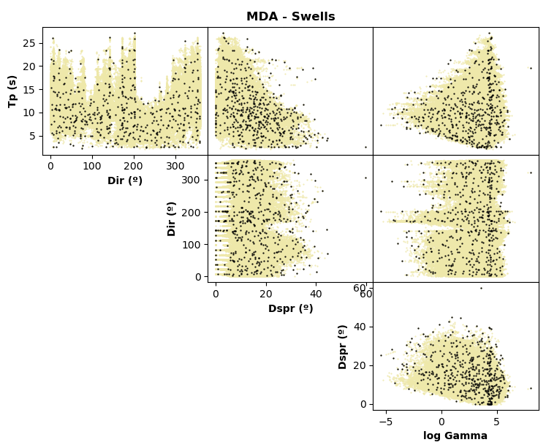
METHODOLOGY: MDA Selection
Maximum Dissimilarity Algorithm MDA (Camus et al,. 2011)
Subset N = 500 cases
MDA – Sea
MDA – Swells (Hs = 1 m)
$H_{s}, T_{p}, θ_{m}, σ,γ$, $W_{spd}$, $W_{dir}$
$$T_{p}, θ_{m}, σ,γ$$
8 HyWaves : A hybrid method to downscale swells in small Pacific Islands
Alba Ricondo

Slide 10
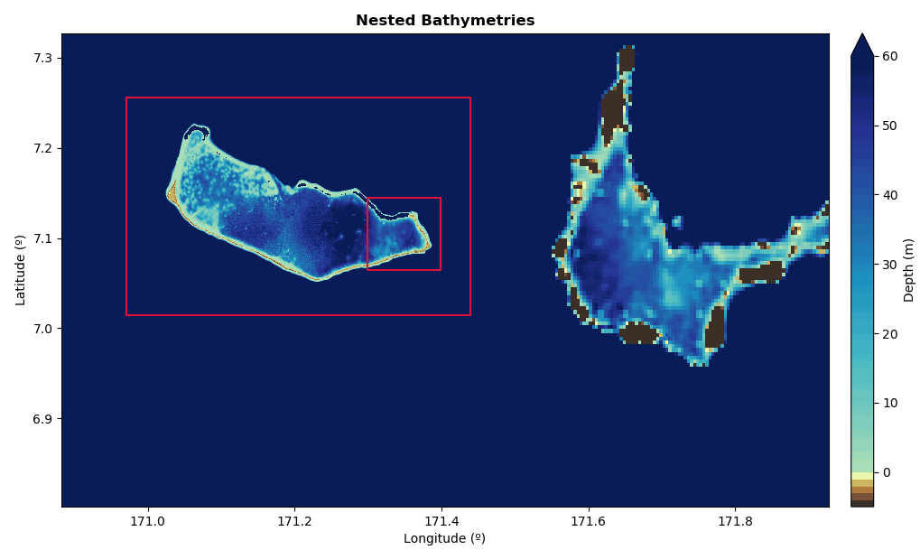
METHODOLOGY: Dynamical Downscaling
SWAN
Simulating Waves Nearshore
(Delft University of Technology)
(Booij et al., 1999)
Mesh 3
Mesh 1 (bathymetry GEBCO) 1 km
Mesh 2 (bathymetry USGS) 200 m
Mesh 3 (bathymetry USGS) 50 m
Mesh 2
Stationary mode
Same forcing in boundaries
SL = 0 m
Mesh 1
9 HyWaves : A hybrid method to downscale swells in small Pacific Islands
Alba Ricondo

Slide 11
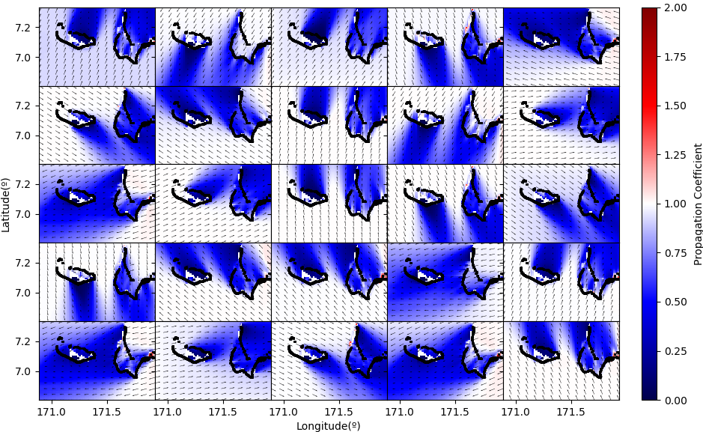
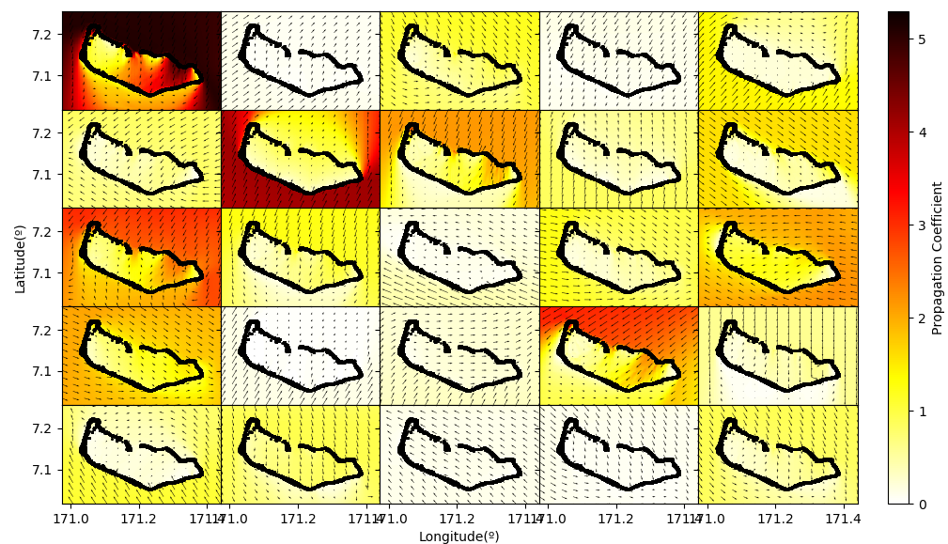
METHODOLOGY: Dynamical Downscaling
First 25 propagation maps from MDA
SWELLS
(Propagation Coefficient)
SEAS
10 HyWaves : A hybrid method to downscale swells in small Pacific Islands
Alba Ricondo

Slide 12
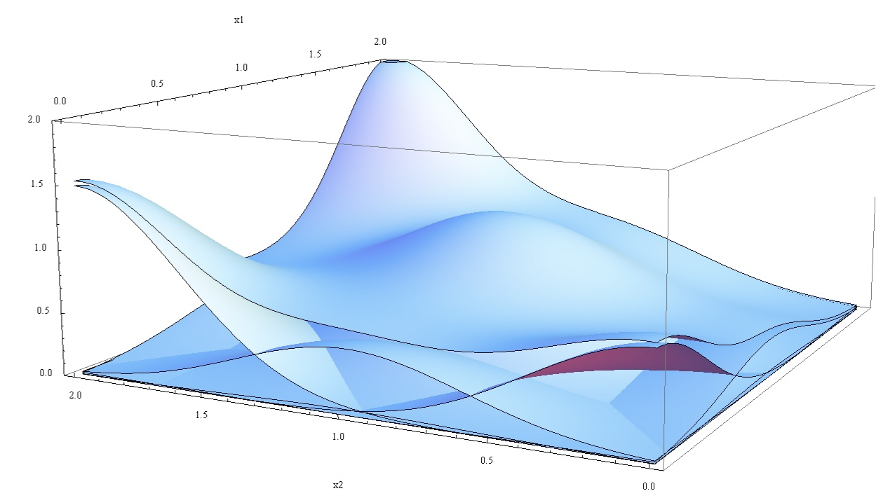
METHODOLOGY: RBF Reconstruction
Radial Basis Function RBF
Interpolation Algorithm
(Rippa 1999)
$$D_{j}=\left\{H_{j}^{D}, T_{j}^{D}, θ_{j}^{D},W_{j}^{D},β_{j}^{D}\right\};j=1,…,M$$
$$D_{p,j}^{∗}=\left\{H_{sp}^{D}, T_{mp}^{D}, θ_{mp}^{D} \right\};j=1,…,M$$
The historical wave climate can be reconstructed throughout the island
“a weighted sum of radial basis functions”
11 HyWaves : A hybrid method to downscale swells in small Pacific Islands
Alba Ricondo

Slide 13
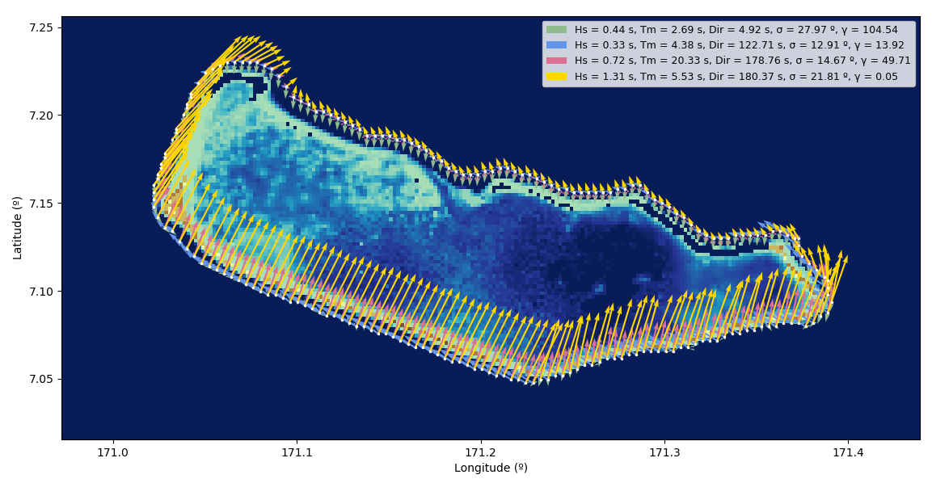
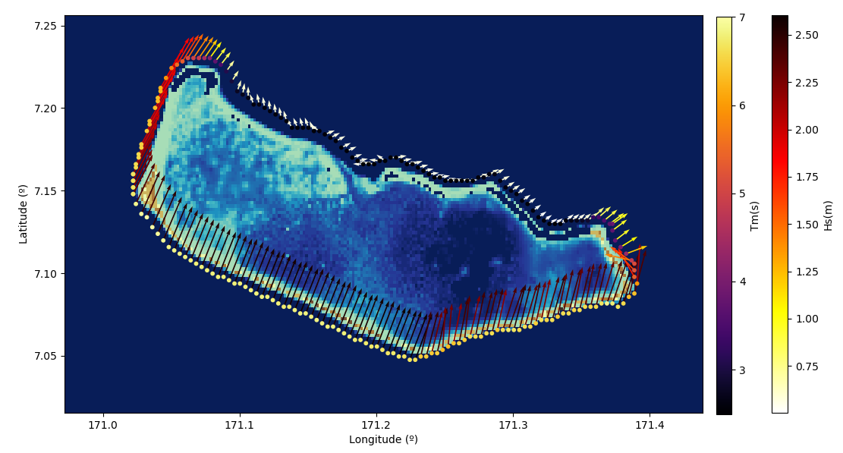
METHODOLOGY: Aggregation
Wave Systems Aggregation
Linear Theory
$$S_{t}\left(f,θ\right)=\sum_{i=1}^{N_{wave systems}}{S_{i}\left(f,θ\right)}$$
12 HyWaves : A hybrid method to downscale swells in small Pacific Islands
Alba Ricondo

Slide 14
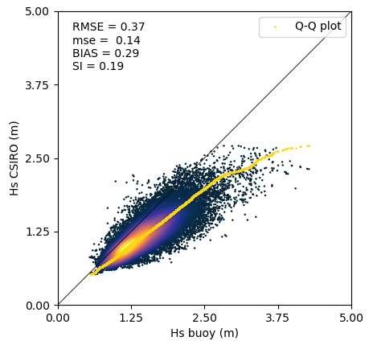
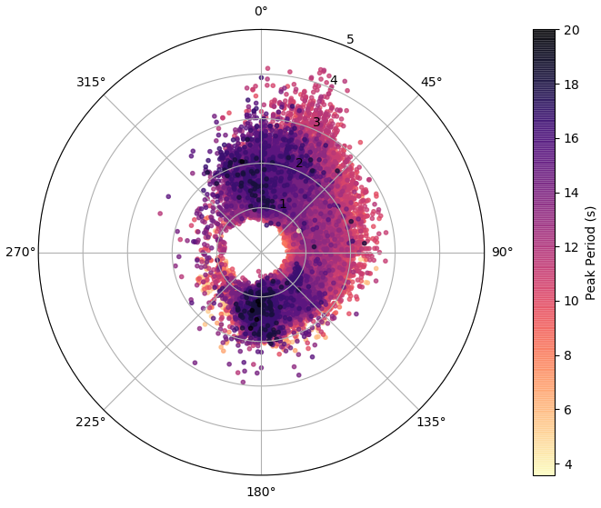
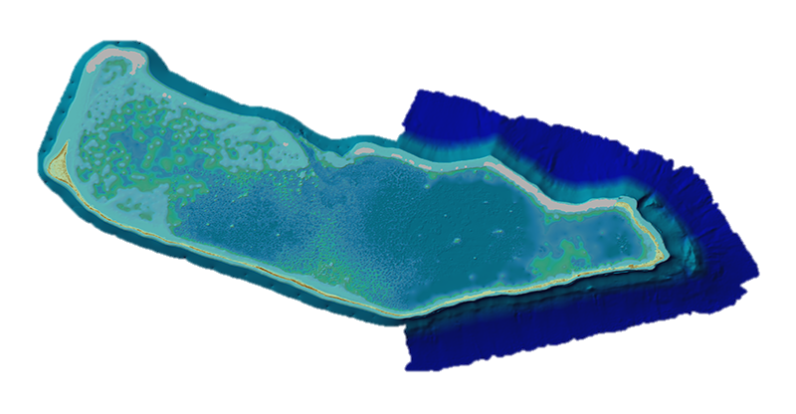
METHODOLOGY: Validation
CSIRO hindcast
HyWaves
Wave buoy
PacIOOS (The Pacific Islands Ocean Observing System)
2010/04 – 2018/12
0.9 km E
540 m depth
Data every 30’
$$H_{s}, T_{p}, θ_{m}$$
13 HyWaves : A hybrid method to downscale swells in small Pacific Islands
Alba Ricondo

Slide 15
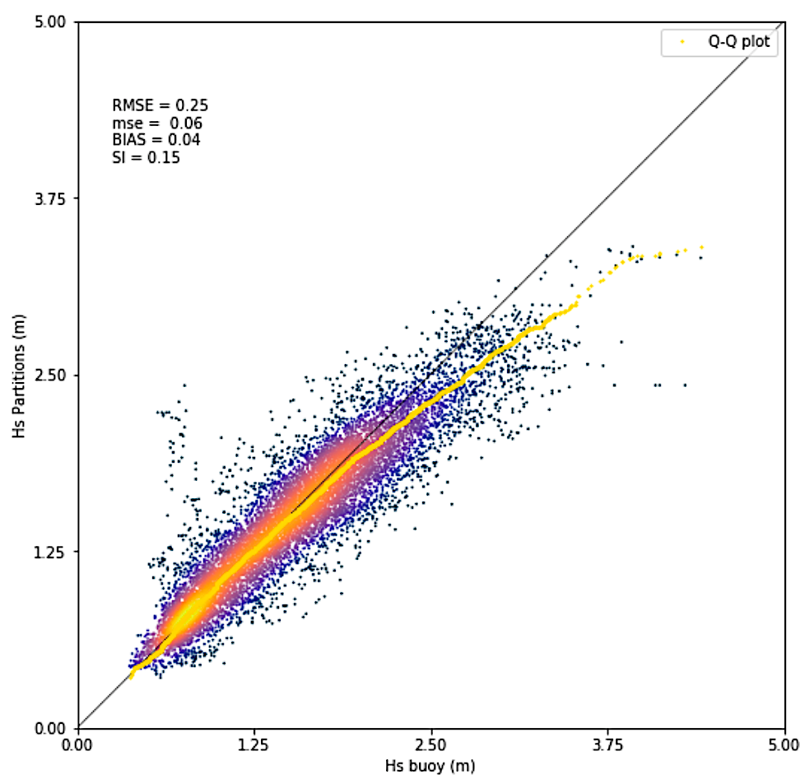
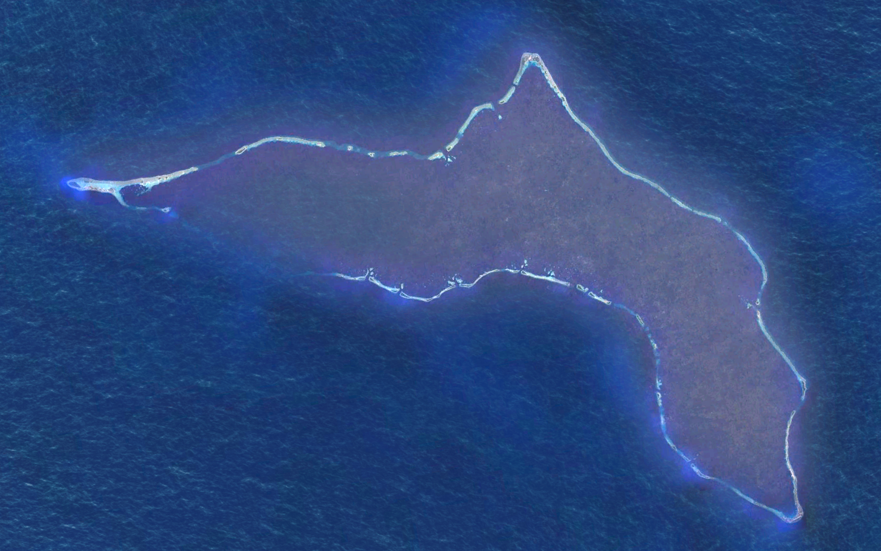
METHODOLOGY: Validation sites
Majuro Atoll
Kwajalein Atoll
Roinamur
Kwajalein
14 HyWaves : A hybrid method to downscale swells in small Pacific Islands
Alba Ricondo

Slide 16
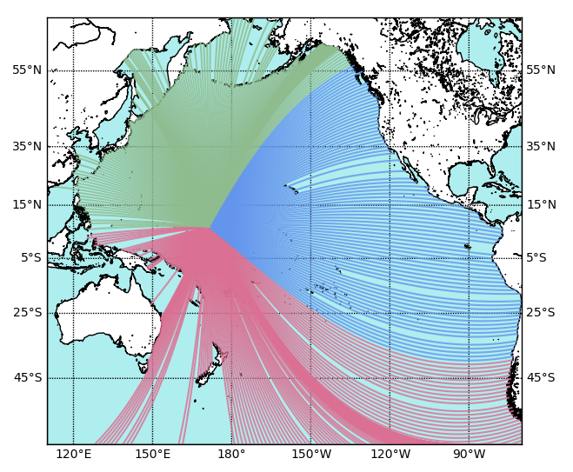
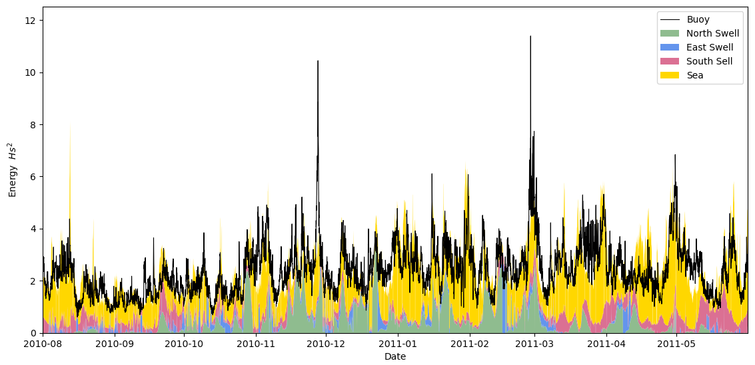
Spectral Wave Climate
North Swells (270 – 30º)
Contribution of each wave system
to the total Energy
East Swells (30 – 130º)
South Swells (130 – 270º)
$$E \sim H_{s}^{2}$$
15 HyWaves : A hybrid method to downscale swells in small Pacific Islands
Alba Ricondo

Slide 17
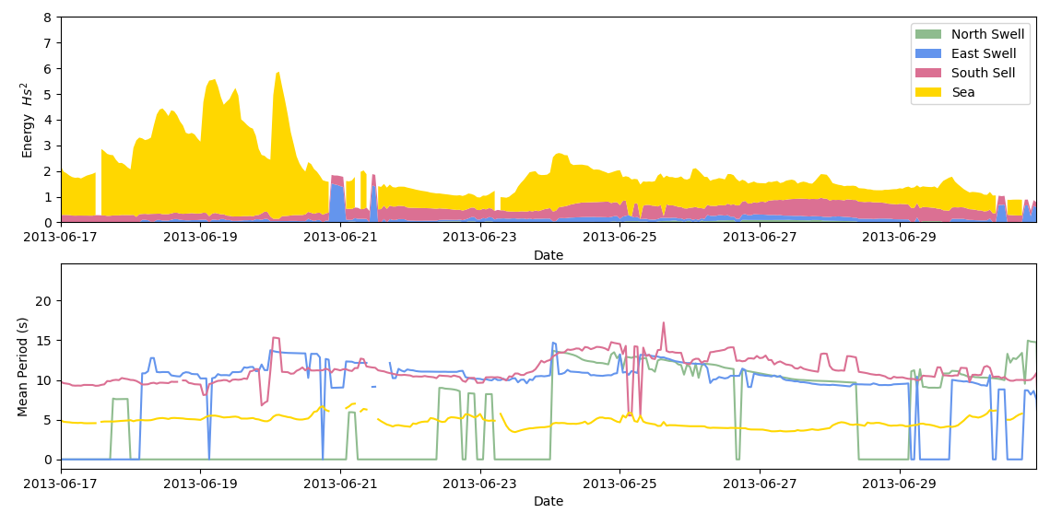
Spectral Wave Climate
Flooding Event
24th June 2013
Southern region (Airport)
La Niña ENSO phase
MSL ~ 2 m
Hs = 1 m
Tm = 15 s
16 HyWaves : A hybrid method to downscale swells in small Pacific Islands
Alba Ricondo

Slide 18
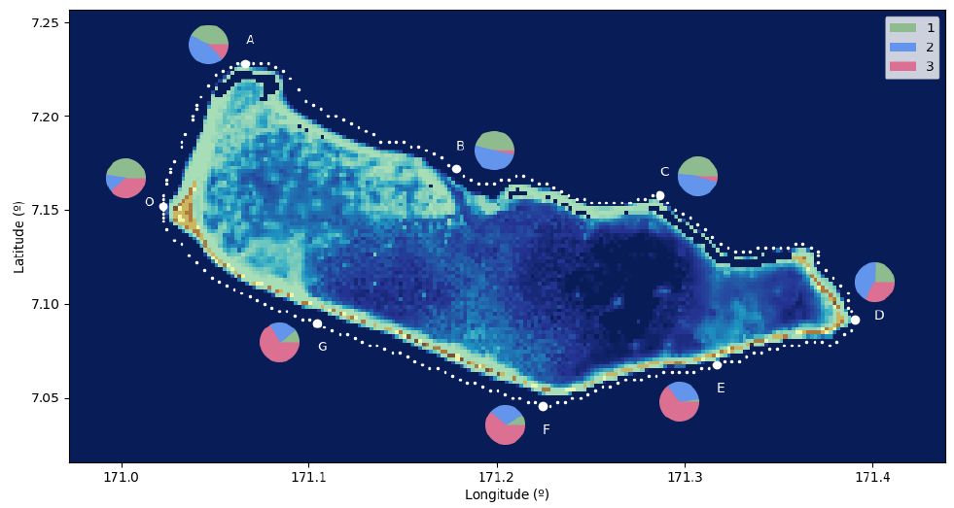
Spectral Wave Climate
Energy Flux Contribution
$$FE= H_{s}^{2}·T_{p}$$
Seasonality
Interannual variability
ENSO events
17 HyWaves: A hybrid method to downscale swells in small Pacific Islands
Alba Ricondo

Slide 19
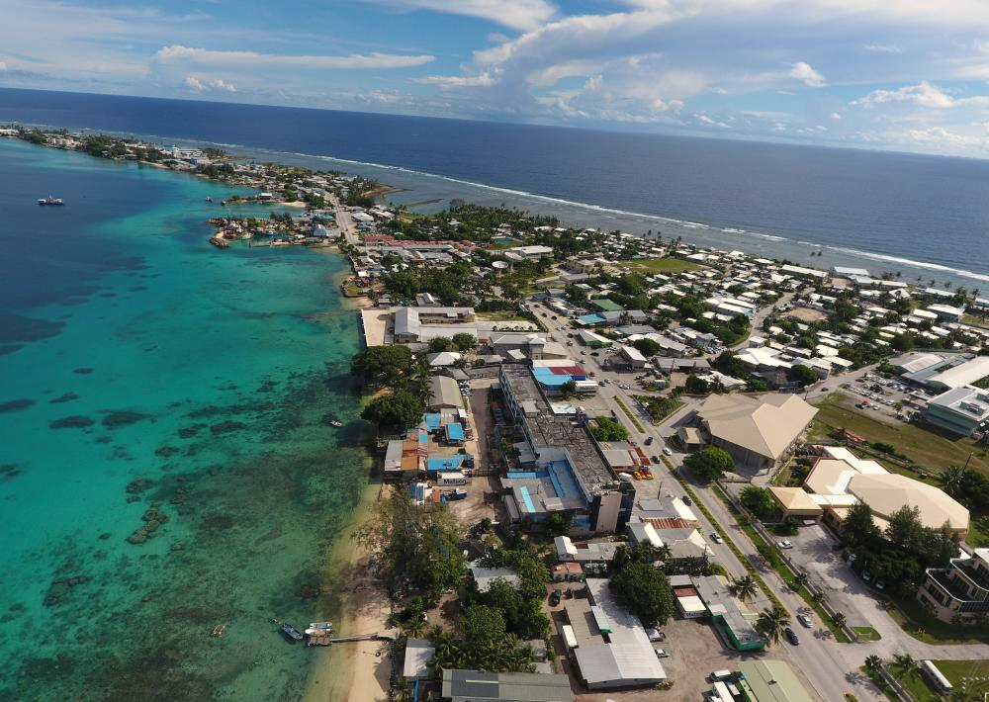
Ge cean
UNIVERSIDAD DE CANTABRIA
HyWaves: A hybrid method to downscale swells in smal Pacific Islands
Thank you very much for your attention
Acknowledgements
This work is funded by the Spanish Ministry of Science and Innovation, National Project “Beach4Cast” (PID2019-107053RB-I00).
Alba Ricondo
alba.ricondo@unican.es

