Slide 1
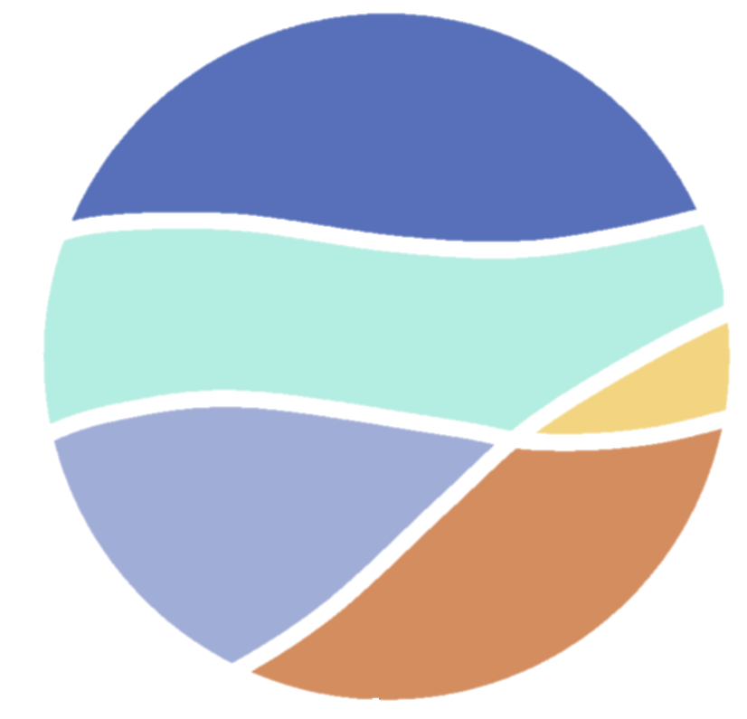
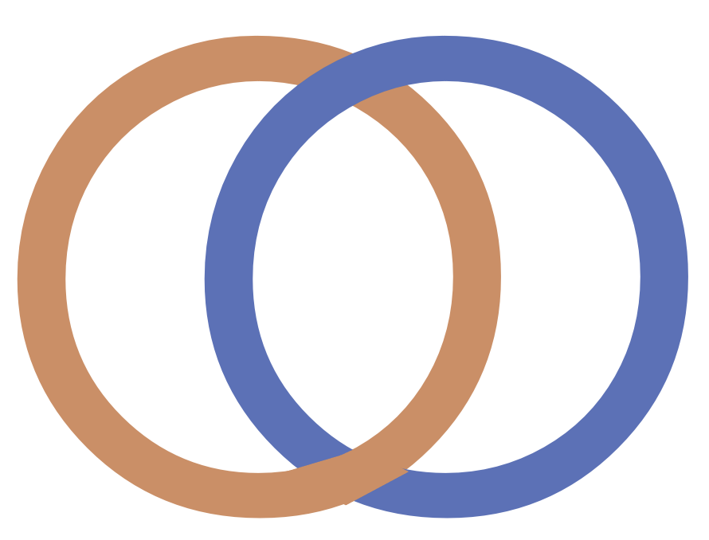
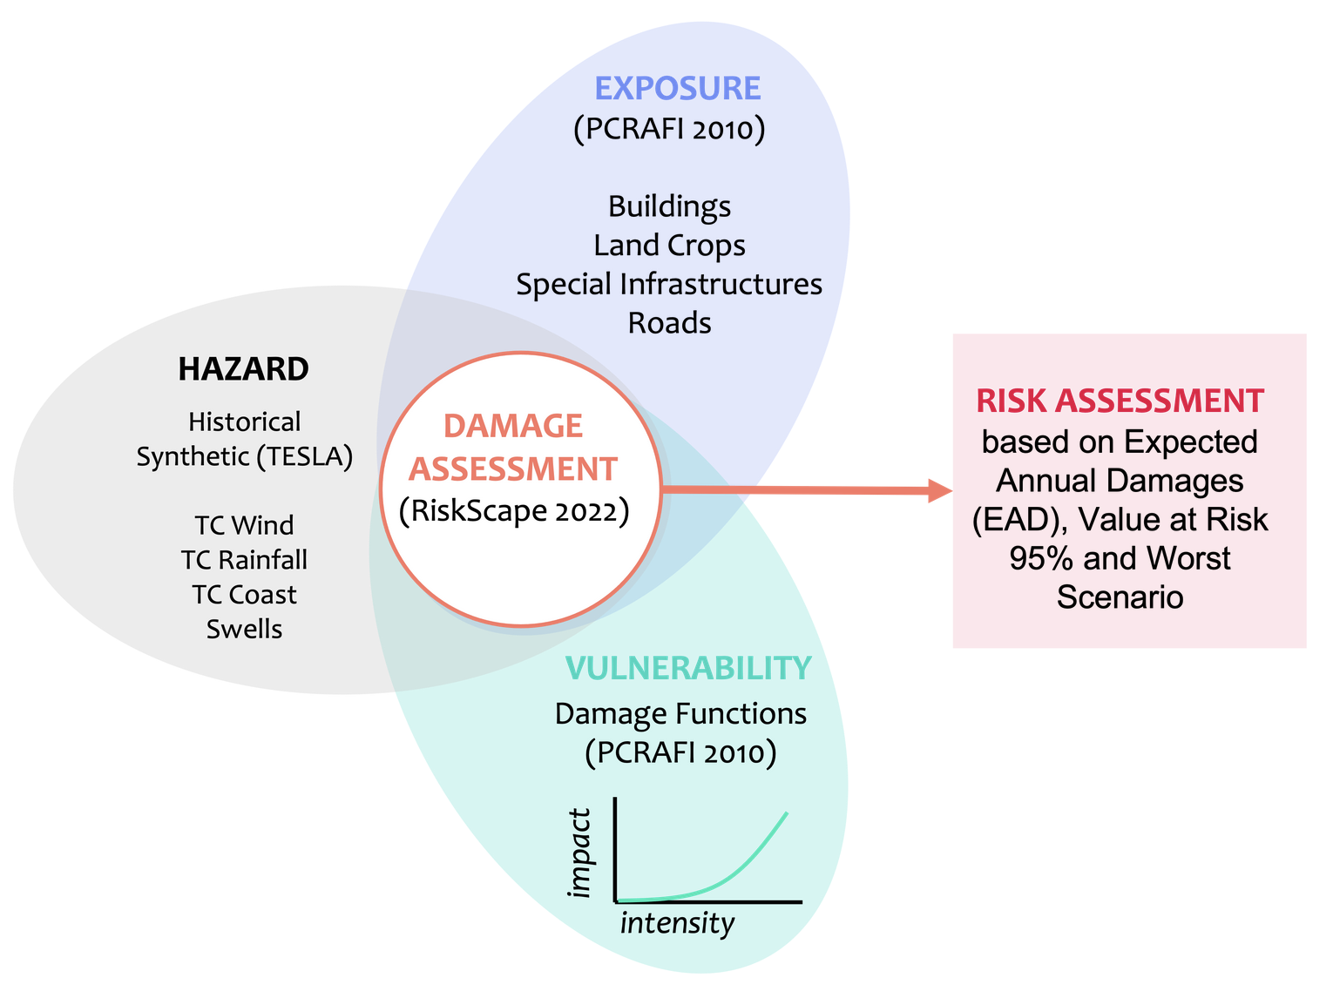
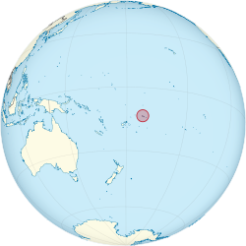
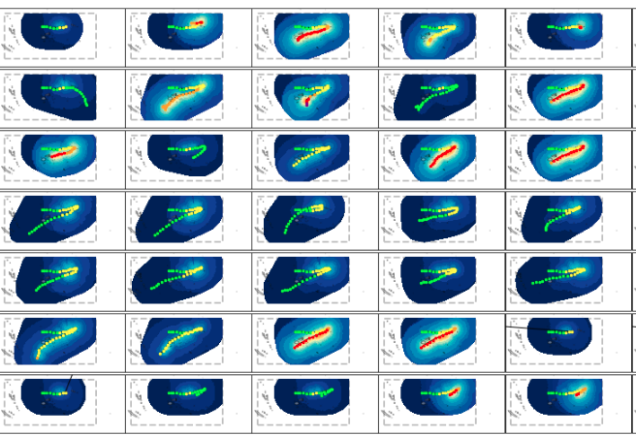
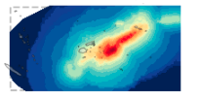
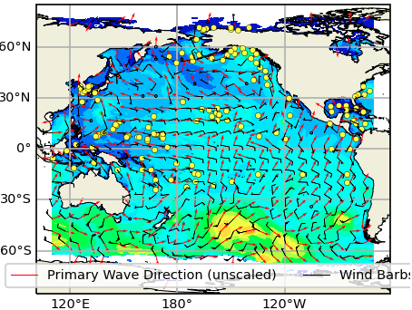
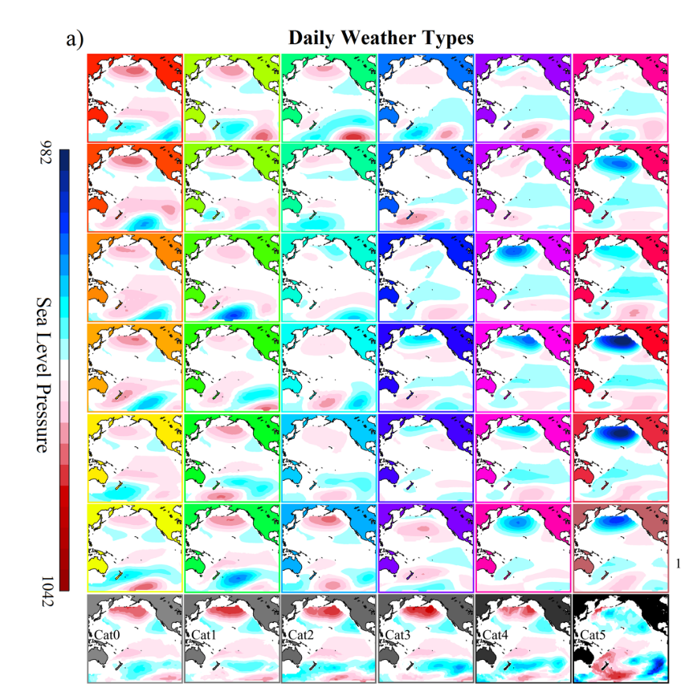
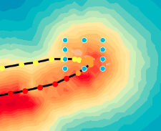
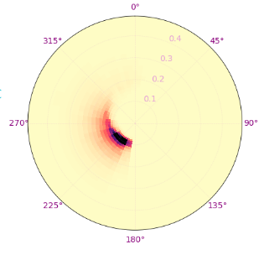
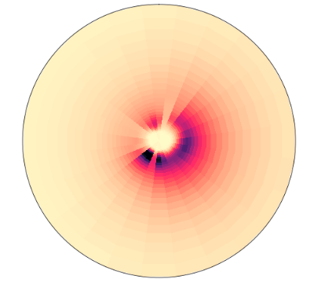
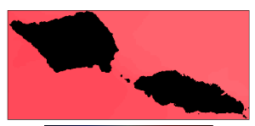
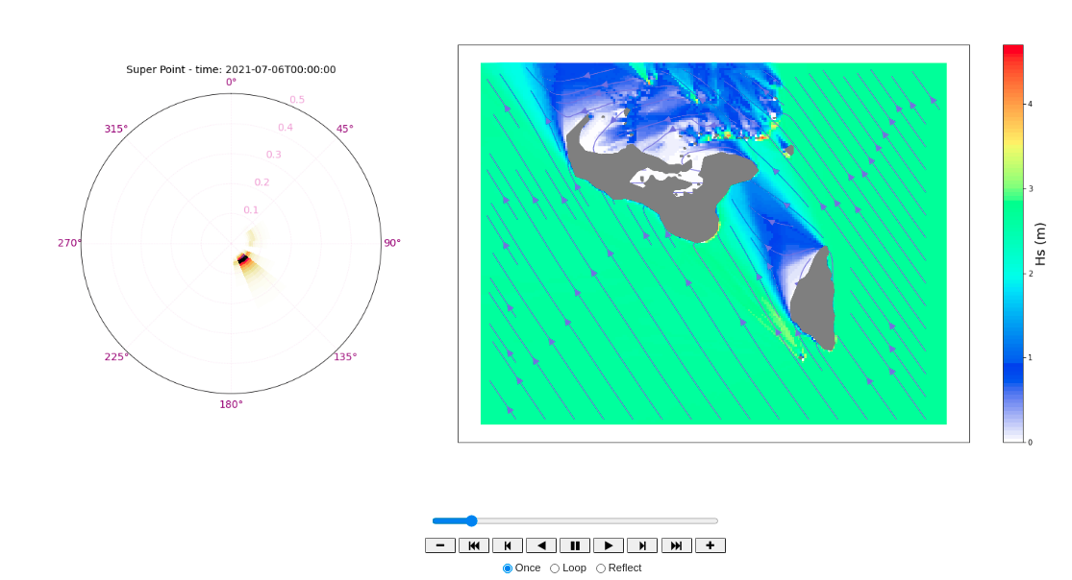
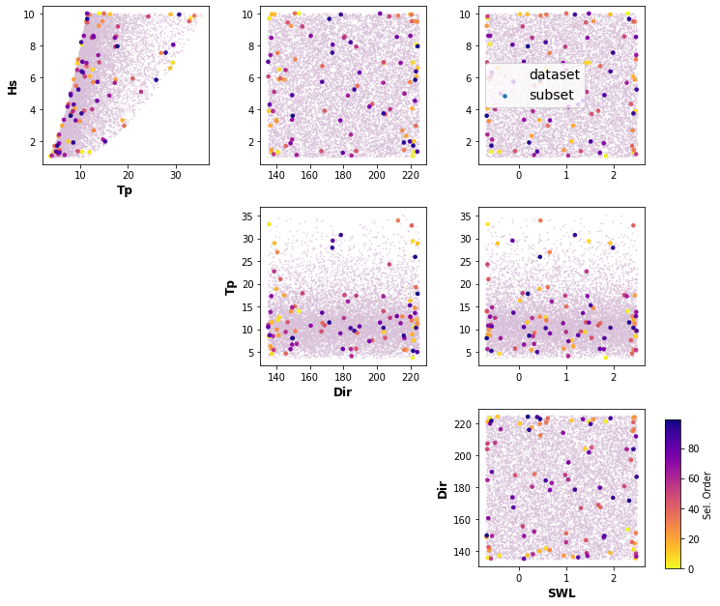
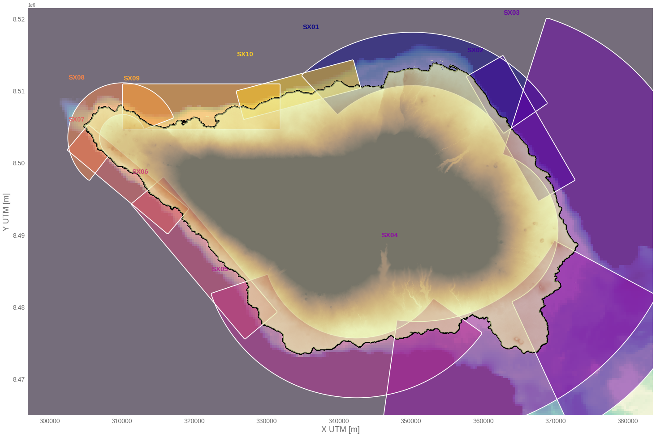
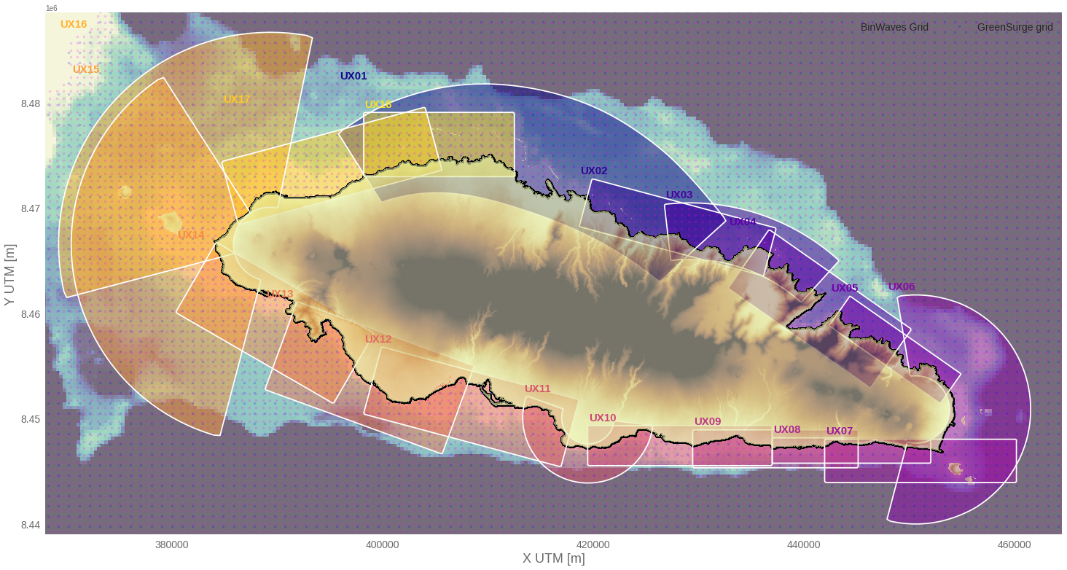
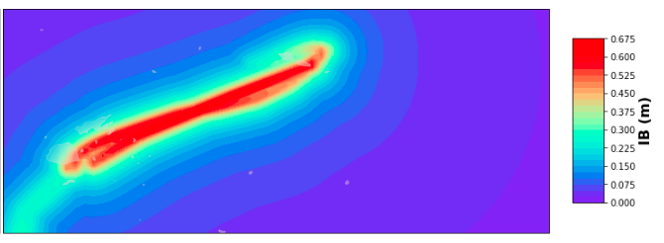
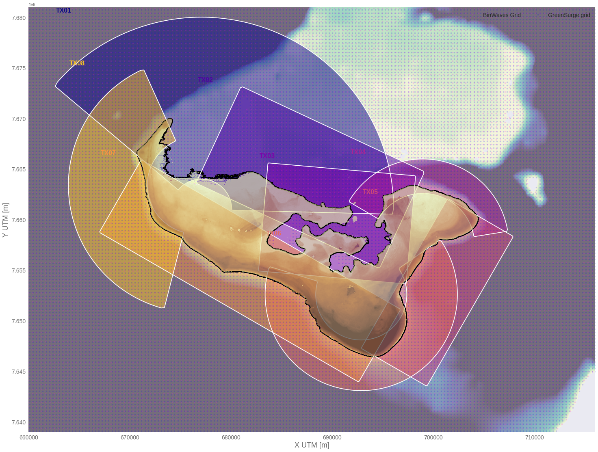
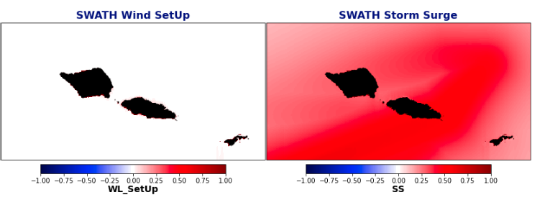
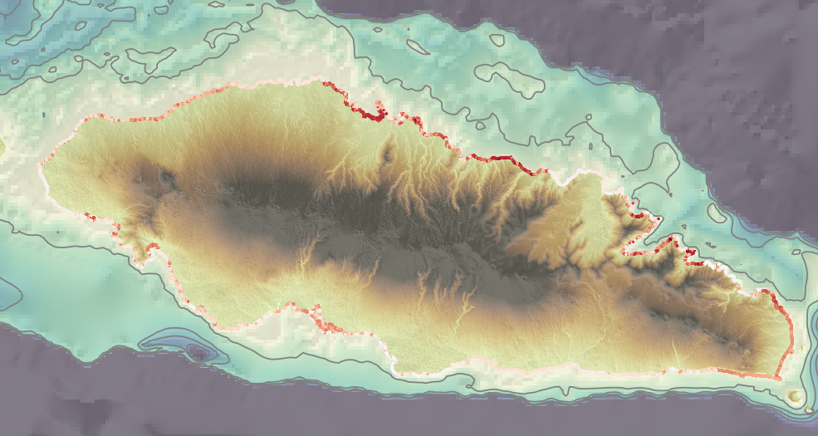
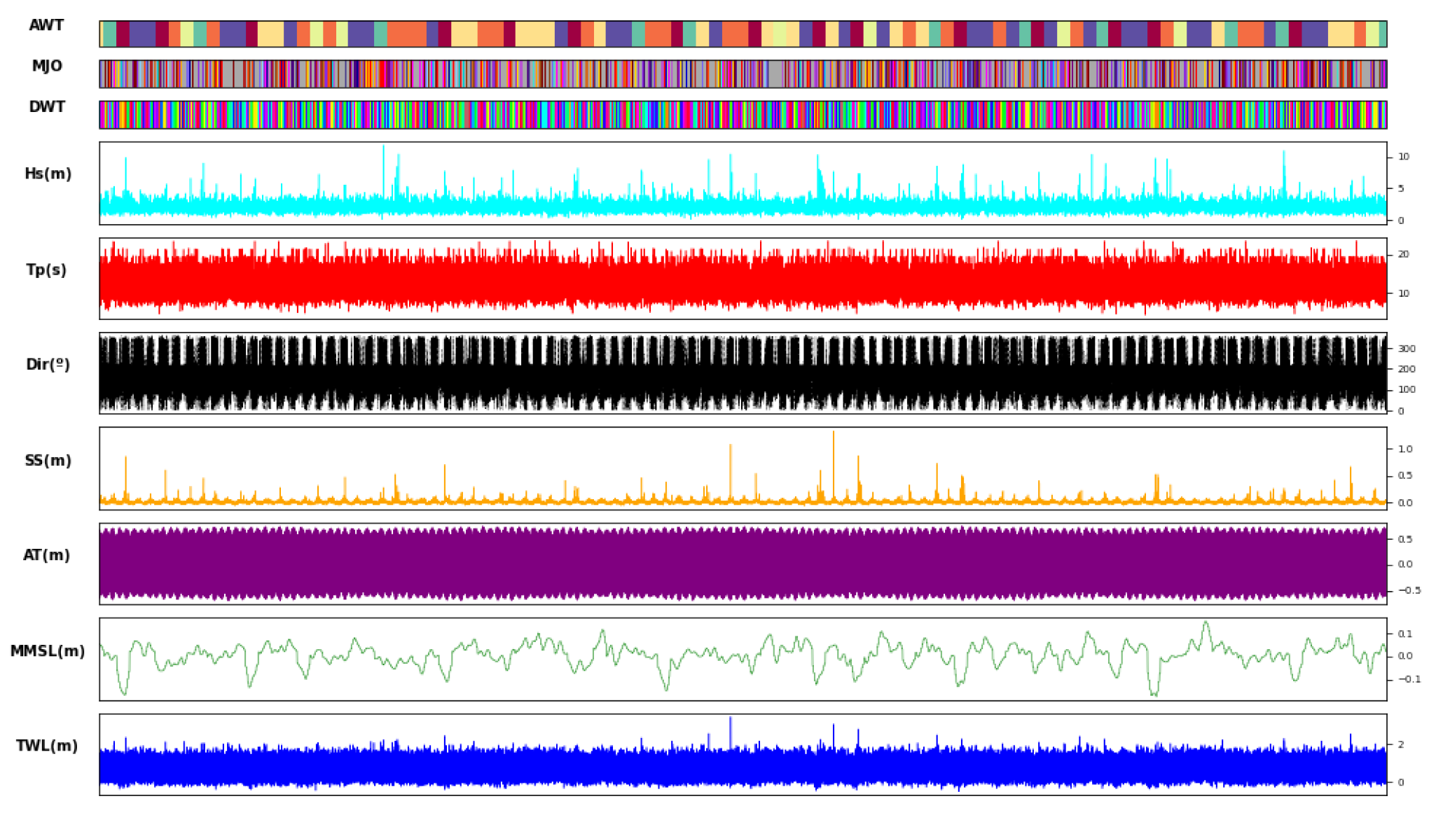
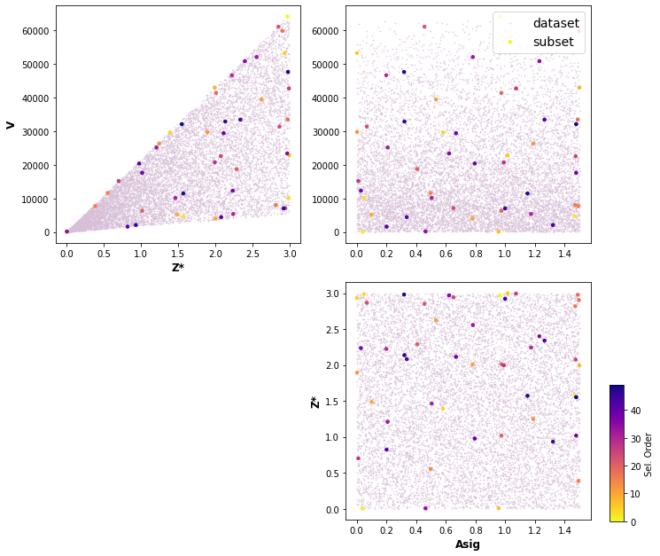
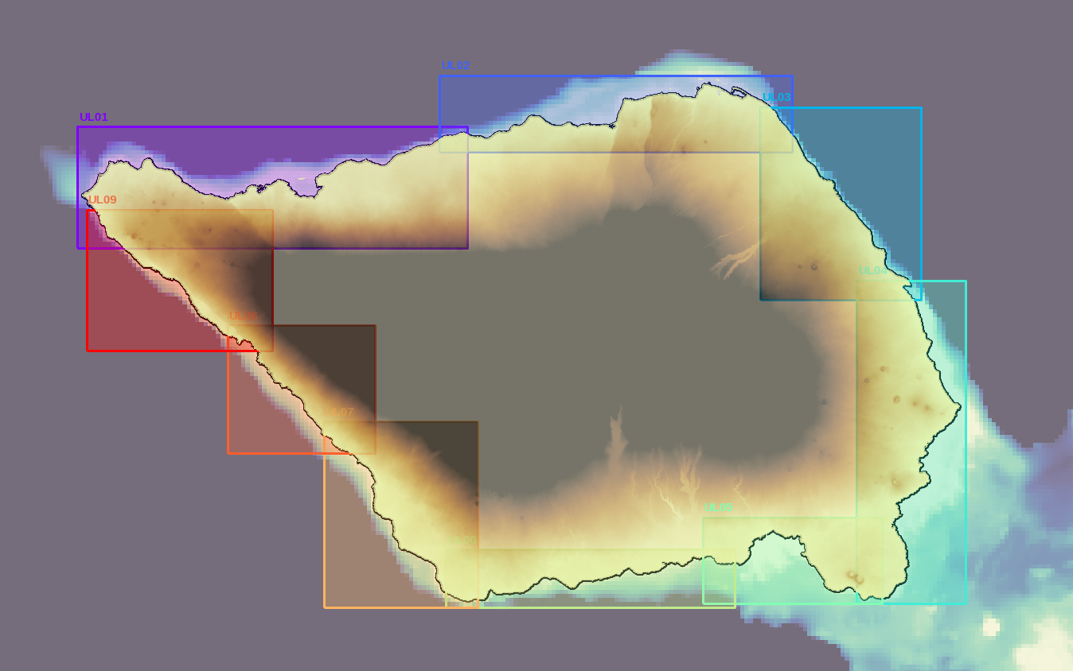
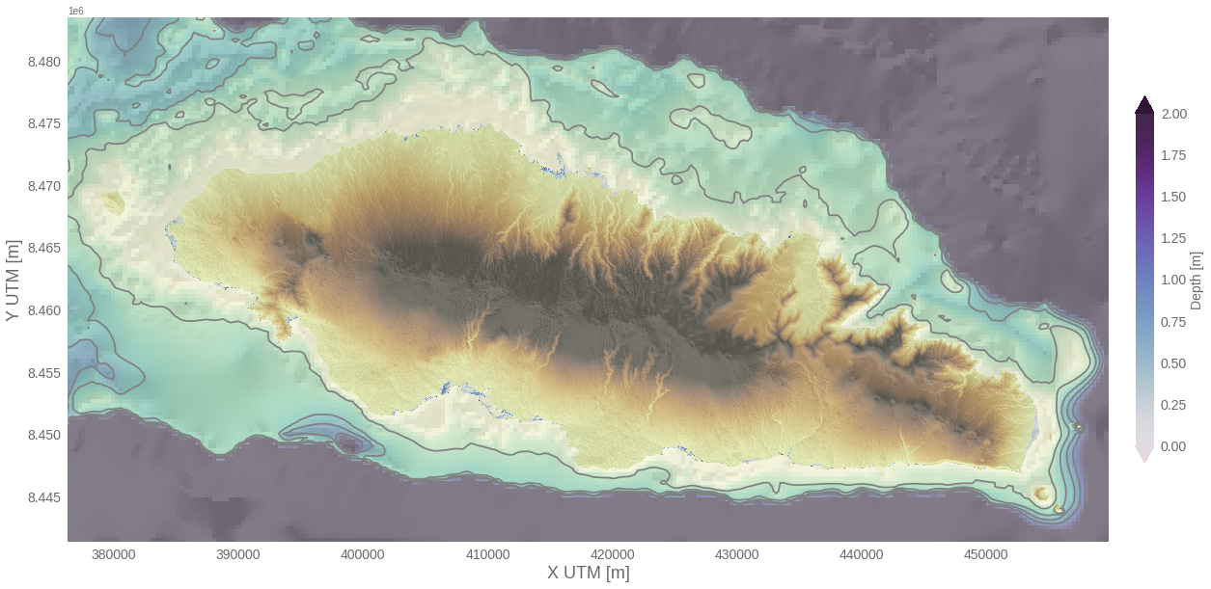
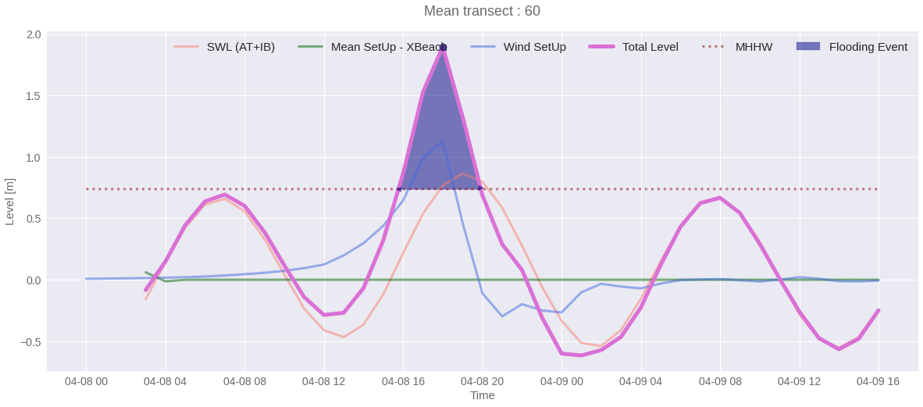
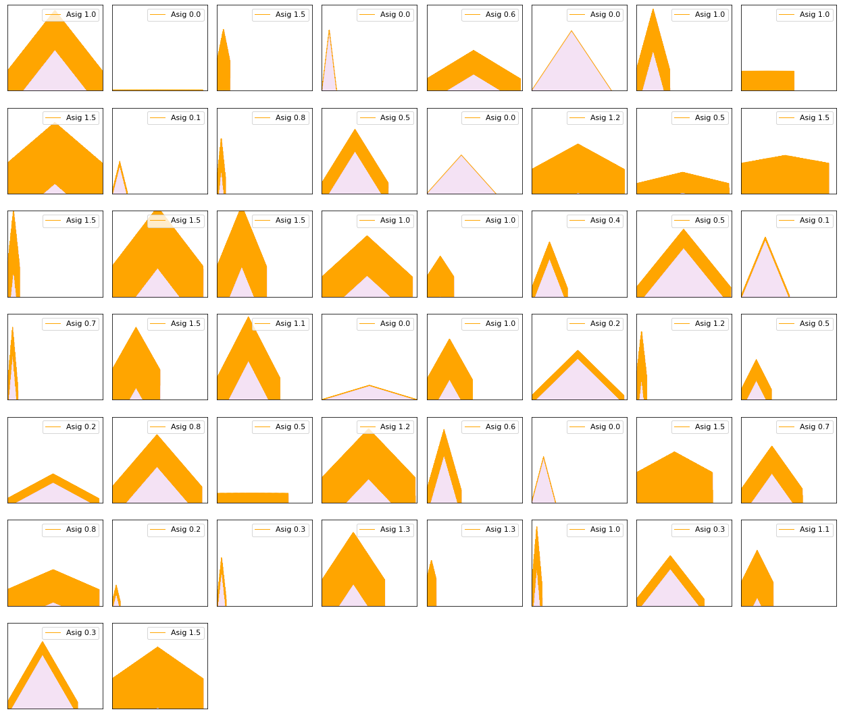
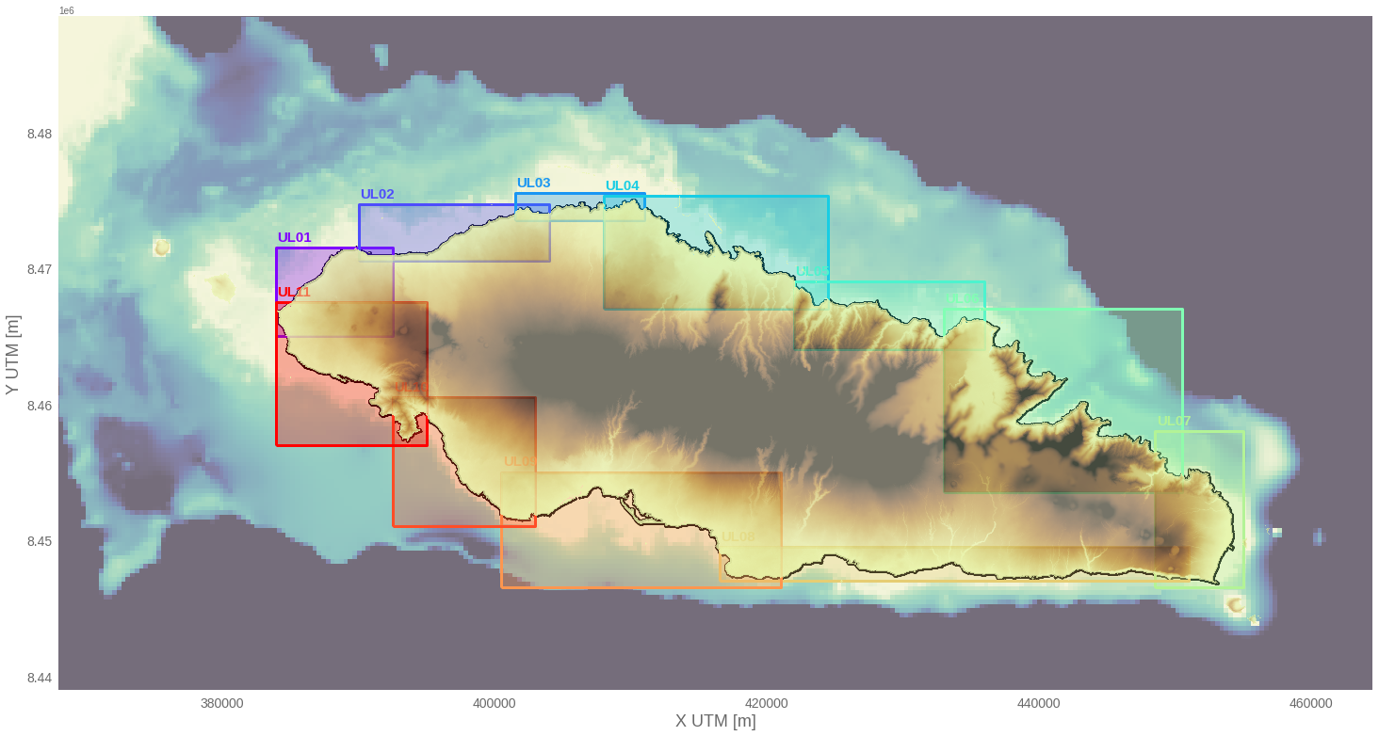
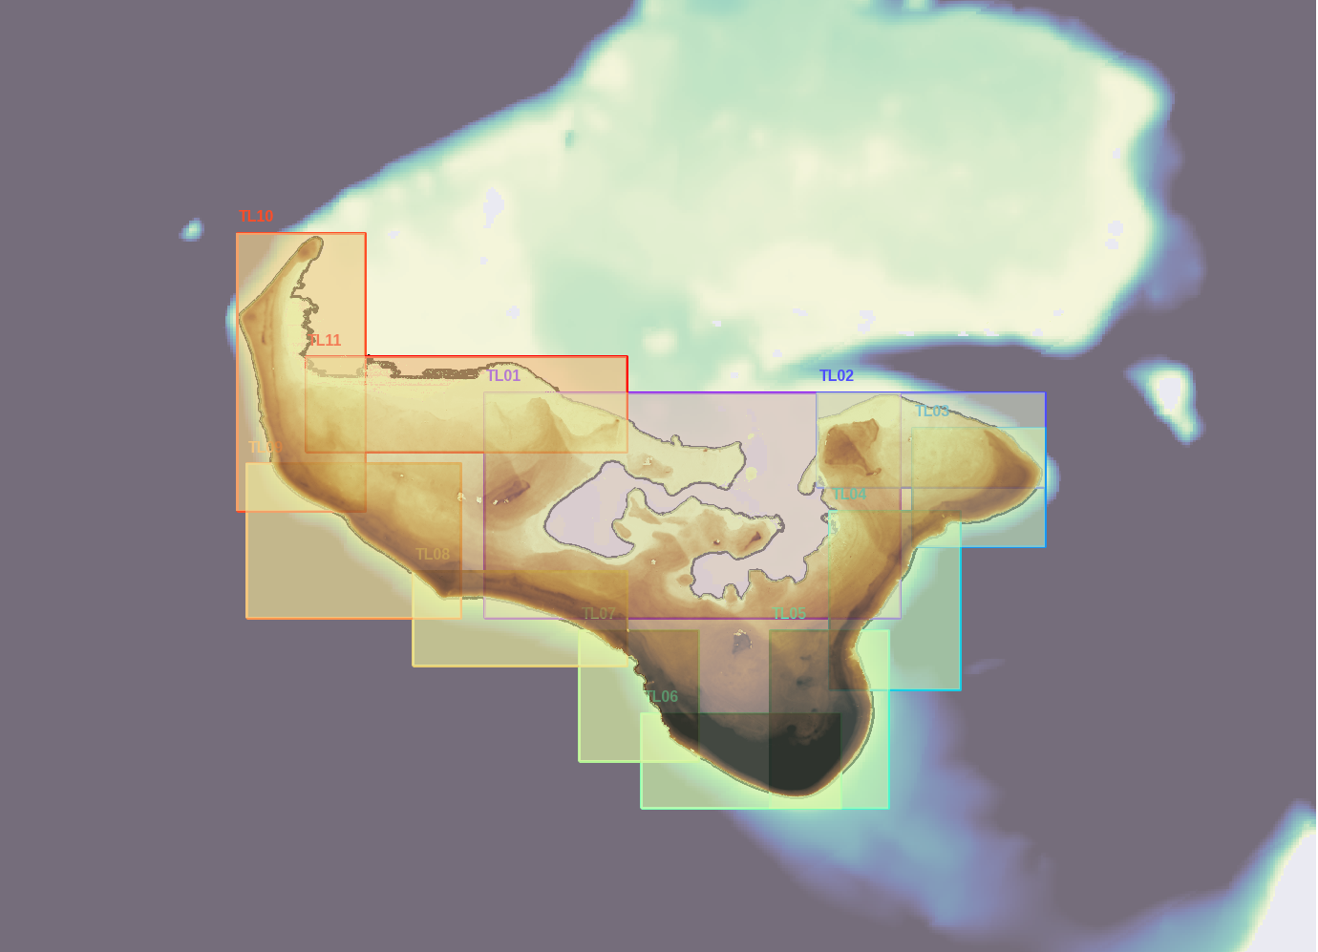
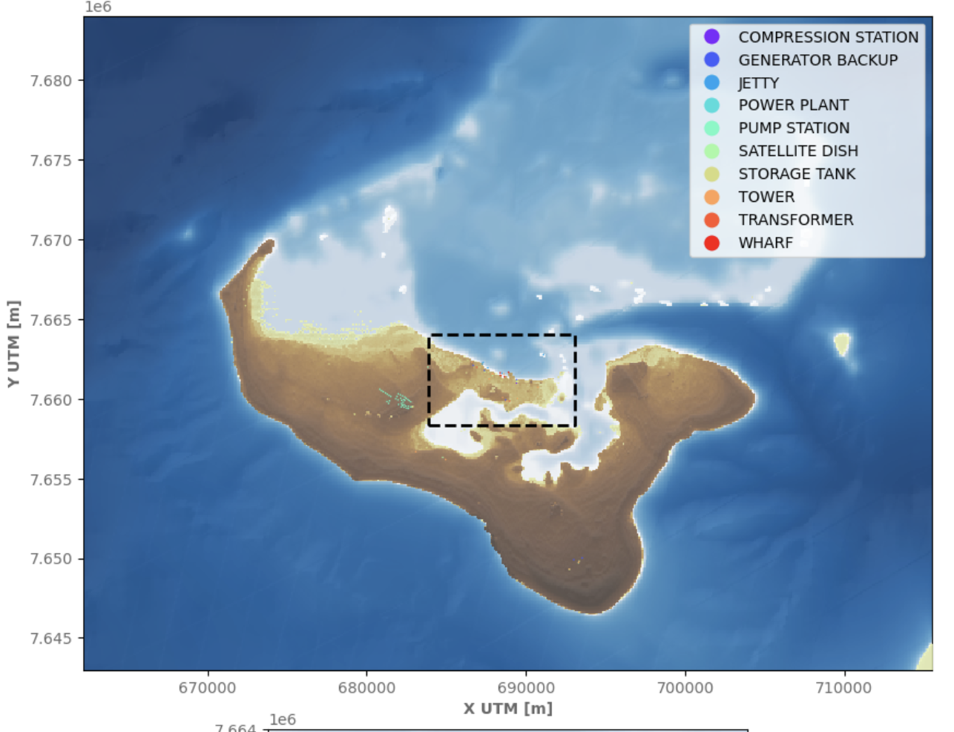
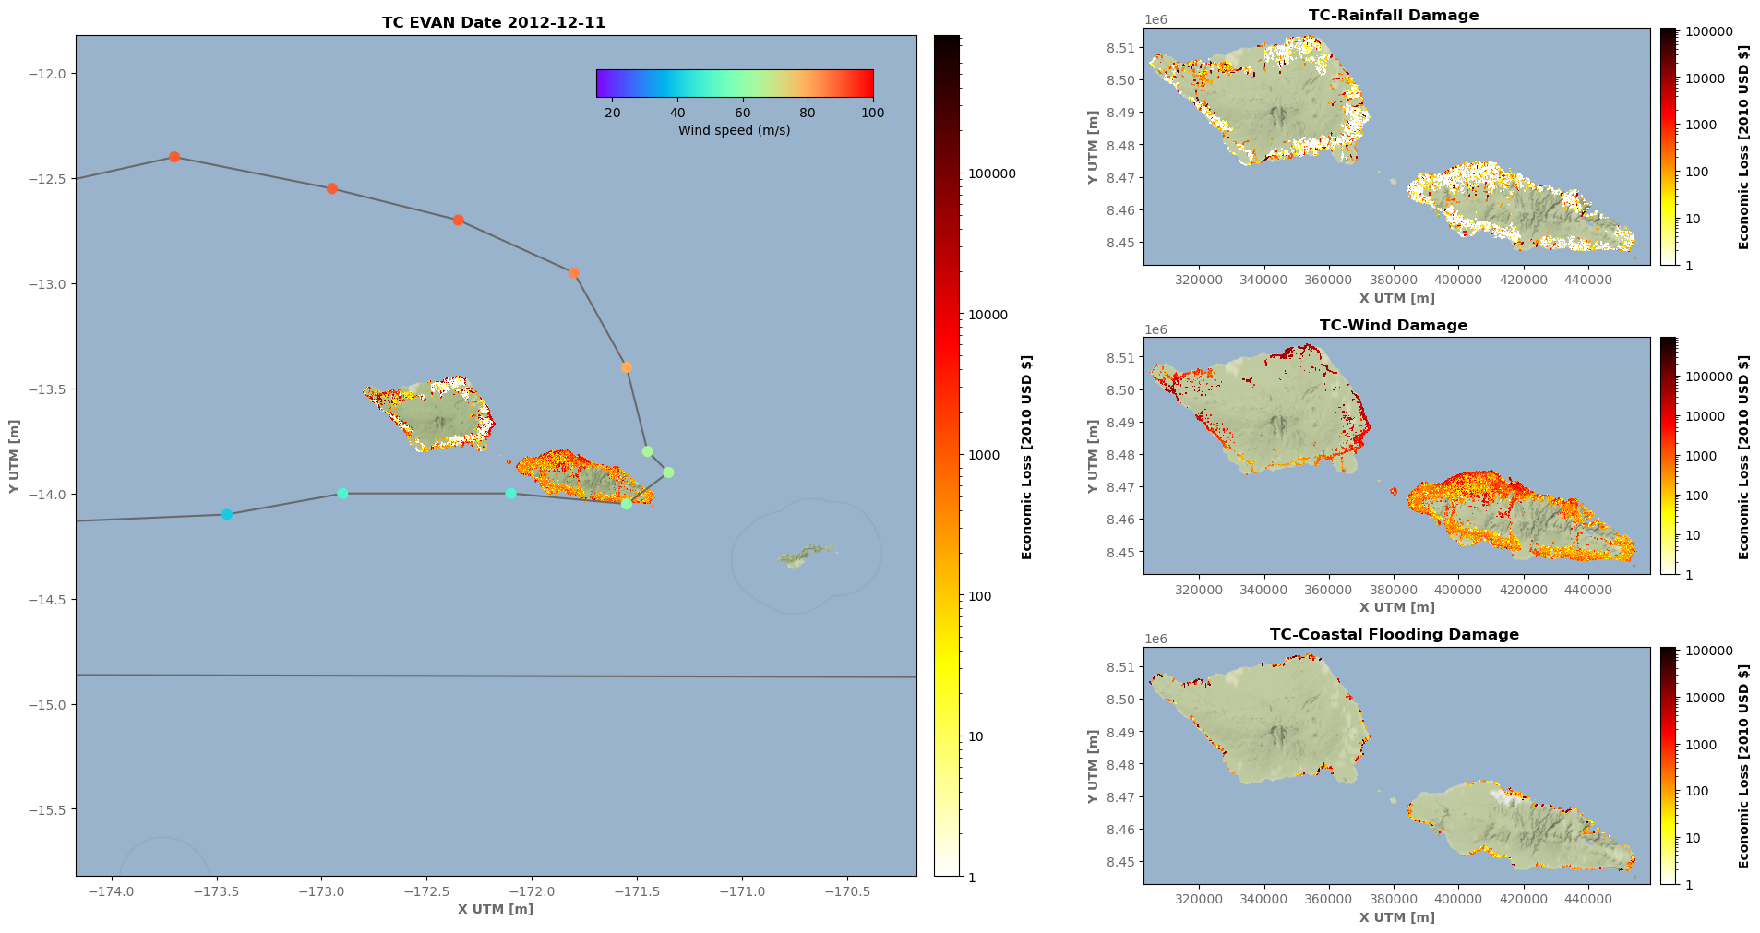
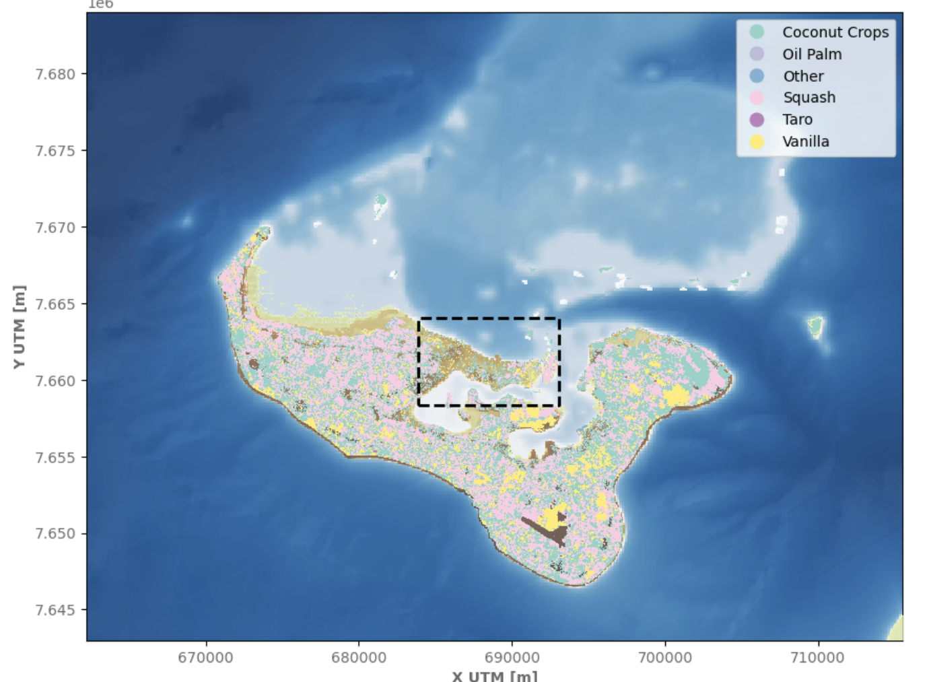
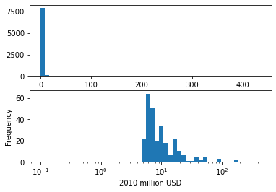
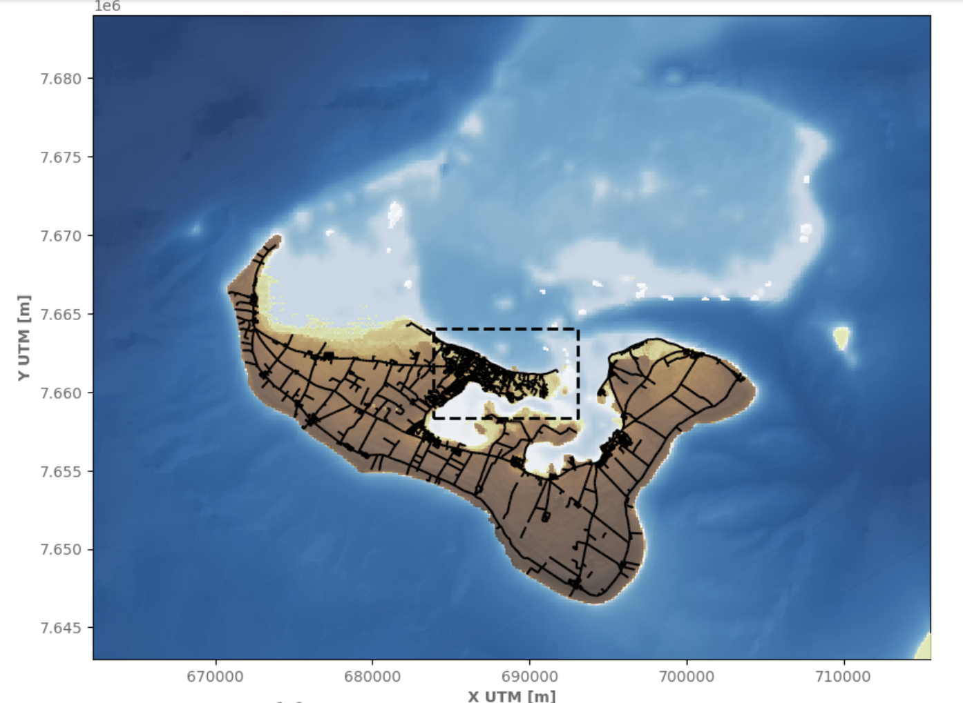
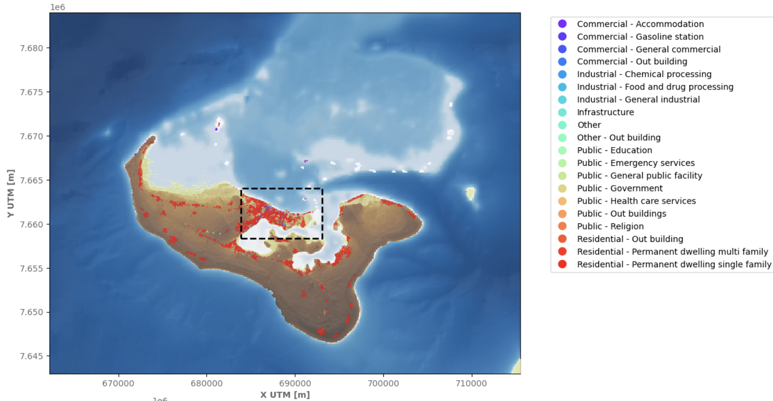
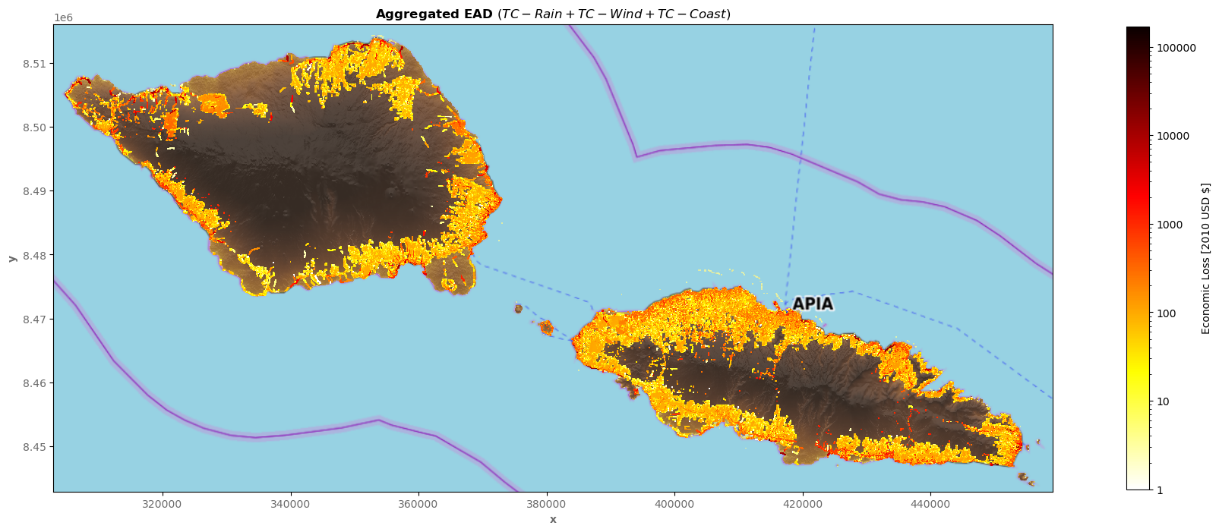
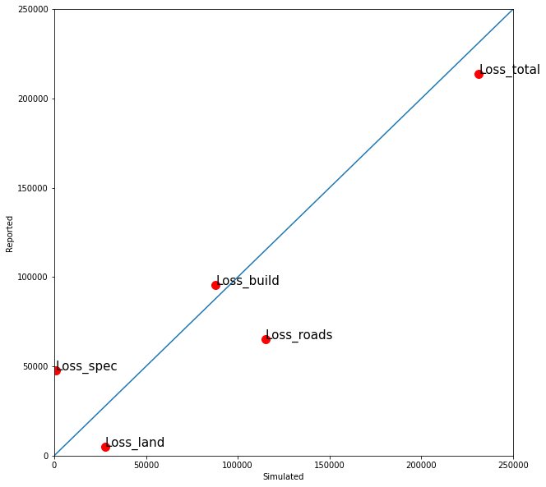
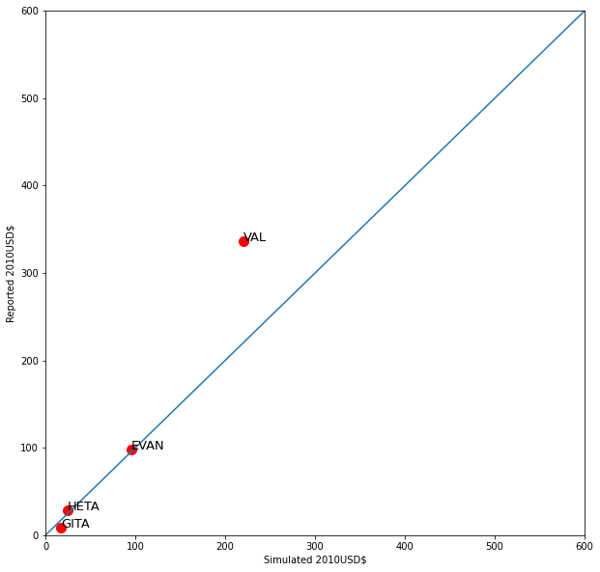
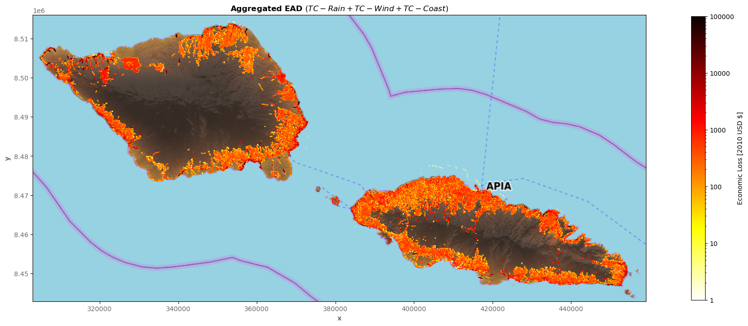
ANALYSIS OF COASTAL FLOODING RISK IN SMALL ISLANDS AFFECTED BY EXTRA-TROPICAL AND TROPICAL CYCLONES
Ana Rueda, Fernando J. Méndez, Laura Cagigal, Alba Cid, Beatriz Pérez-Díaz, Alba Ricondo, Manuel Zornoza, Sara O. van Vloten, Nicolás Ripoll, Sonia Castanedo
Ge cean
Universidad de Cantabria, Spain
Contact: ruedaac@unican.es
UNIVERSIDAD DE CANTABRIA
OBJECTIVE:
STUDY AREAS: SAMOA AND TONGA
TO PERFORM A QUANTITATIVE RISK ASSESSMENT OF COASTAL FLOODING IN THE MAIN ISLANDS OF SAMOA AND TONGA
THROUGH A CLIMATE-BASED EMULATOR TO POPULATE HISTORICAL RECORDS WITH PLAUSIBLE MULTIVARIATE EVENTS
AND HYBRID METHODOLOGIES TO DOWNSCALE TO HIGH RESOLUTION FLOODING MAPS OVERCOMING THE COMPUTATIONAL BURDEN
Samoa, is an island state situated in the Pacific Ocean between New Zealand and Hawaii. It is located at 13º latitude south, and 175º longitude east. It has a total land area of 2820km² distributed in two main islands, Savai’i and Upolu and several smaller islands. The resident population of Samoa in 2021 was 200.144, with 80% living in rural areas. In the last 50 years, Samoa has suffered 56 events with associated losses of SAT 1270million (US$543 million).
The Kingdom of Tonga, is an archipelago of 176 coral and volcanic islands – of which 52 are uninhabited - scattered over more than 700,000 km² in the Pacific Ocean, south-east of Samoa. The main island is Tongatapu, where the capital Nukualofa is located. The population in 2021 was 106.759 people. Since 1997 Tonga has experienced about 20 natural disasters between Tropical Cyclones, Tsunamis, and earthquakes.
Upolu and Savaii, Samoa
Risk =
∫
Tongatapu, Kingdom of Tonga
Probability x Consequences
TESLA 2.0
HYBRID DOWNSCALING:
Regional Waves: Synthetic TC tracks + SHyTCWaves
Regional Waves: CAWRC hindcast + synthetic events
Generation of synthetic multivariate events for regular and tropical cyclone conditions
Downscaling of Total Water levels to flooding maps
Large-scale met-ocean predictor
Local hydro-met-ocean dynamics
Local coastal impacts
Max Swath
X(t)
Statistical Downscaling
Y(t)
Z(t)
SHyTCWaves (Stop-motion Hybrid TC-induced Waves) the spatio-temporal fields of directional wave spectra are estimated by combining data mining techniques (MDA) and SWAN numerical simulations of 6-hour segments of cyclones.
SuperPoint
SuperPoint
Input
BinWaves allows to generate spatio-temporal fields of directional wave spectra on a local scale by discretizing the spectra, and prerun SWAN of the 696 monochromatic cases to obtain the propagation coefficients (Kp) of each "bin”, finally reconstructing any directional wave spectrum by superimposing the energy associated with the different components.
Astronomical Tide: TPX09
HR wave setup: HyBeat
Local Waves: BinWaves
LHS+MDA
Metamodel
Xbeach (Ax=10m)
PCA
GreenSurge generates space-time fields of meteorological tide by means of (Delft3d-Flow) of the possible responses of the free surface to the stress exerted by the wind (24 directions) in each of the different forcing cells previously defined (i.e. Green's library of functions
Storm Surge: GreenSurge
Binwaves
TPX09
GreenSurge
Reconstruction
(RBFs)
𝜂_{Wsetup} & 𝜂_{IG}
10 Simulations x 100 Years
Rueda et al. (2017)
Anderson et al. (2019)
Cagigal et al. (2020)
HyBeat methodology consists of obtaining the mean wave setup and the infragravity wave at very HR scale (~5 to 20 meters) along the entire island coastlines by means of the combination of data mining techniques and a reduced number of 2D hydrodynamic model Xbeach (Roelvink et al., 2015) numerical simulations.
HyFlood methodology consists of obtaining the coastal flooding at very HR scale (~5 meters) along the entire island coastlines by means of the combination of data mining techniques and a reduced number of 2D simplified inundation model LISFLOOD-FP (Bates et al., 2010) numerical simulations
HR coastal flooding: HyFlood
HyBeat
TPXO09 GreenSurge
Reconstruction
(Summation - Analogous)
Events identification
Metamodel
LISFLOOD-FP (Ax=5m)
LHS+MDA
𝜂_{M𝑊𝐿}=
𝜂_{SWL}+𝜂+𝜂_{IG}+𝜂_{SSw}>HHWHT
RISK ASSESSMENT
EXPOSURE
VULNERABILITY
DAMAGE
RISK
Special infrastructures
TC Damage Samoa
Crops
TC Gita (2012)
Roads
TC Evan 2012
Validation
Buildings
95% Value at Risk (TC Damage)
Depth and wind damage curves for Pacific Island nations (PCRAFI, 2014)
Paulik et al. (2022) riskscape.org.nz/
CONCLUSIONS
REFERENCES
ACKNOWLEDGMENTS
Coastal flooding risk in Samoa and Tonga main islands have been assessed by a combination of MonteCarlo methods to characterize the ocurrence probabilities of extreme events of TC and swells (TESLA 2.0) , and hybrid methodologies to downscale the historical and synthetic events to flooding maps.
The hybrid methodologies allow to reduce the computational cost, which permits to not only simulate the damages associated with certain return periods but each and every individual event suceptible to cause damage.
The current risk outputs (EAD, VaR95, worst case scenario) are being used by the Samoa and Tonga governments under the PREP1 WB funded Project.
The system has also been developed as a forecast system, contributing to improve the islands response capabilities to extreme events and therefore, hopefully, reducing damages of future events.
Anderson, D., et al. (2019). Time-Varying Emulator for Short and Long-Term Analysis of Coastal Flood Hazard Potential. Journal of Geophysical Research: Oceans, 1–26. https://doi.org/10.1029/2019JC015312
Cagigal, L., et al. (2021). Climate-based emulator of distant swell trains and local seas approaching a Pacific atoll. Journal of Geophysical Research: Oceans, 126, e2020JC016919
Rueda, A. et al. (2017). Multiscale climate 697 emulator ofmultimodal wave spectra: MUSCLE-spectra. Journal of Geophysical Research : Oceans, 121(3), 2268–698 2285. https://doi.org/10.1002/2016JC011882
Paulik,H. et al. (2022) RiskScape: A flexible multi-hazard risk modelling engine.
This project was funded by the World Bank under the Pacific Resilience Program (PREP)
AR acknowledge the funds by a Juan de la Cierva Incorporación Scholarship IJC2020-04390. MZ acknowledge the funds from “Beach4Cast” National Project (PID2019-107053RB-I00)

