Slide 1
TESLA 2.0: Un Emulator de Parámetros Meteo-Oceánicos para el Diseño Probabilístico de Obras Marítimas en Climas con
Ciclones Tropicales y Extra-Tropicales
Fernando J. Méndez, Laura Cagigal, Alba Cid, Alberto Luceño, Ana Rueda, Nicolas Ripoll
Agradecimientos
Este trabajo está financiado por el Ministerio de Ciencia e Innovación, bajo el proyecto de Plan Nacional “Beach4Cast” (PID2019-107053RB-I00).

Slide 2
STORMS 2013/2014

Slide 3
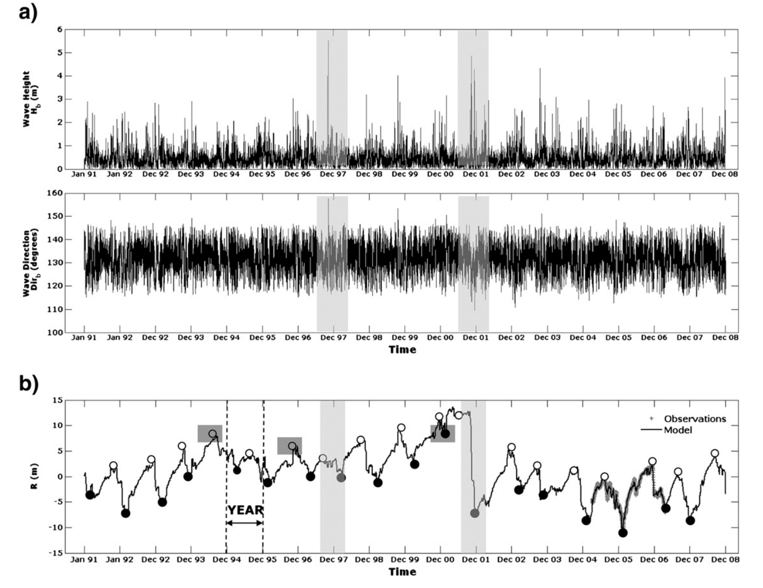
INTERANNUAL VARIABILITY
Barcelona – from Turki et al., 2013

Slide 4
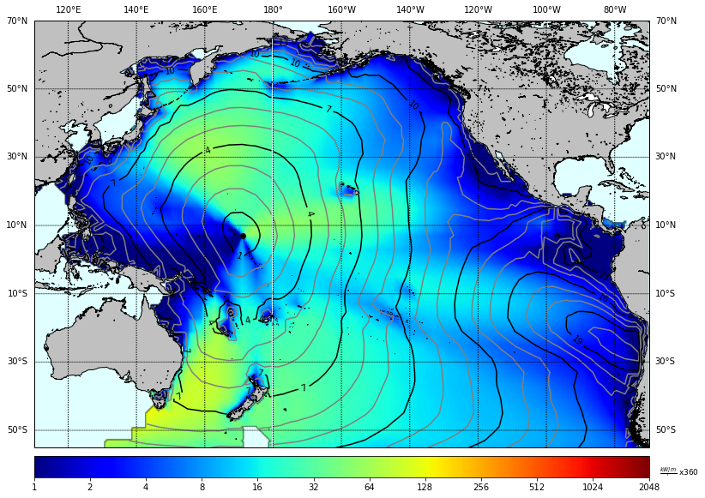
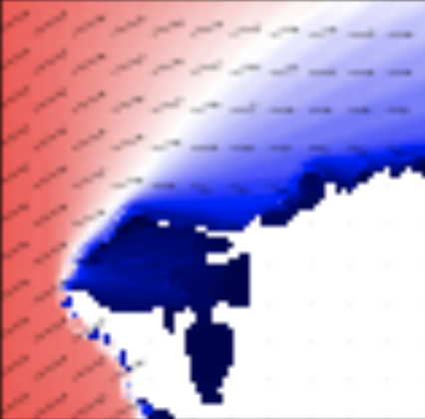
MOTIVATION
Large-scale met-ocean predictor
Local hydro-met-ocean dynamics
Local coastal impacts
X
Y
Z
10-m wind
Waves (Directional spectra, Spectral parameters)
Storm surge levels
Currents
Overtopping
Flooding
Erosion/Accretion
Operability
Reliability
Sea Level Pressure (SLP)
10-m wind (U10)
Geopotential
Sea Surface Temperature (SST)

Slide 5
MOTIVATION
X = X₁ = X
Univariate pdf
f_{x}(x)
Univariate
Multivariate
X = (X₁ ,X₂,…, X_{n})
f_{x}(x) = f_{x} (x₁, x₂,…x_{Nx})
Multivariate pdf
X
Y
Large-scale met-ocean predictor
Local hydro-met-ocean dynamics
X
DD
Y
Dynamical Downscaling
X
Y = f(X)
SD
Y
Statistical Downscaling
X
HD
Y
Hybrid Downscaling

Slide 6
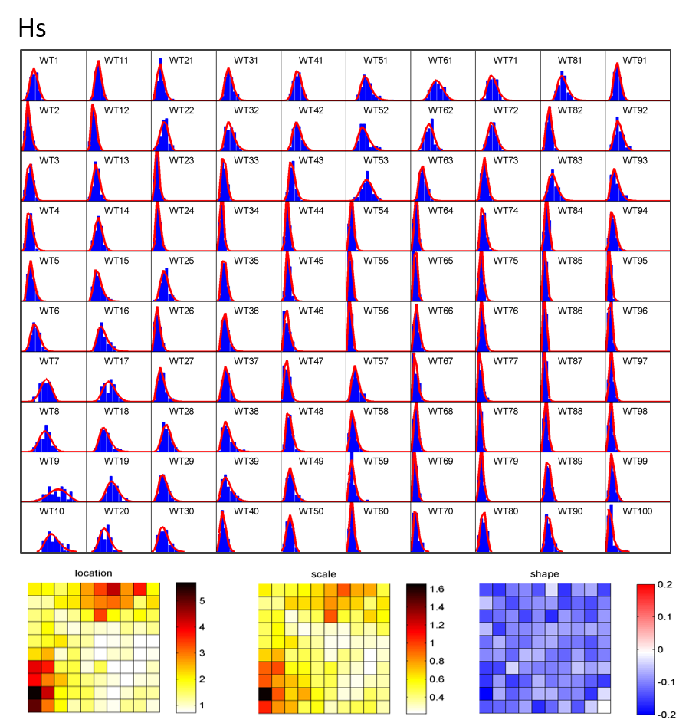
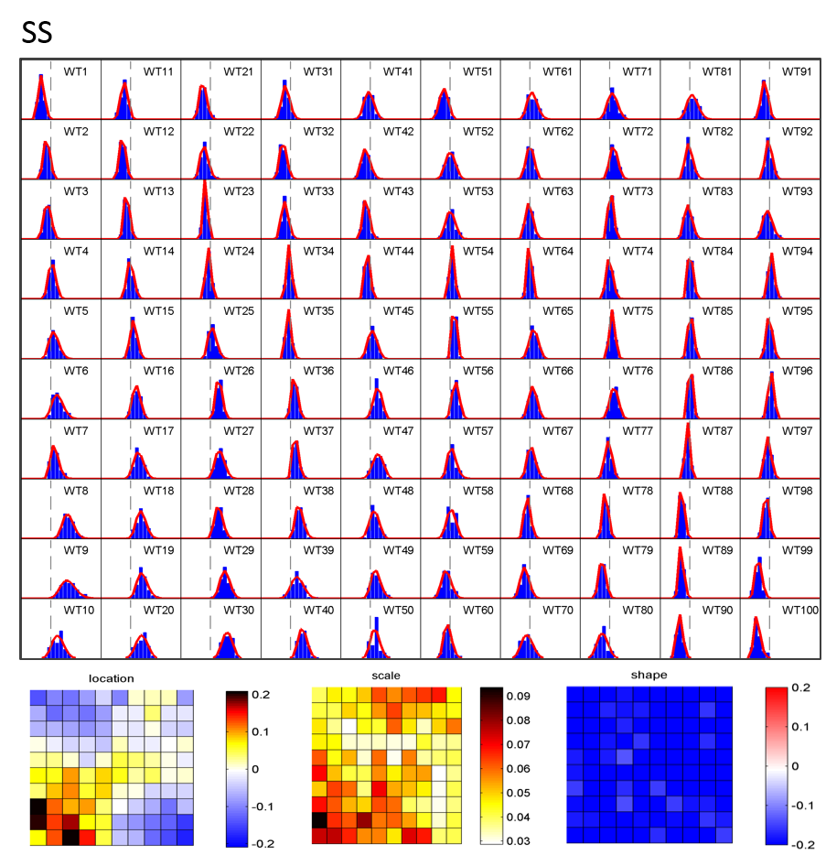
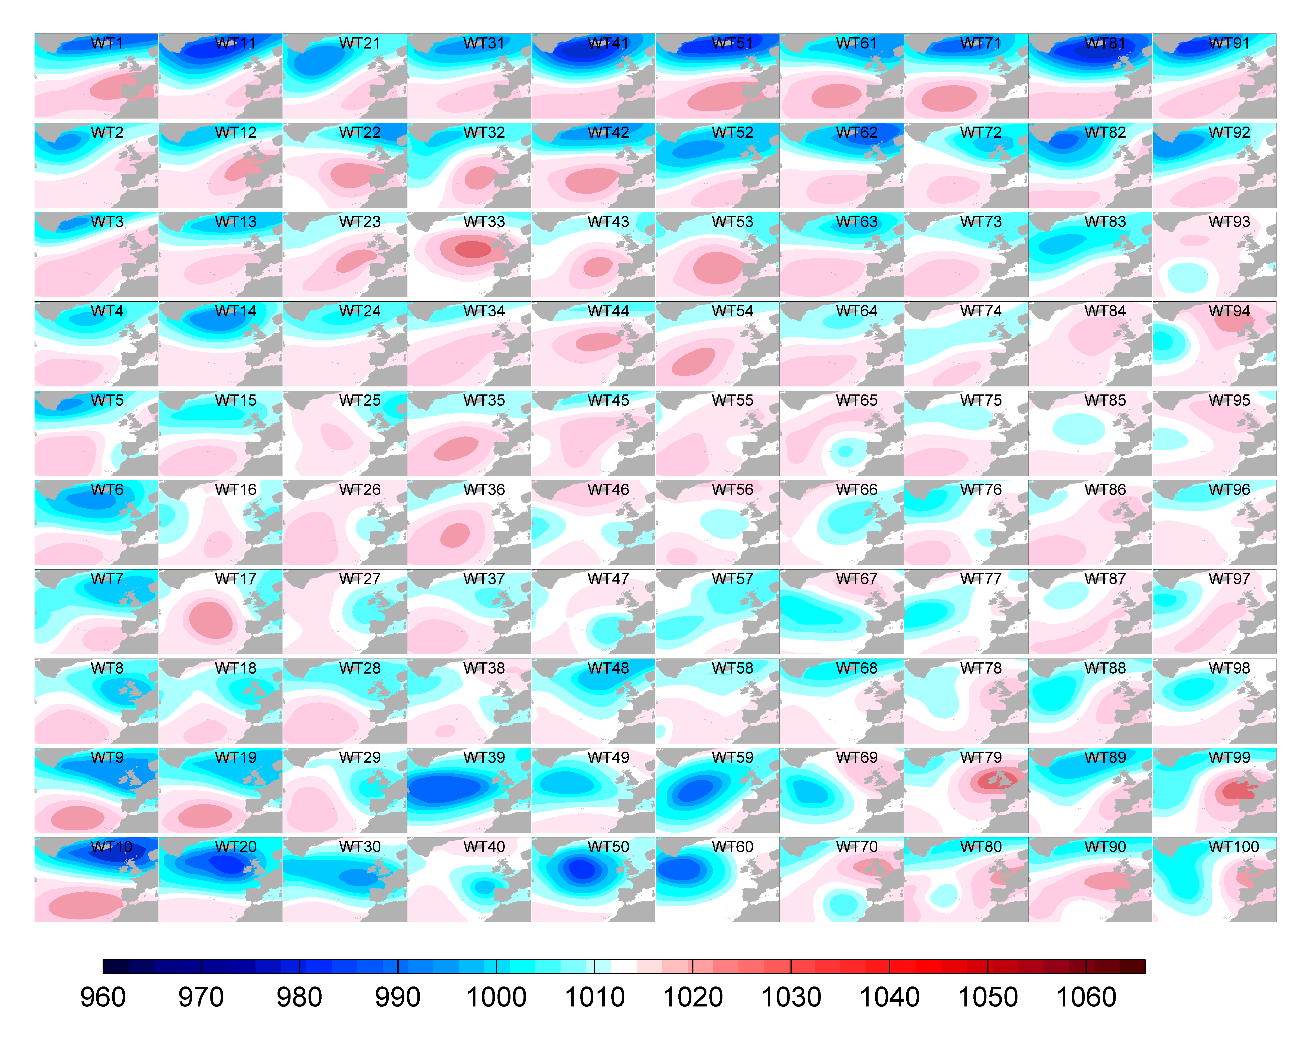
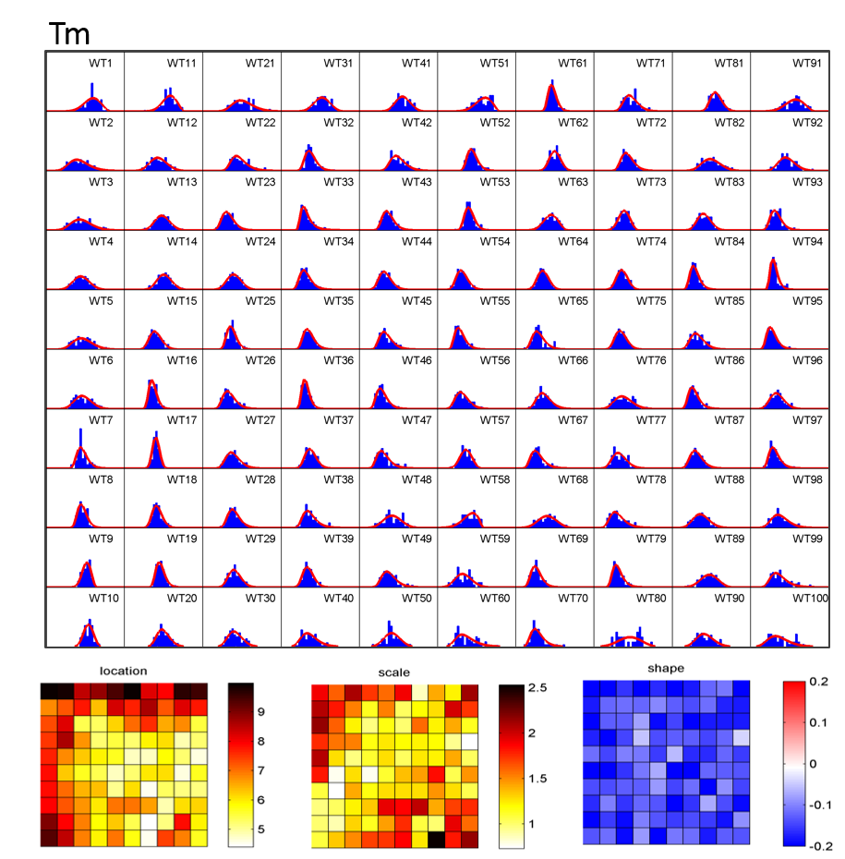
X
Y
WEATHER TYPES
SD
Camus et al 2014 JGR
Rueda et al 2016 JGR
$$μ$$
$$ψ$$
$$ξ$$

Slide 7
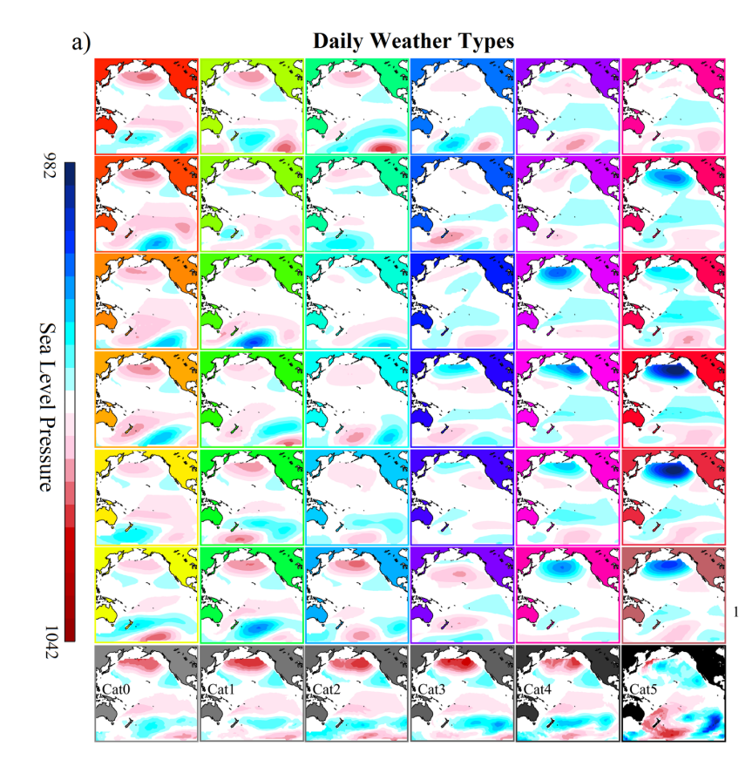
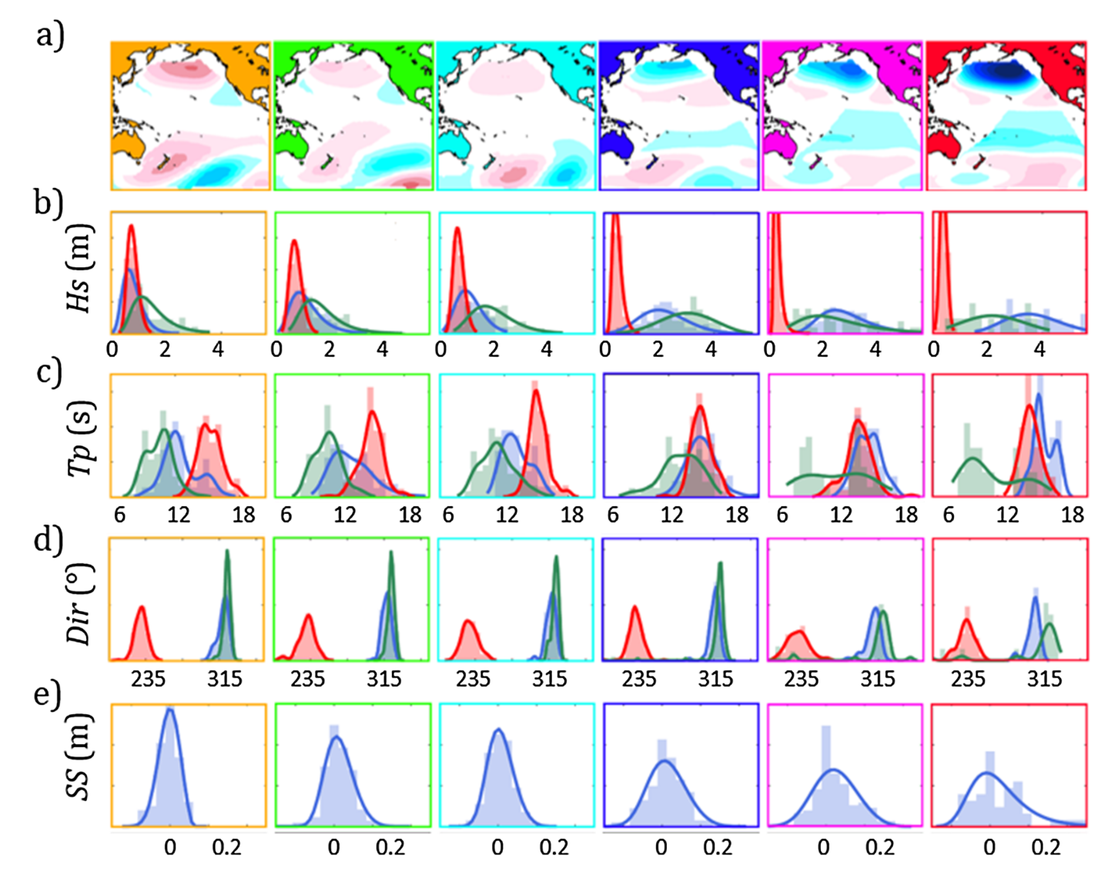
WEATHER TYPES
X(t)
Y(t)
SD
Rueda et al 2017 JGR
Anderson et al 2019 JGR
Anderson et al 2019 JGR

Slide 8
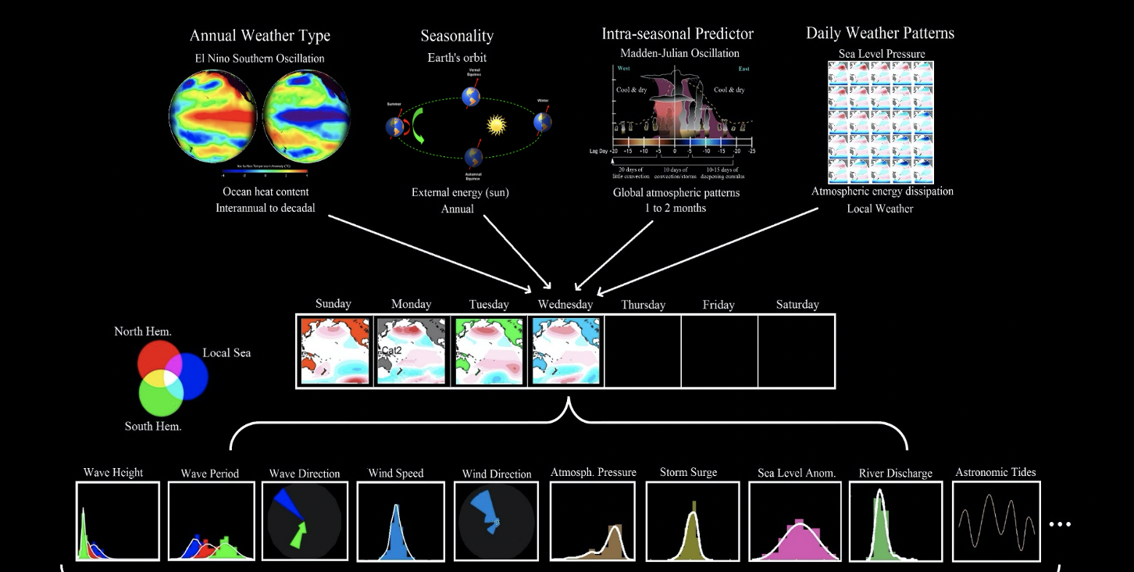
CHRONOLOGY MODEL
Autoregressive Logistic Model (Guanche et al 2013, Antolinez et al 2017, Anderson et al 2019)

Slide 9
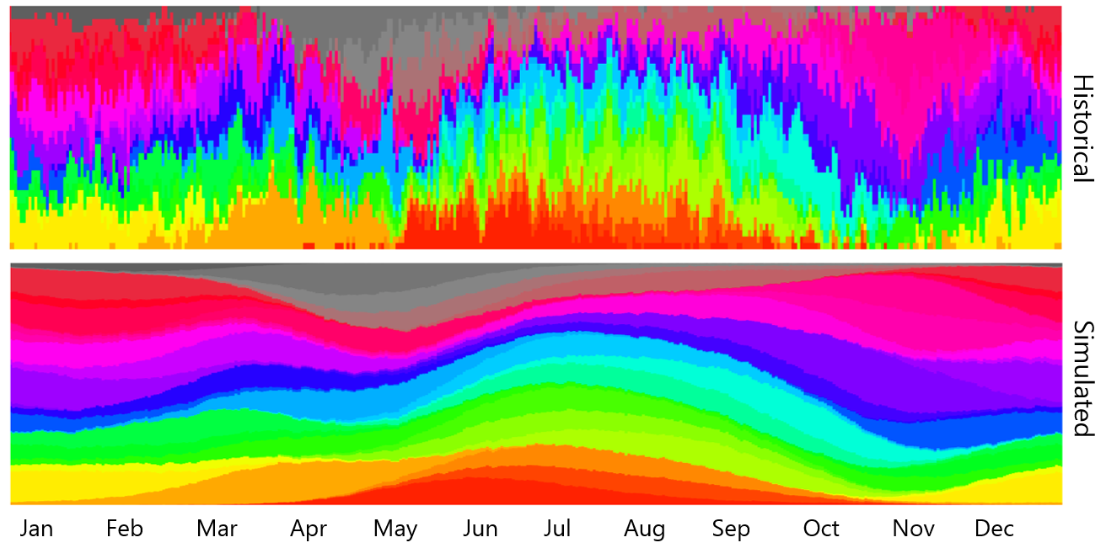
ALR : DAILY WT vs PERPETUAL YEAR

Slide 10
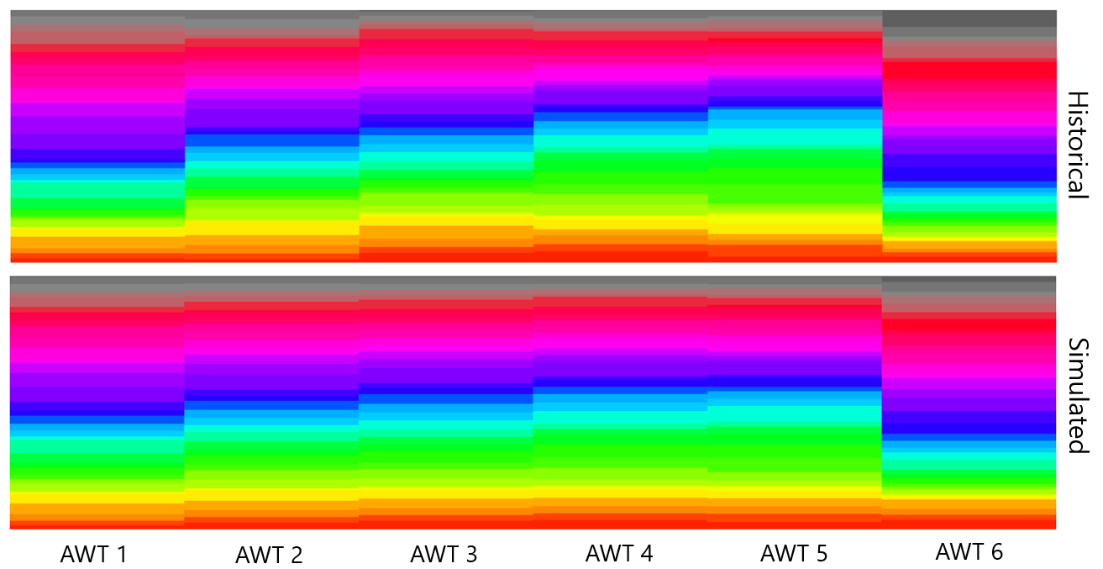
ALR : DAILY WT vs ANNUAL WT
LA NIÑA
EL NIÑO

Slide 11
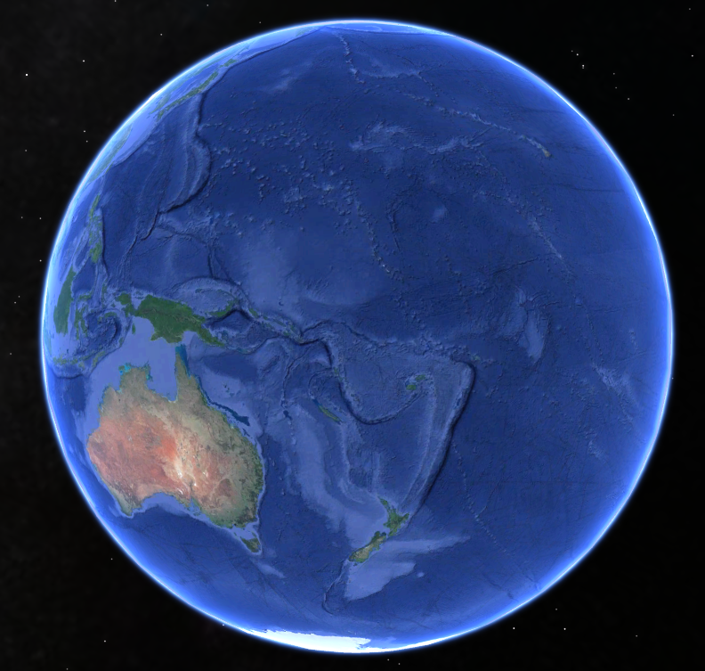
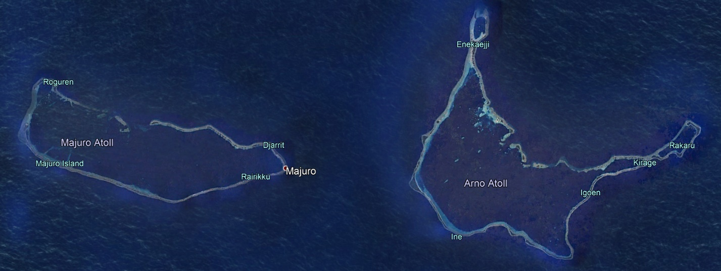
MAJURO ATOLL : MARSHALL ISLANDS
64 ISLANDS
Area: 9.7 km²
Mean elevation: 3m
Population: 28000

Slide 12
FLOODING EVENTS MAJURO

Slide 13
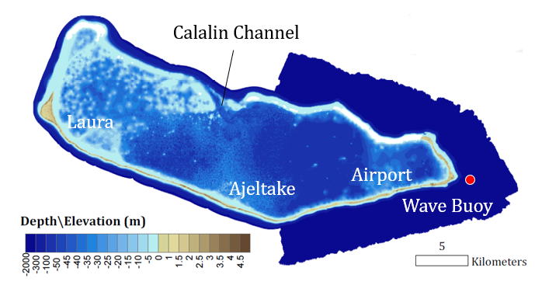
FLOODING EVENTS MAJURO
(Source: M. Ford, U. Auckland, SH swell Event in 2018)

Slide 14
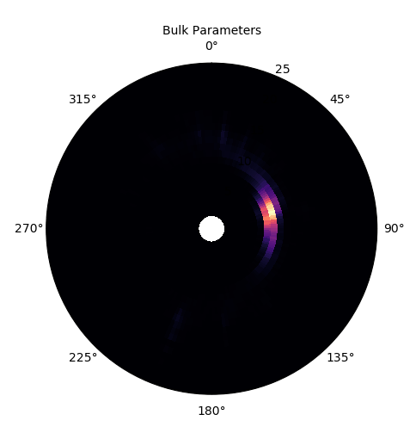
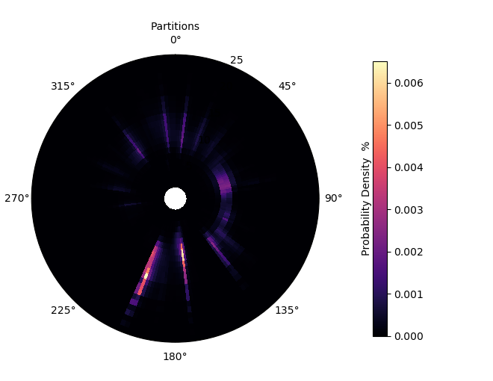
IMPORTANCE OF DIRECTIONAL SPECTRA

Slide 15
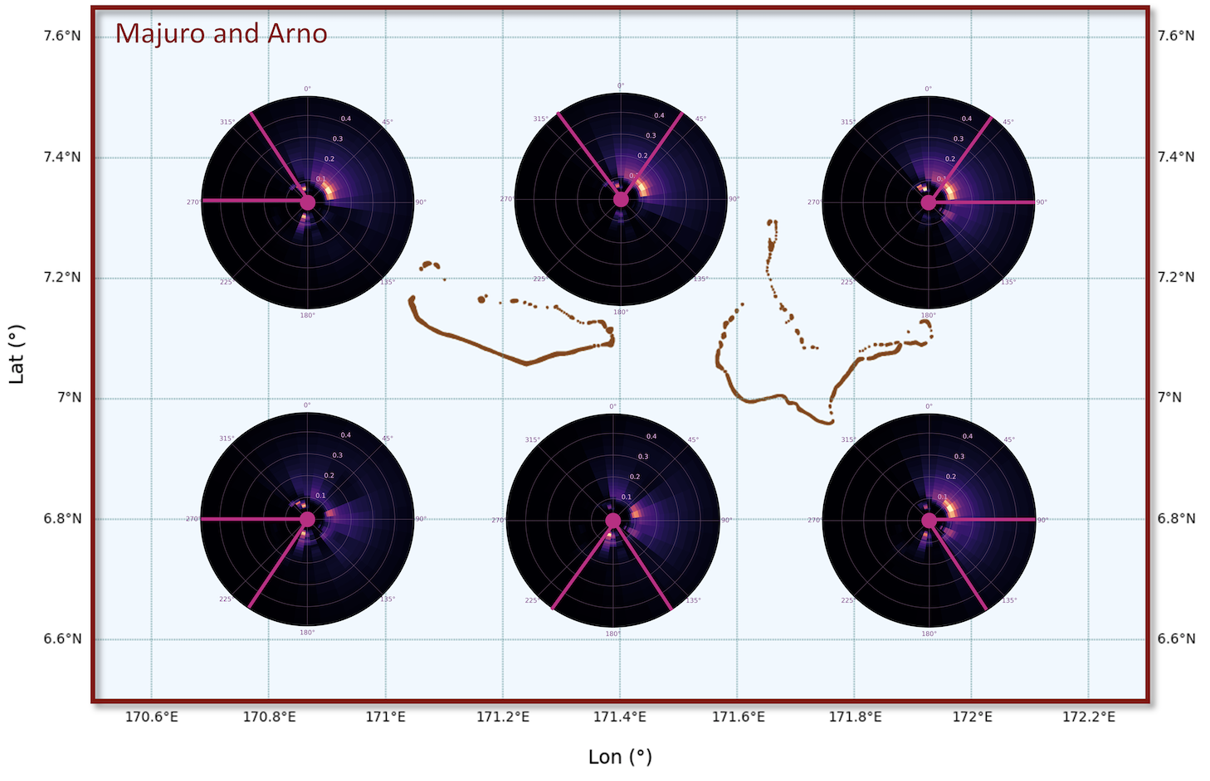
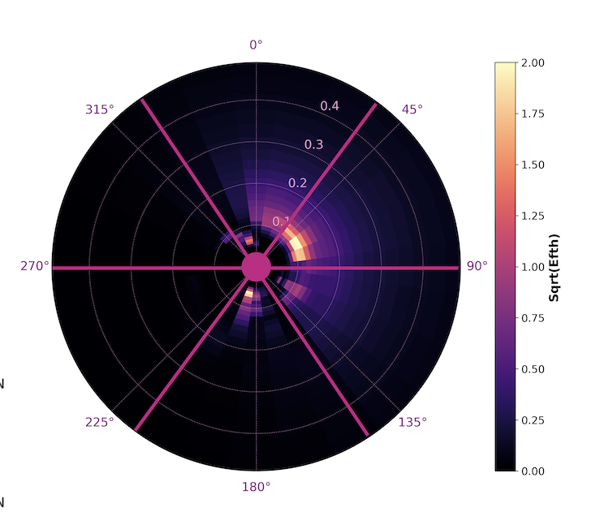
SUPER-POINT

Slide 16
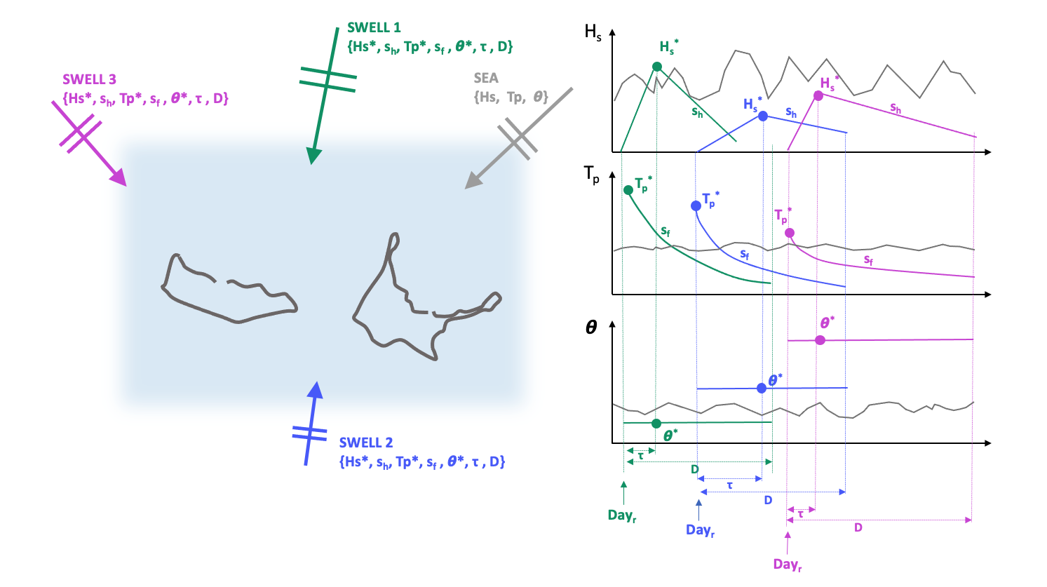
OBJECTIVE

Slide 17
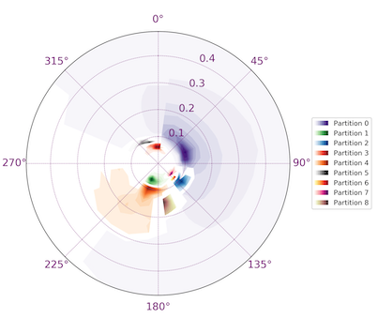
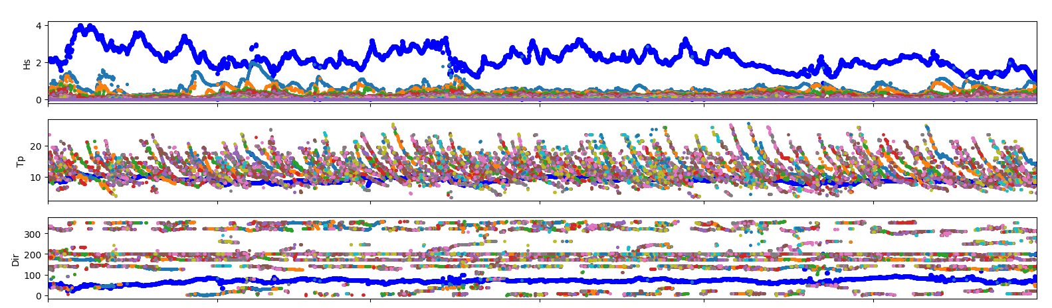
PARTITIONING
WAVESPECTRA
https://github.com/metocean/wavespectra/
WW3 Watershed Algorithm, Hanson and Philips 2009
SEA
HS
TP
DIR

Slide 18
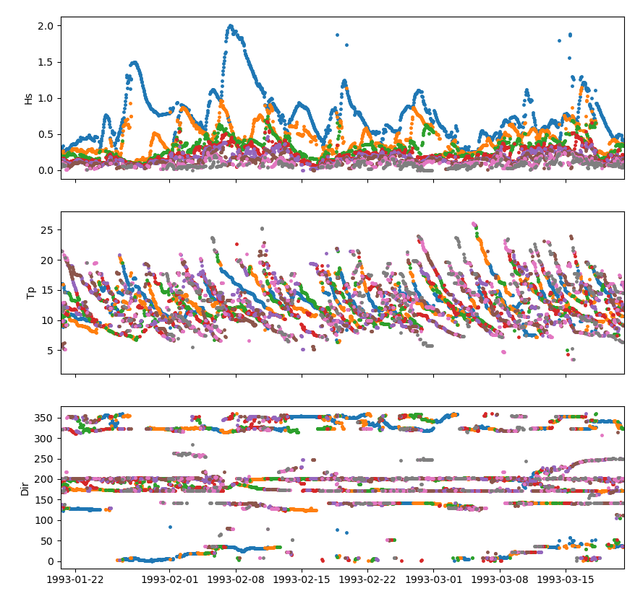
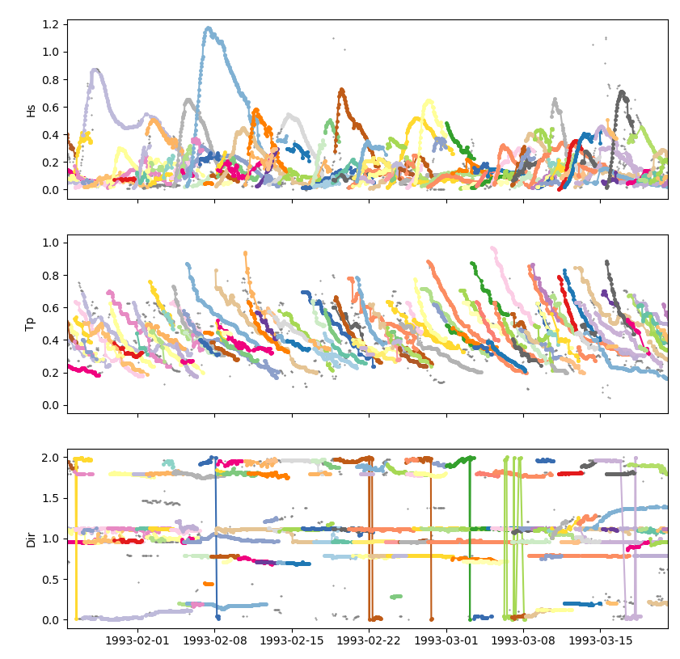
IDENTIFYING INDIVIDUAL SWELLS
$$3D − DISTANCE=\sqrt{{\left(H_{t+1}−H_{t}\right)}^{2}+{\left({Tp}_{t+1}−{Tp}_{t}\right)}^{2}{+ \left({Dir}_{t+1}−{Dir}_{t}\right)}^{2}}$$
PARTITIONS
ISOLATED SWELL EVENTS

Slide 19
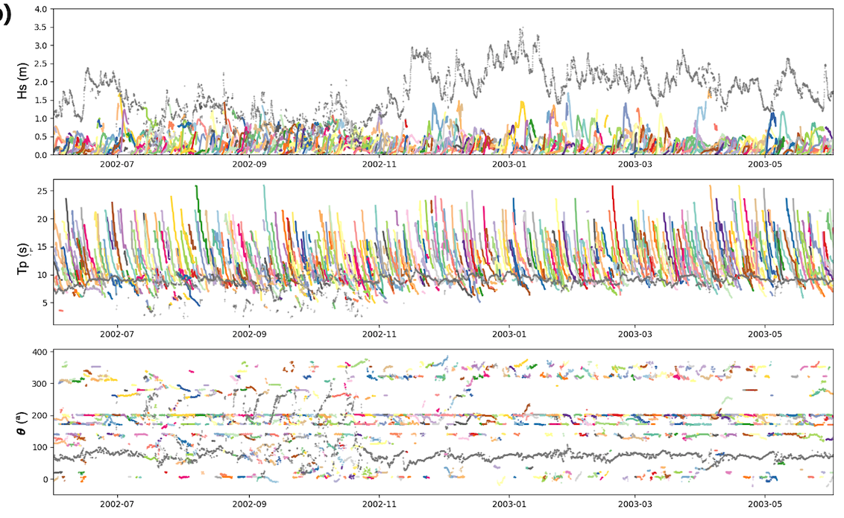
SEA+SWELLS

Slide 20
PARAMETERIZING SWELLS

Slide 21
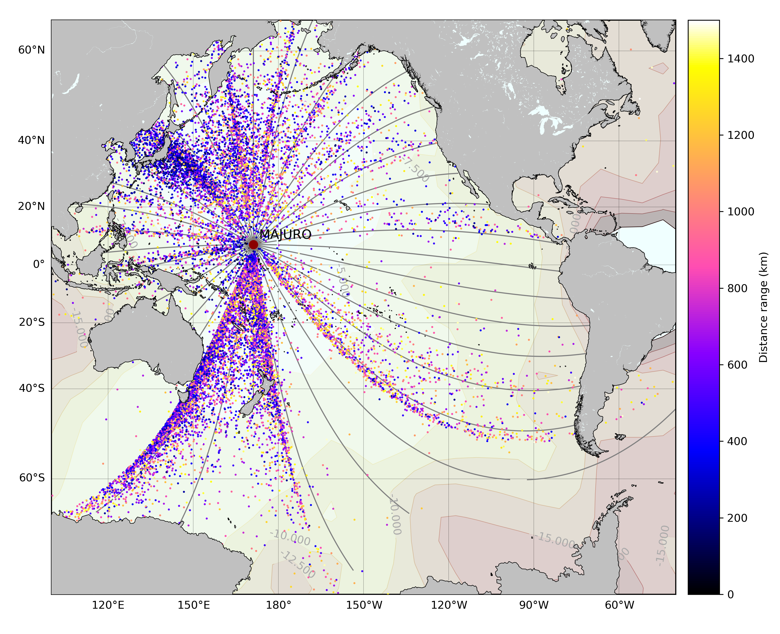
PARAMETERIZING SWELLS
$t_{0}= − \frac{b}{m_{ft}}$
$Cg= \frac{g}{4πf}\text{→} \frac{df}{dt}=m_{ft}= \frac{g}{4πd}$
$$d= \frac{g}{4πm_{ft}}$$
$m_{ft}$ :slope associated to the linear fit of the peak frequency
$b$: corresponds to the intercept
source: Portilla et al. 2012

Slide 22
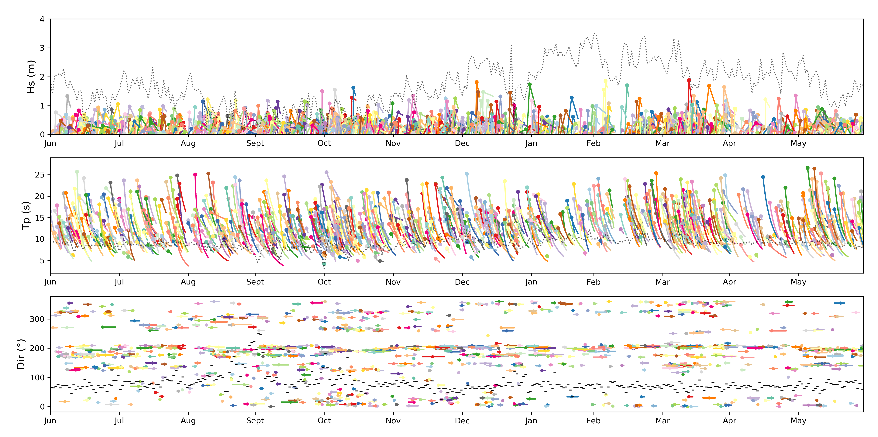
EMULATOR: SWELLS + SEA
Sea: grey
Synthetic swells from emulator: Colours

Slide 23
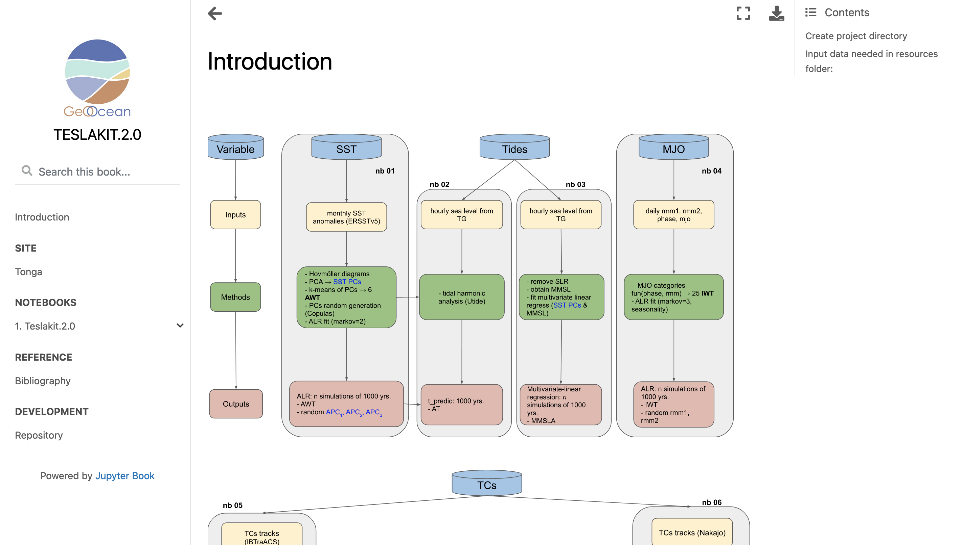

Slide 24
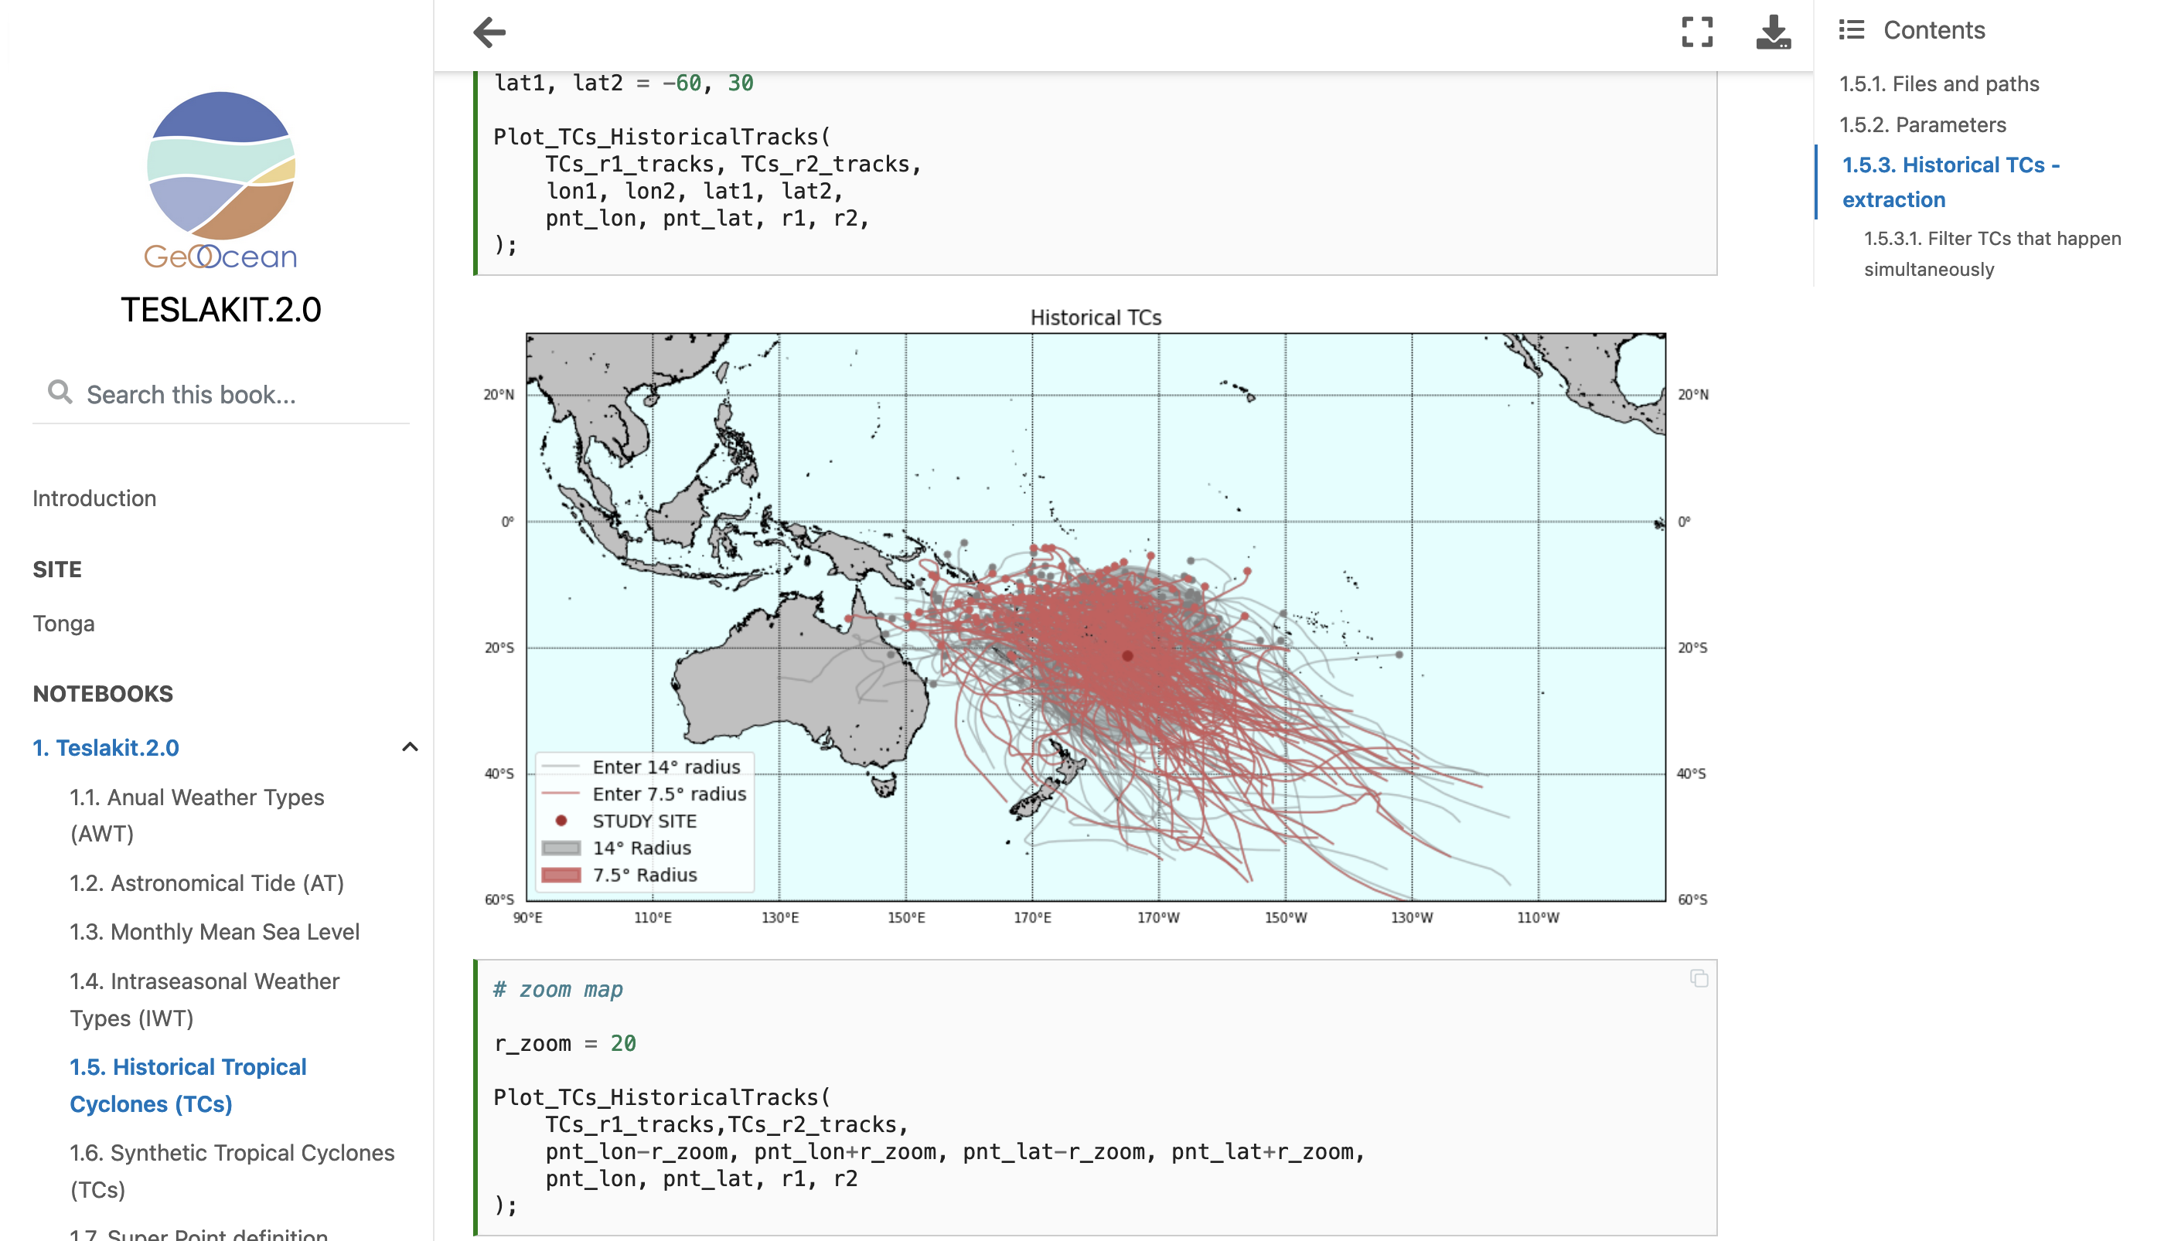

Slide 25
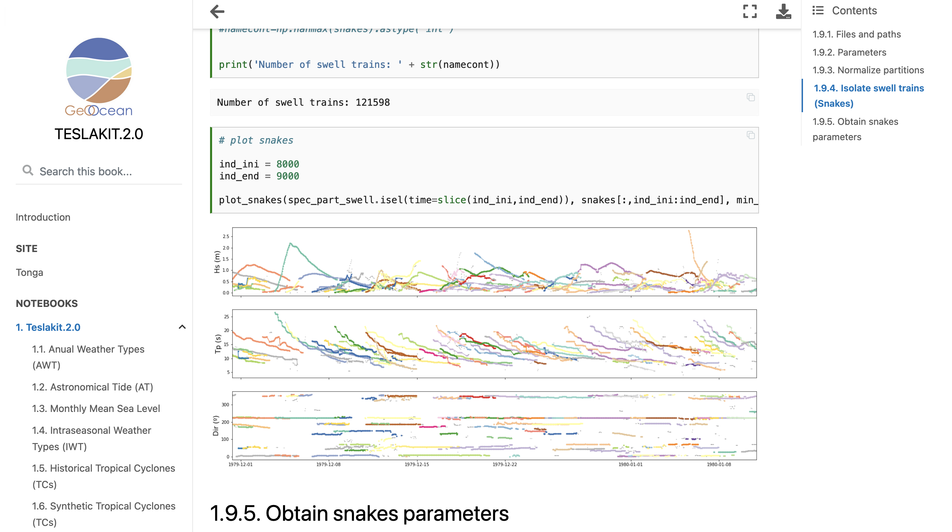

Slide 26
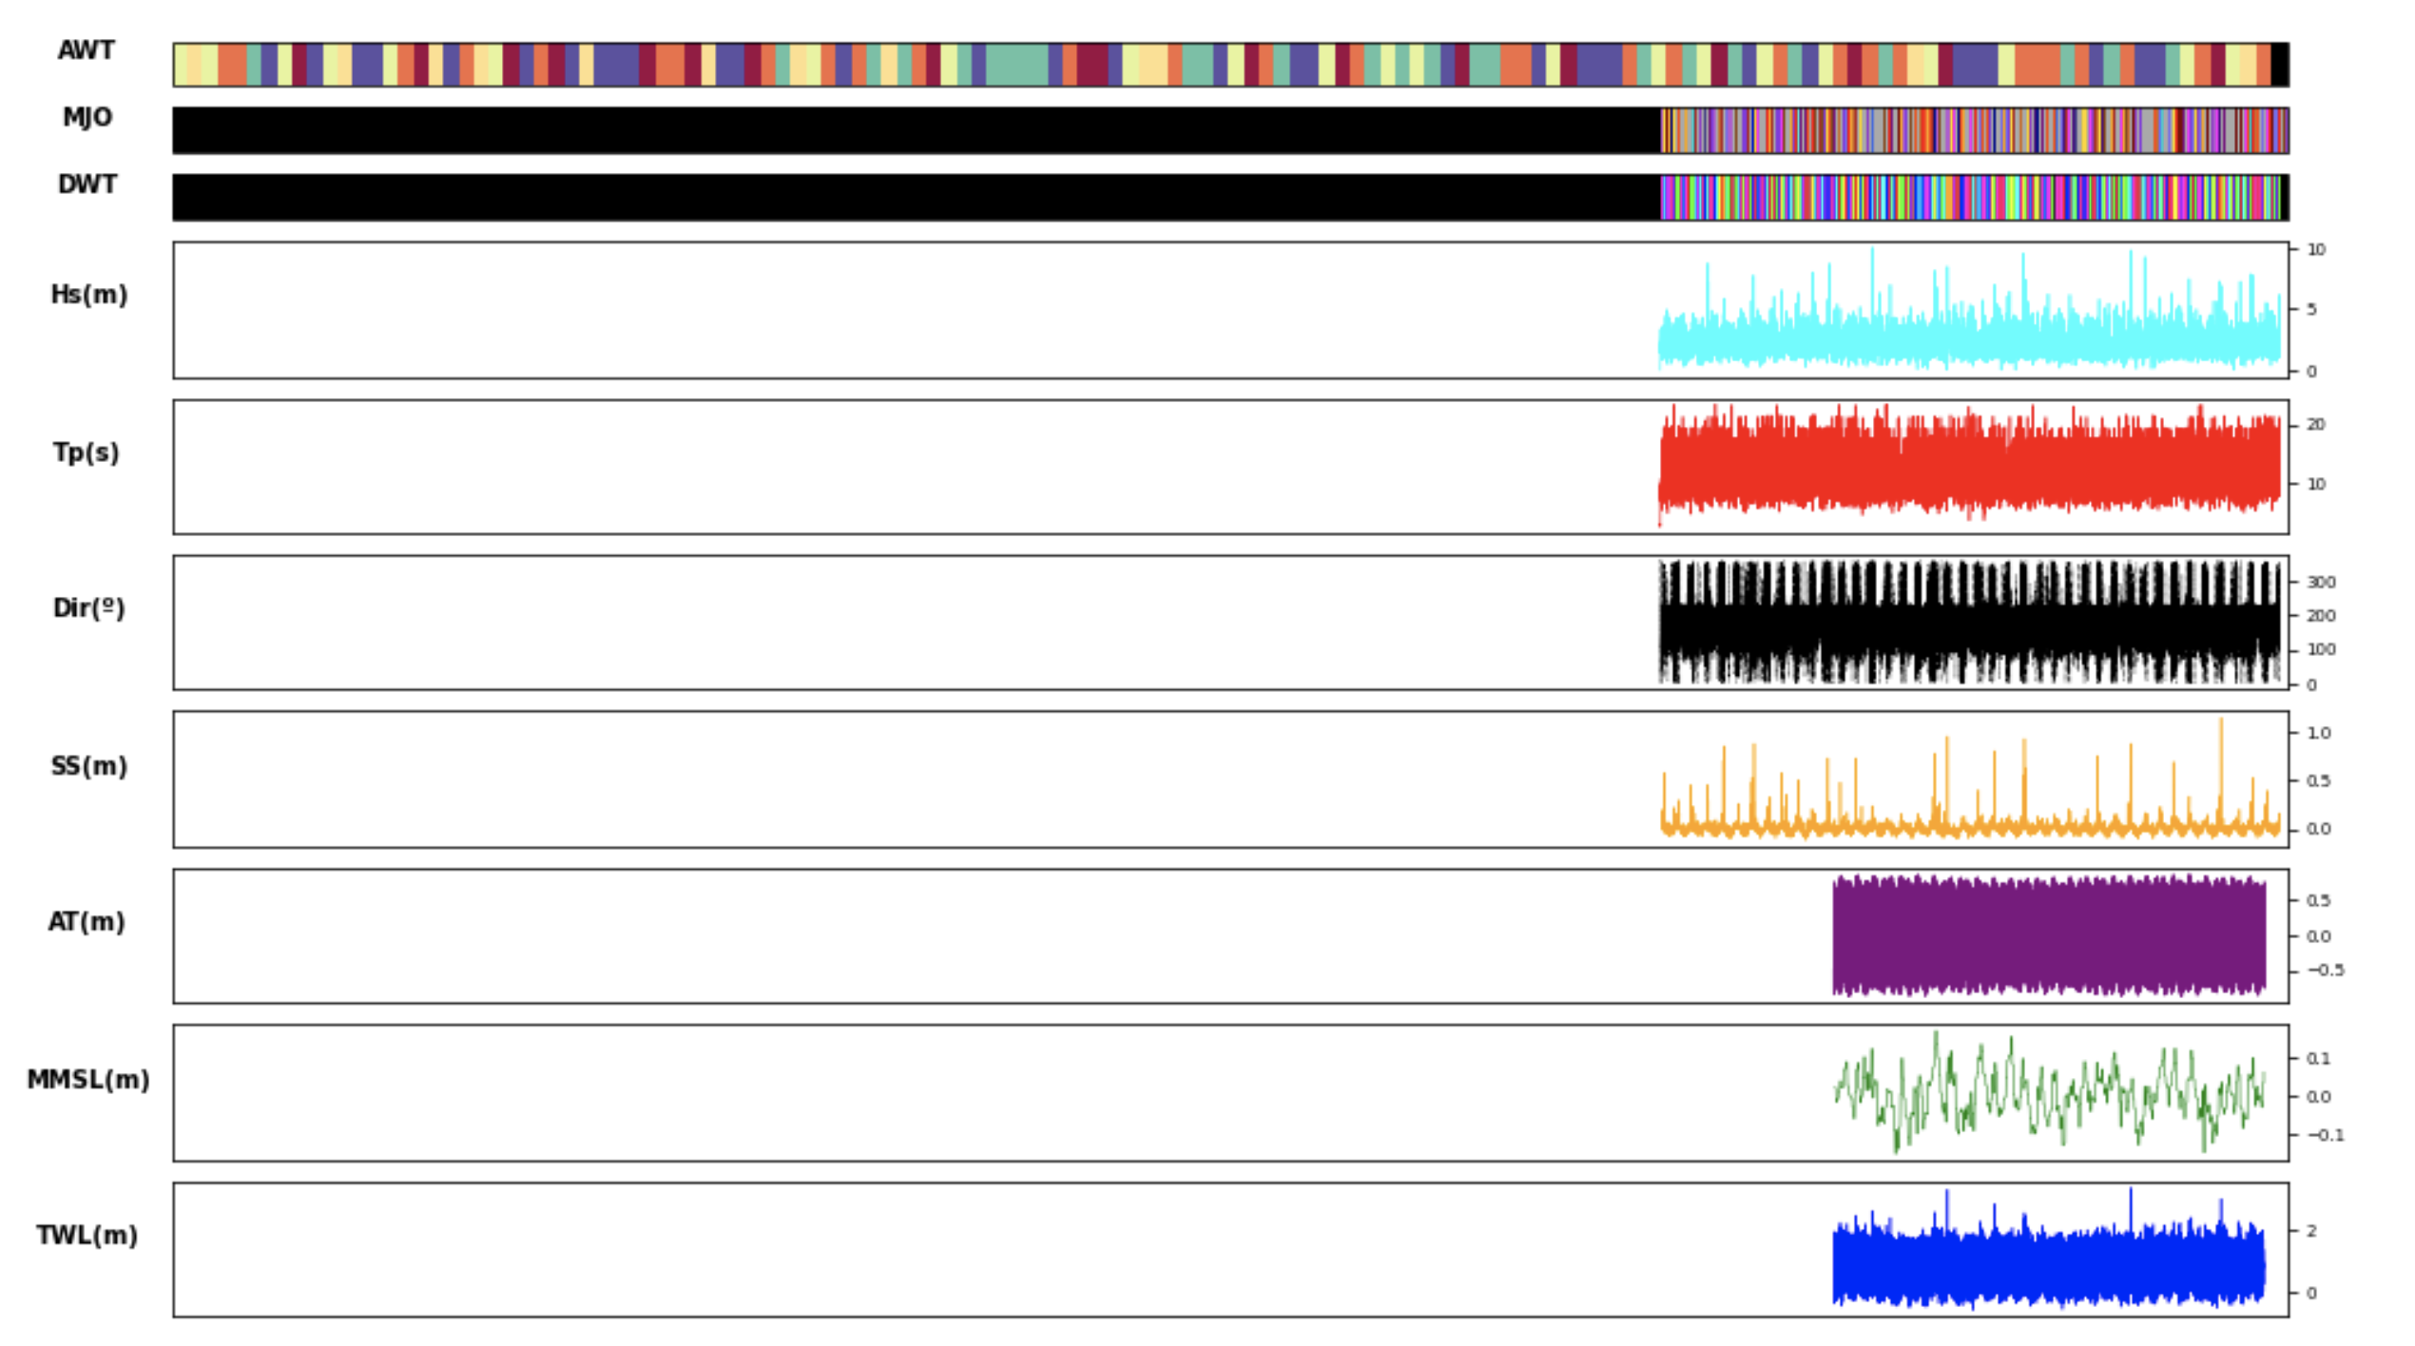

Slide 27
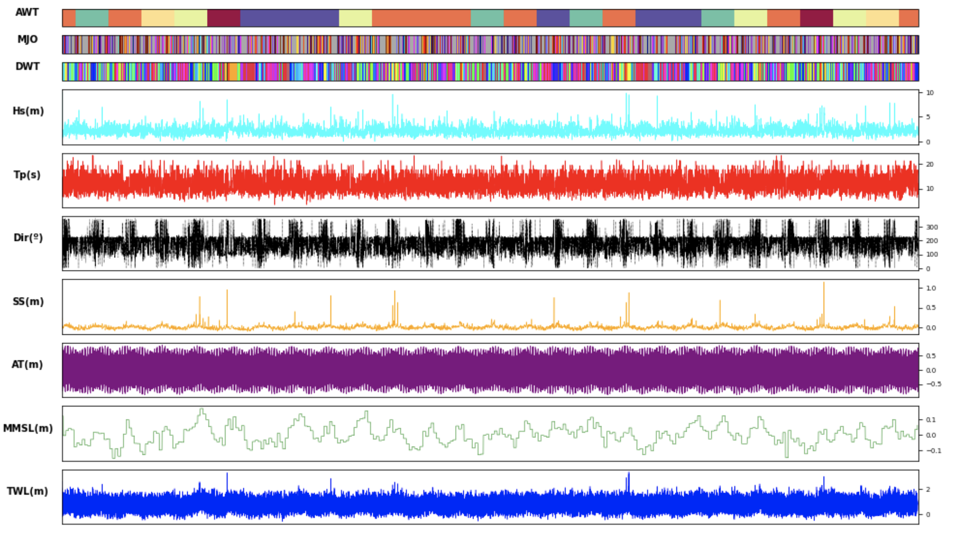

Slide 29
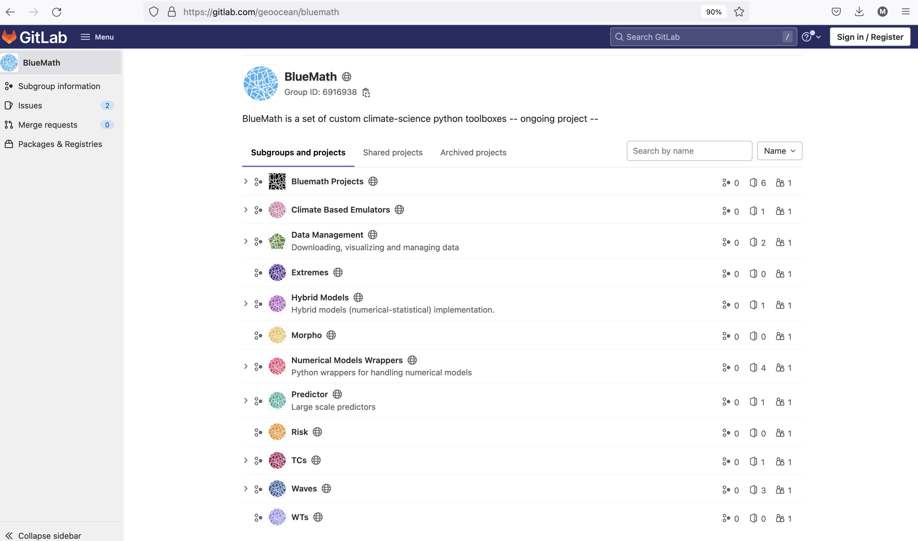

Slide 30
TESLA 2.0: Un Emulator de Parámetros Meteo-Oceánicos para el Diseño Probabilístico de Obras Marítimas en Climas con
Ciclones Tropicales y Extra-Tropicales
Fernando J. Méndez, Laura Cagigal, Alba Cid, Alberto Luceño, Ana Rueda, Nicolas Ripoll

